Slide 1
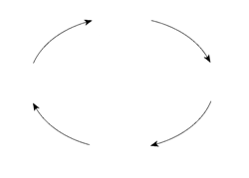
“Based upon observations of secondary school classroom teaching, is there any evidence to support the key ideas of Kolb Experiential Learning Theory (ELT), and related models of learning styles?”
?

Slide 2


Motivation for research
Ideas, Facts, Methods
What is this mechanism? Can we model it?
Prime objective of a professional
teacher is to facilitate the process of students’ learning
?
Learning objectives
Scheme of work
Develop Knowledge, Attitude, Skills (Bloom & Krathwohl, 1956)
Assessment

Slide 3
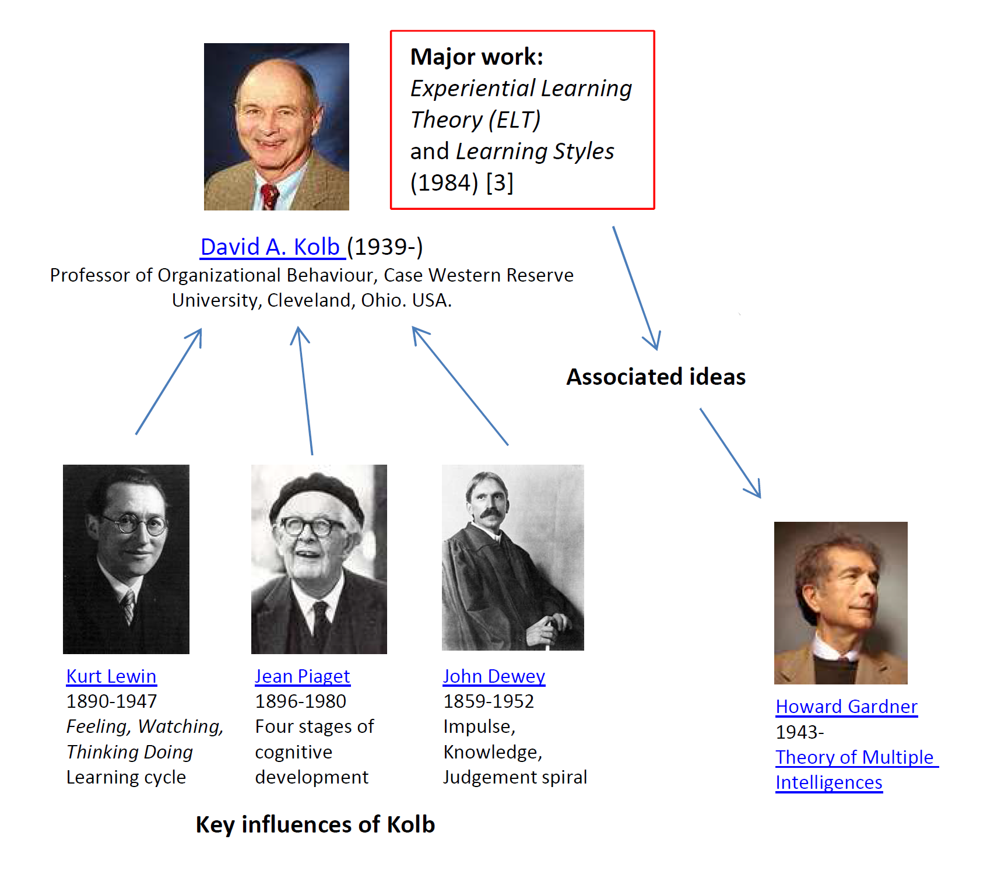
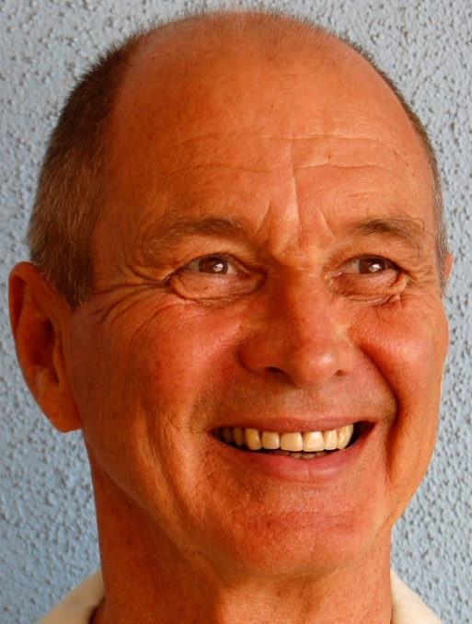
“Learning involves transactions between a person and the environment”
Kolb (1984)
“Learning is the process whereby knowledge is created through the transformation of
experience."
Kolb (1984) p38.
“Learning is an emergent process whose outcomes represent only historical record, not knowledge of the future.”
Kolb (1984)
“Impetus for the development of new concepts is provided by new experiences” McLeod (2010)
Key influences on Kolb

Slide 4
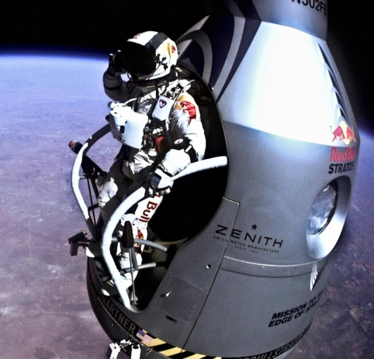
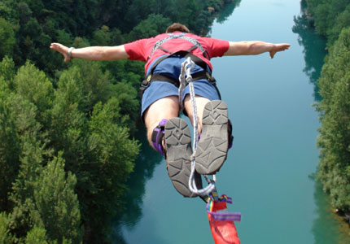
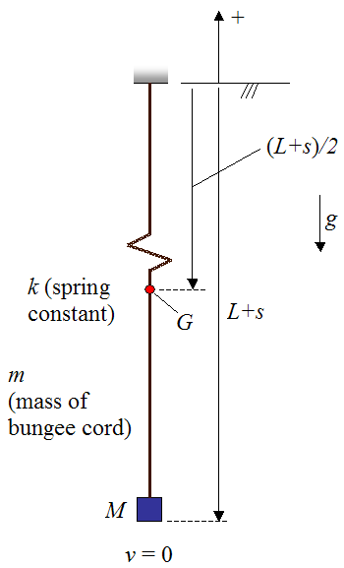
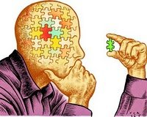
Activist
Having an experience
Reflector
Reviewing the experience
Pragmatist
Planning the next steps
David A. Kolb (1939-)
Theorist
Concluding from the experience
Honey & Mumford’s (1982) interpretation of Kolb’s Learning Styles

Slide 5
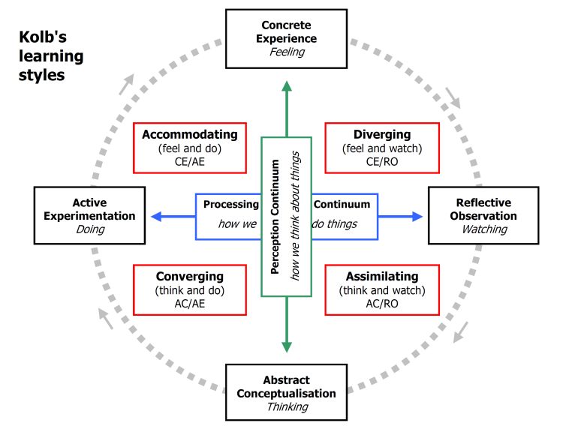
Activist
Pragmatist
Reflector
Theorist
From Business-Balls

Slide 6
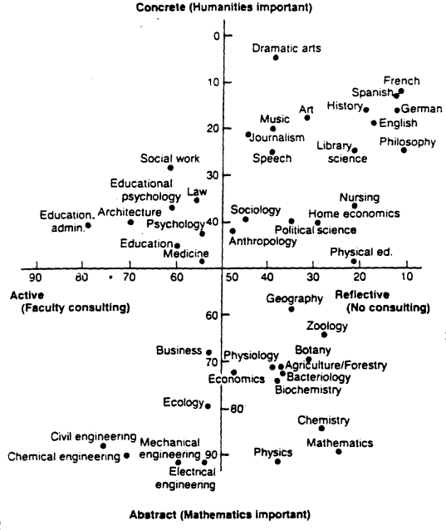
FEELING
Kolb’s Learning Style Inventory plots typical scores from different professions on a grid parameterized according to perpendicular “thinking - feeling” and “doing – watching” dimensions which are associated with the Kolb ELT.
Svinicki (1987)
DOING
WATCHING
THINKING
For debate!

Slide 7
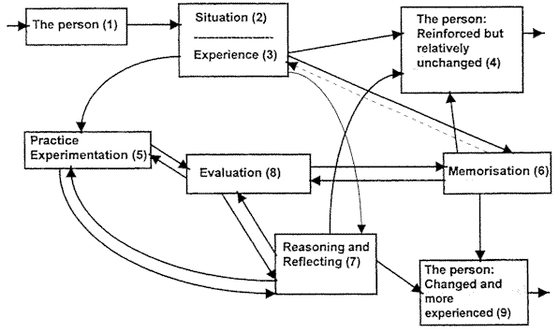
Critique of ELT, and Constructivism
Smith (2010), Kirshner (2006).
No cultural context
Real learning may not occur in the ideal Kolb fashion
- Ideological, not evidence based
- Kolb doesn’t define what “reflection” means
Development of Kolb’s learning cycle
Jarvis (1987)

Slide 8
Research methodology
“A genuine method of research”
Bell (2005), Clarke (2005)
Practitioner research /case study
Qualitative, descriptive study based upon observations and reflections of typical classroom practice rather than a controlled ‘experiment.’
Reflective diary
Lesson observations
2013-2014
17 teachers observed, different classes, topics and subjects
State Academy
Fee paying Boarding School

Slide 9
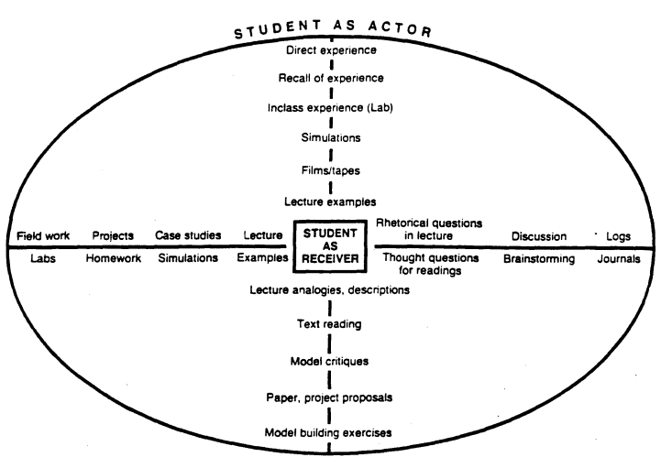
Activist
Observations
Pragmatist
Reflector
Application of Kolb’s ELT to the Classroom.
Svinicki (1987)
Theorist

Slide 10
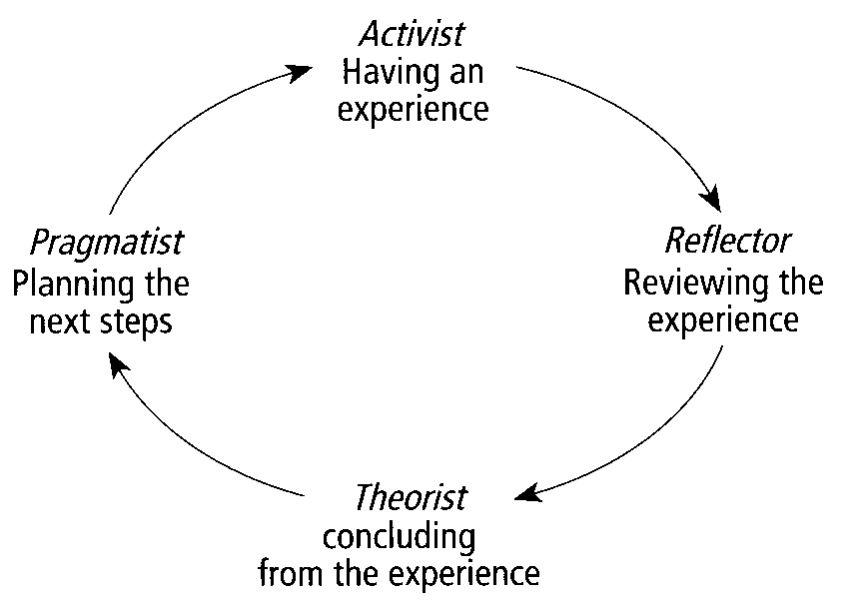
Summary
My own professional development this year
Experiences of my students
Initial teacher exposition phase
Demonstrations
Simulations
Class discussions
Solving example problems
Lesson adaptation
Homework
Assessment
Revision notes
Idealised model
Too generic?
Formulae
Proof of general theorems
Self confirmation bias

