Slide 1



VBk Practical Mathematics
and Microsoft Excel Course
Formatting
cells
WINCHESTER
COLLEGE

Slide 2
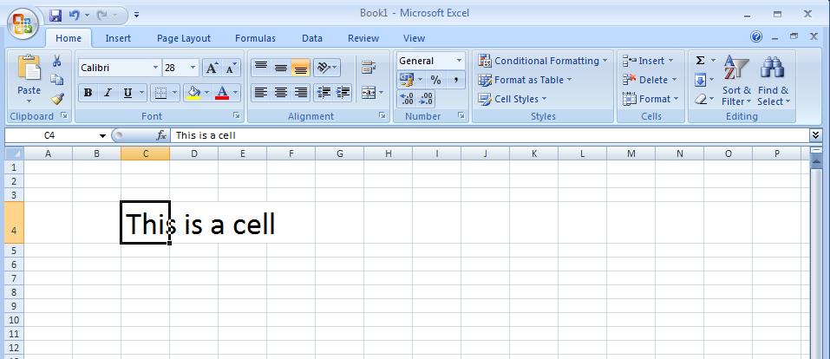
Load up Excel and click in the spreadsheet. Type something!
Many text effects (typeface, font size, underline etc...) can be accessed via the Home tab

Slide 3
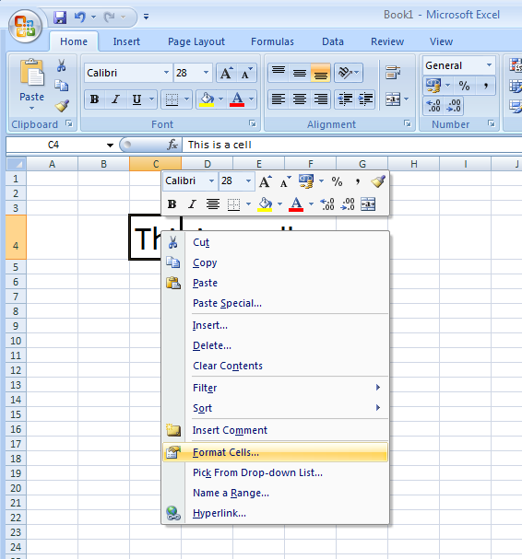
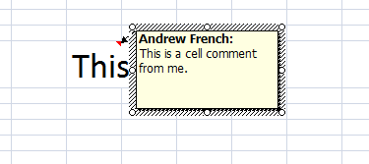
For more comprehensive
cell formatting options
Right click in the cell. This will bring up a context menu (i.e. the menu which appears depends on what you right click on).
Select the Format Cells ... option.
Note this menu is also how you can add comments to a cell. Commented cells will be indicated by a red triangle in the top right hand corner.

Slide 4
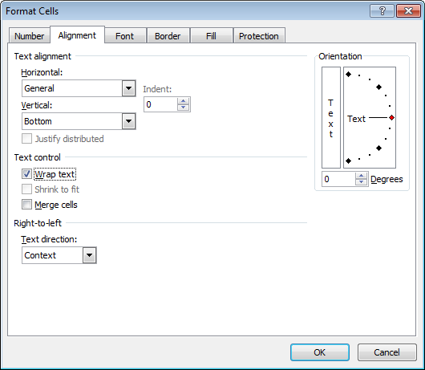
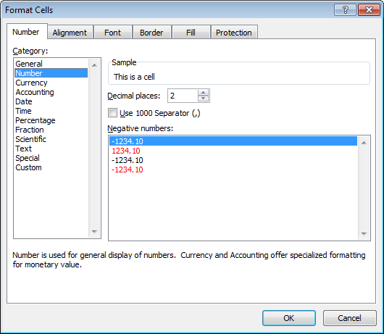
Selecting Format Cells .... will
bring up a dialogue box. Probably the most useful options are in the Number and Alignment tabs.
In the Number tab you can set the display format, e.g. £ or $ prefix, decimal places etc.
In the Alignment tab, the Wrap text
option will enlarge the cell to fit the text.
Note Alt + Return when typing text
in a cell will result in a line return.
Just pressing return will move you one cell down. You may find this initially frustrating.

Slide 5
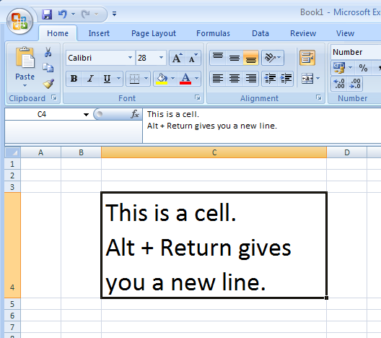
Drag the columns
and rows around set the cell size to your needs.
If the Wrap text option is set, the text will be shaped by the cell boundaries.

Slide 6
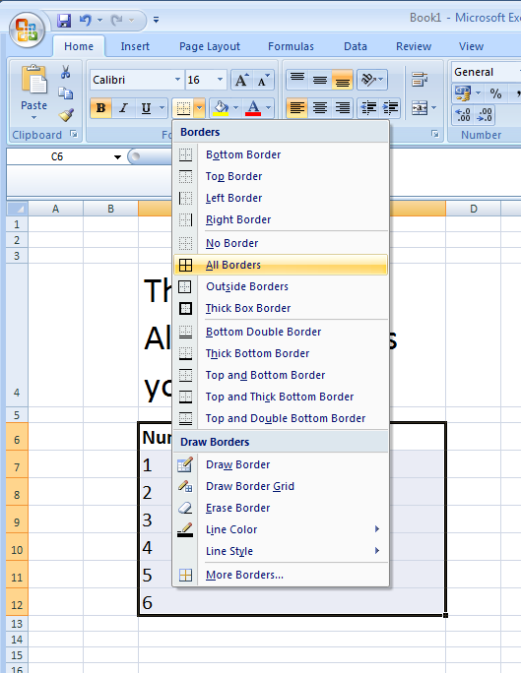
Now experiment with
cell borders and colour
Select some cells
using a mouse and click
on the Borders button.
All Borders is a typical
option to highlight cells.
Note if you print the document
you will need to have borders
in order to view the spreadsheet
as a table. (i.e. the grey cell
dividers will not be present in the printed copy).
Note I have also made the
heading of my table of numbers
Bold.
Clarity!

Slide 7
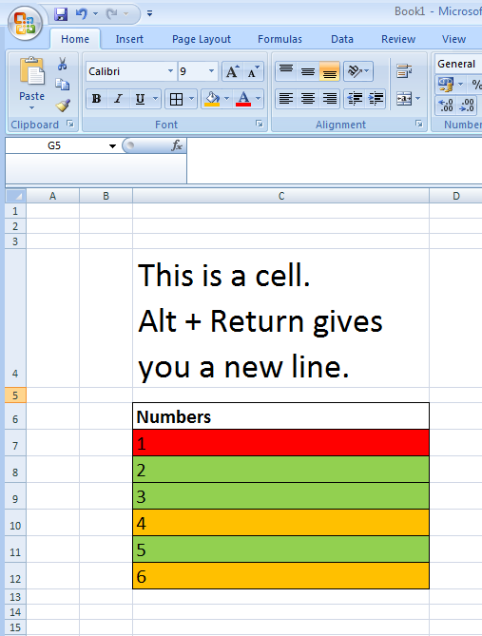
Colour can be very effective
in highlighting cells
of interest.
Red, Amber and Green (RAG) colours (i.e. Green meaning ‘OK/Done/Good’ and Red meaning ‘Problem!’)
are often used in the industrial discipline of Project Management .
When reviewing a project,
the colour coding system
allows you to quickly identify
parts of the spreadsheet (and hence parts of the project) which need urgent attention.

Slide 8
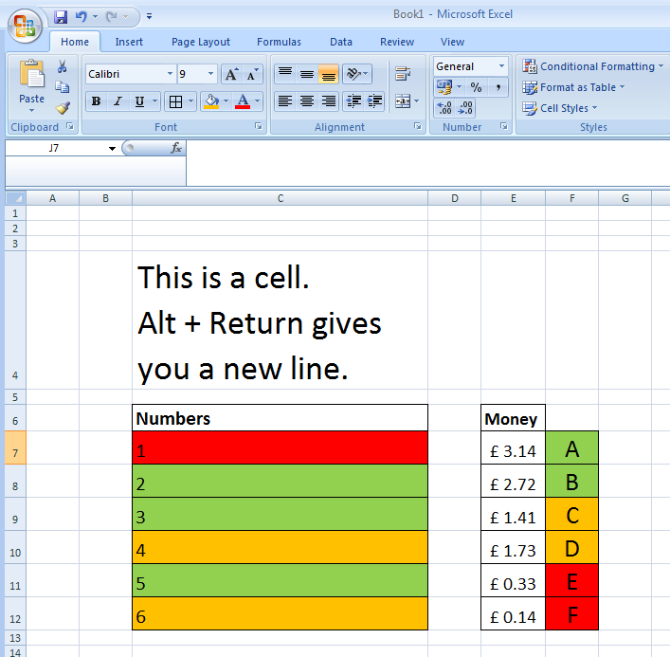
Other things to try:
- Add pictures
Add floating text boxes
Change text direction
- Alignment of text in cells
Accounting option
(£ prefix and 2.d.p)
Alignment of cells
is central (both horizontally and vertically)

Slide 9
Investigate
different Paste options. e.g. ‘Paste as Formulas’, ‘Paste as Values’ etc.
To apply similar formatting
to other cells, use the ‘Format painter’ button, then drag a box over cells to Paste the formatting.

