Slide 1



VBk Practical Mathematics
and Microsoft Excel Course
Pie charts
WINCHESTER
COLLEGE

Slide 2
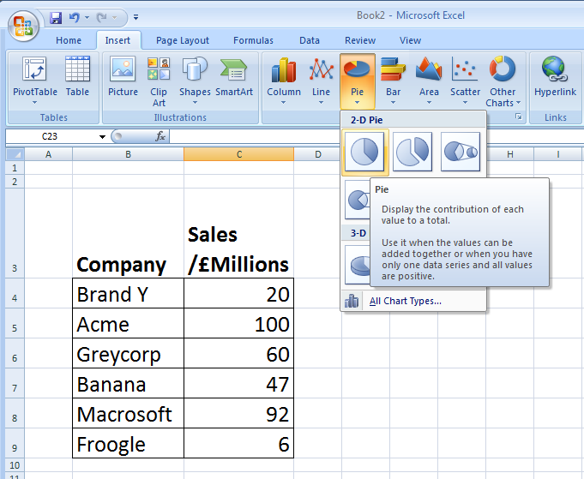
Pie charts are often used to visually represent the proportions of a data set assigned to a finite set of classes. (i.e. named categories).
There are used extensively in finance and retail, where ‘market share’ is one of key metrics for assessing the success of a company, and hence the bonus of the Chief Executive ...!
To create a Pie Chart, firstly create a data table in Excel. You will need a column of
names and a corresponding column of numbers. The pie slice associated with each name will have angular width in proportion to the number divided by the sum of all the numbers. In the example above, ‘Acme’ would have a pie slice of 360º x 100 / 325 = 110.8º.
Then click on the Pie button in the Insert section of the Excel ‘ribbon.’

Slide 3
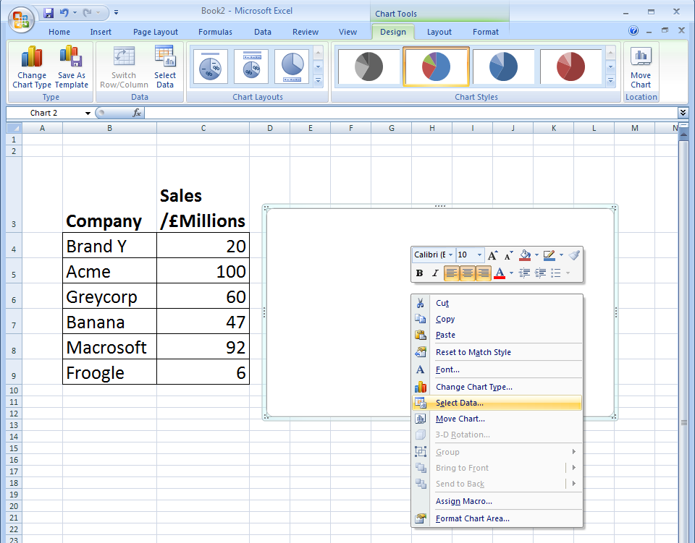
Right click in the white box which will have now appeared. Choose Select Data ... from the menu. Note Chart Tools will have now appeared as an extra option in the ribbon icon bar.

Slide 4
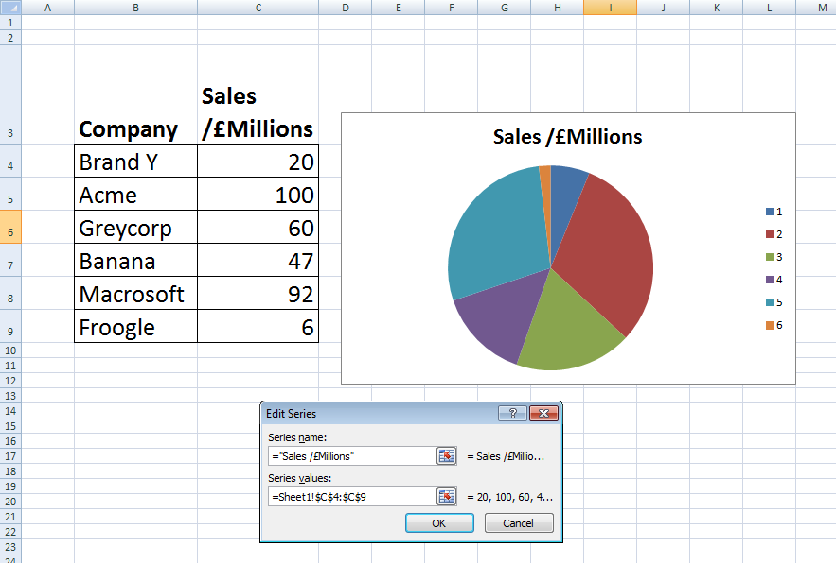
Follow the prompts and assign a range of data to Series values.
In this case the code is = Sheet1!’$c$4:$C$9
which means “Worksheet1, cells C4 to C9.” The pie chart should appear in the white box.

Slide 5
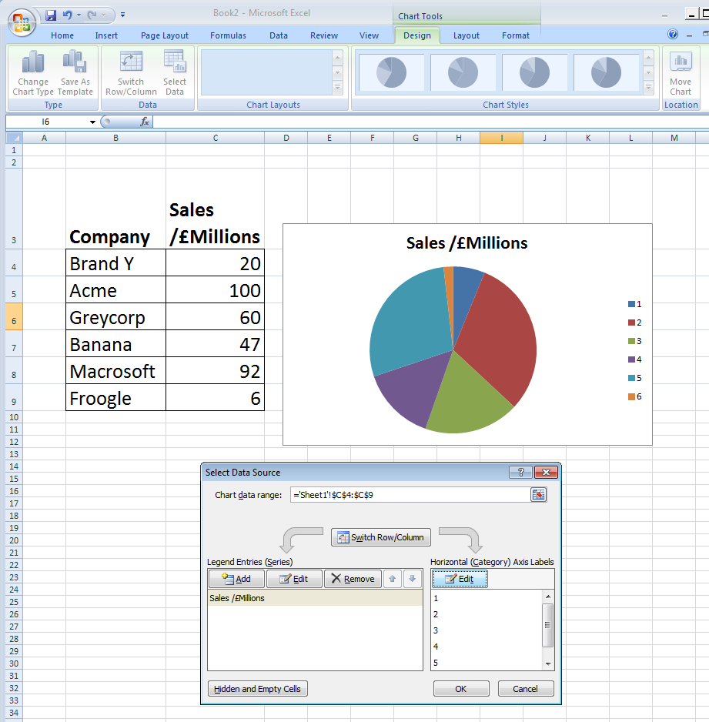
Edit the Horizontal (Category) Axis Labels to associate names to the pie slices.

Slide 6
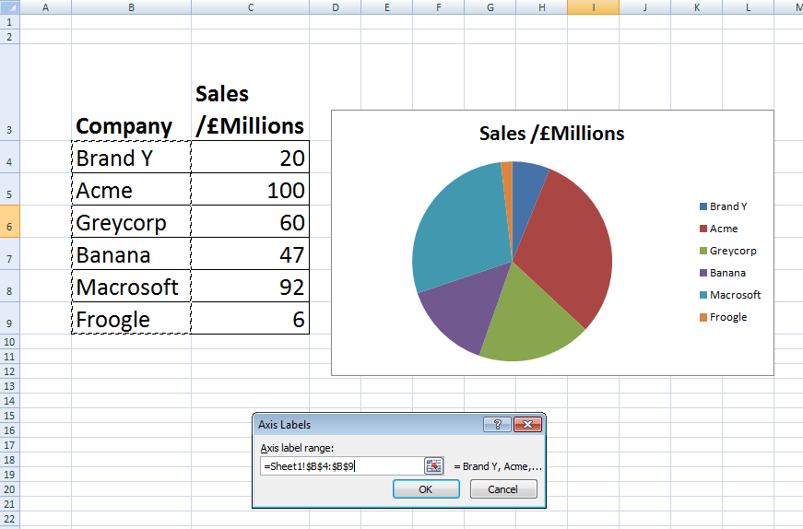
Labels are now updated from numbers to names
This can be done by typing a range into the Axis Labels box, or by dragging a box over the desired column of cells.
In this example the cell range is B4 to B9
i.e. code is
= Sheet1!$B$4:$B$9

Slide 7
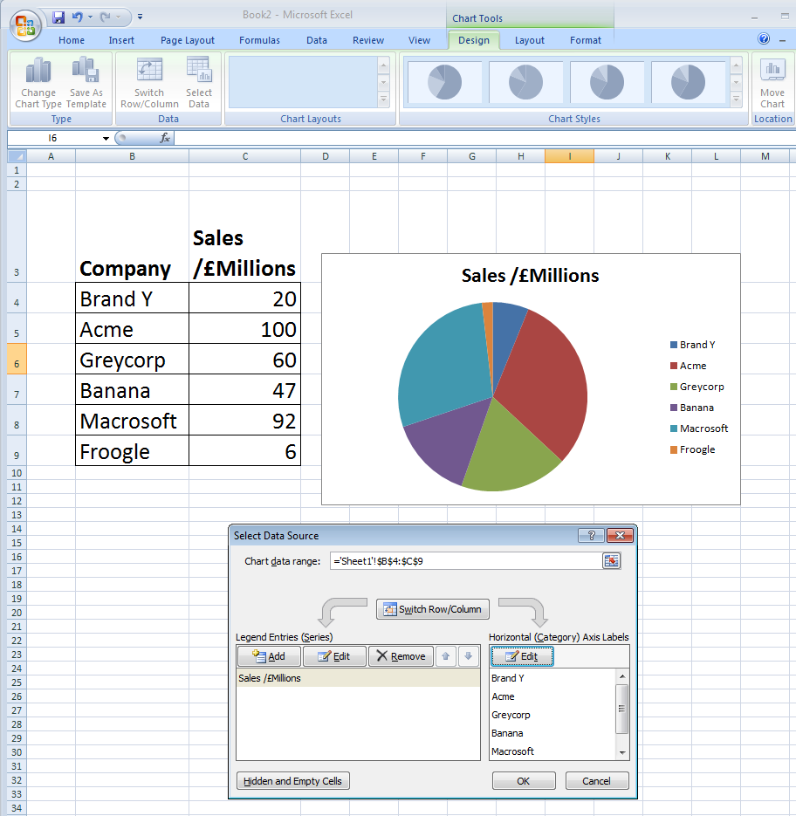
Labels are now updated from numbers to names

Slide 8
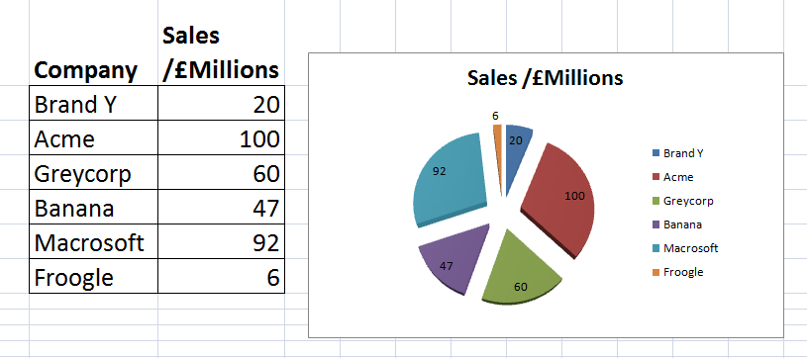
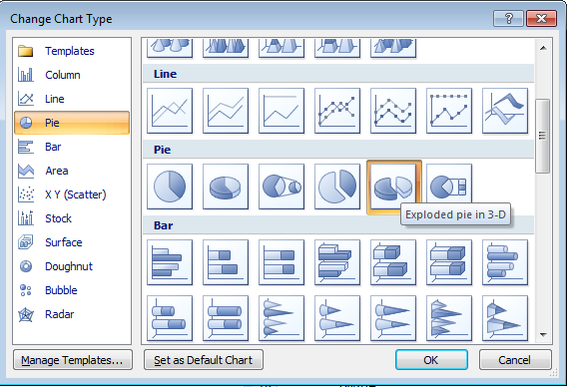
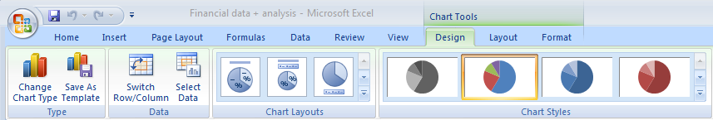
For Excel élan, use the Chart Tools ribbon (and also the options in the context menu which will appear if you right click over the Pie Chart) to enhance the appearance of you Pie Chart . Does your information make sense at a glance?
Display numbers on the pie slices.
Right Click menu on pie chart. Select Format Data Labels ... Go to Label Options section. Select Value check box.
Change Pie Chart to the ‘exploded’ version

