Slide 1



VBk Practical Mathematics
and Microsoft Excel Course
Pivot Tables
WINCHESTER
COLLEGE

Slide 2
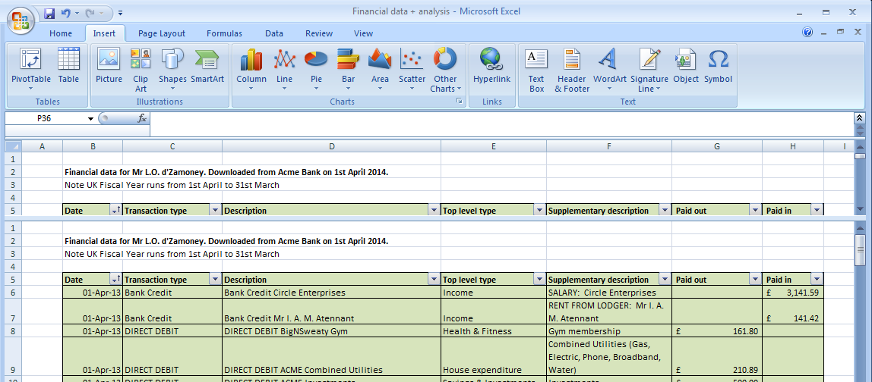
Pivot Tables are a powerful feature of Excel which can be used to automatically summarise
data contained within a spreadsheet.
To create one, load up a spreadsheet containing the data and then click on the PivotTable
button on the Insert section of the icons along the top the Excel window. (“The Ribbon”).

Slide 3
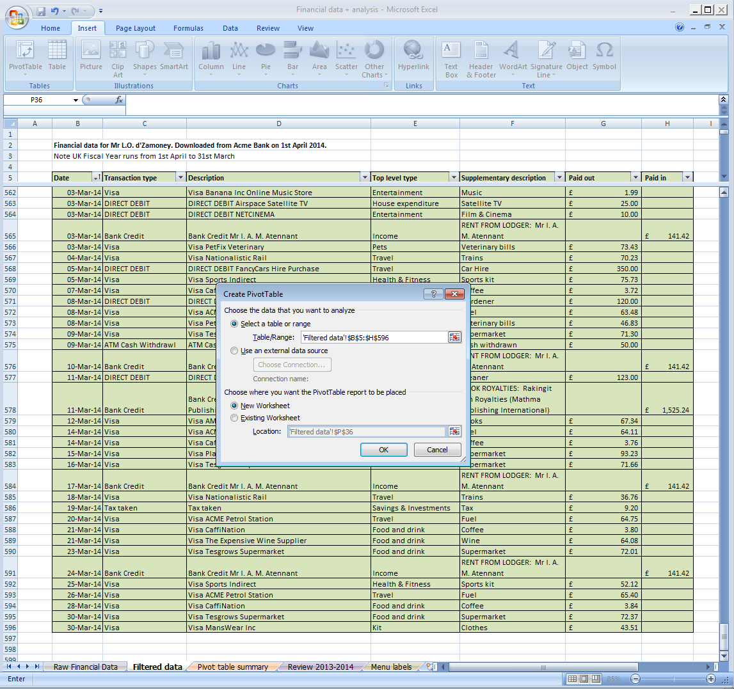
Now set range of data
In this case:
=‘Filtered data’!$B$5:$H$596
Worksheet ‘Filtered data’
Cells B5 to H596
It is usually a very sensible idea to create the Pivot Table in a new worksheet

Slide 4
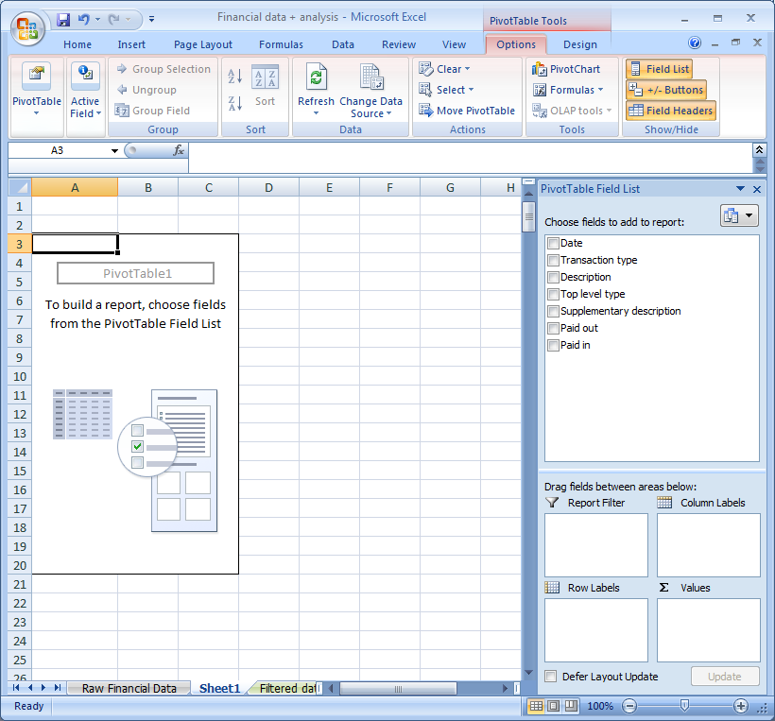
The Pivot Table
is created!
Experiment
with the options
on the right hand side
to design the table
to your requirements.

Slide 5
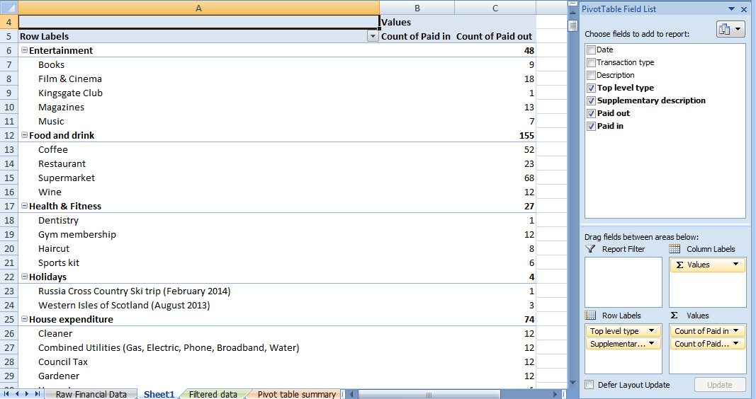
In this example the numbers of entries (‘Count’) are summed against two levels of description
assigned to the financial transactions above.

Slide 6
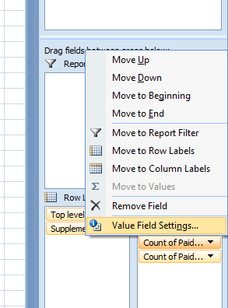
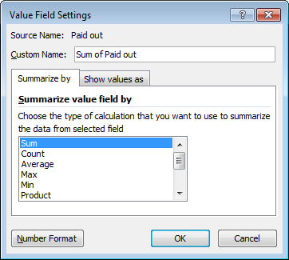
To change the entries count to ‘sum the values’, click on the ‘Count of ...’ item and select Value Field Settings.
Change Count to Sum (or indeed something else, if a sum is not what you need).

Slide 7
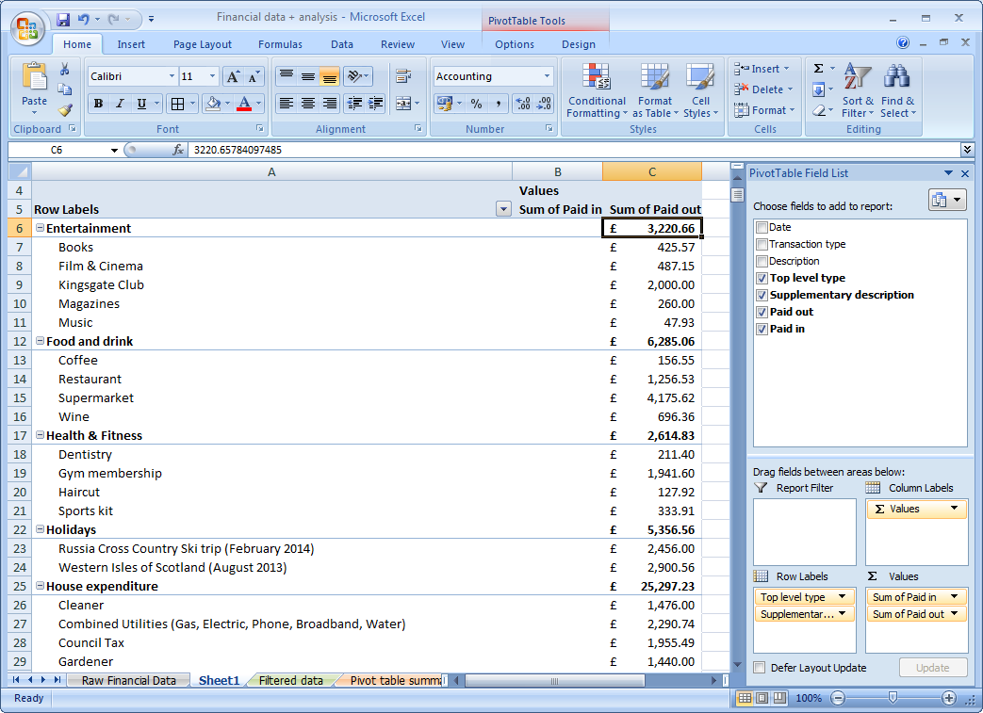
The formatting of these cells
have also been changed to Accounting (with £ prefix), and two decimal places. Right click on the cells and select Format Cells.... from the menu that appears to do this.

