Slide 1


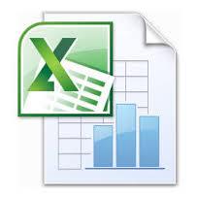
VBk Practical Mathematics
and Microsoft Excel Course
Line graphs
WINCHESTER
COLLEGE

Slide 2
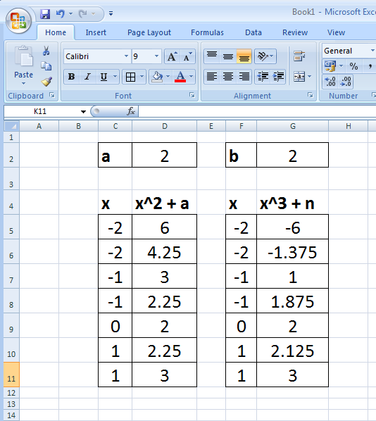
To plot a line graph, first create
a table of values for the horizontal (‘x’) and vertical (‘y’) axes.
In the example on the left, cell formulae have been used to automatically compute the cells.
Replication (or copy and paste) of formula cells has been used to
efficiently create the table.
=f11^3 + $g$2
=a10+1
=a11^2 + $d$2

Slide 3
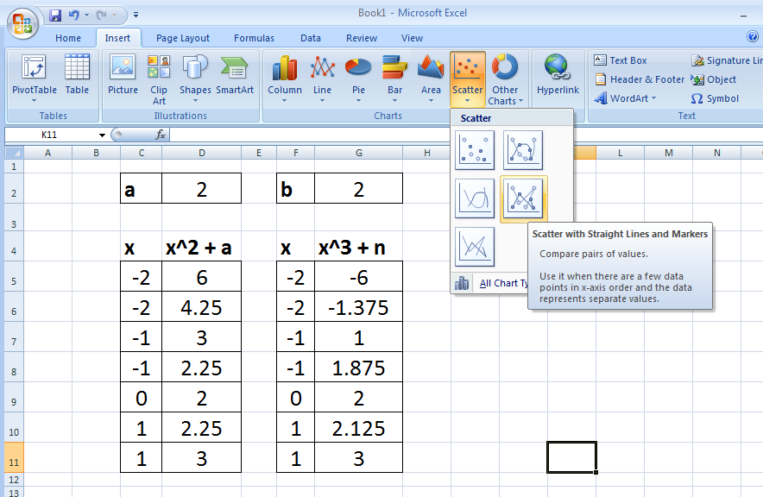
To create a line graph, firstly select Scatter in the Insert section of the Excel ‘ribbon’

Slide 4
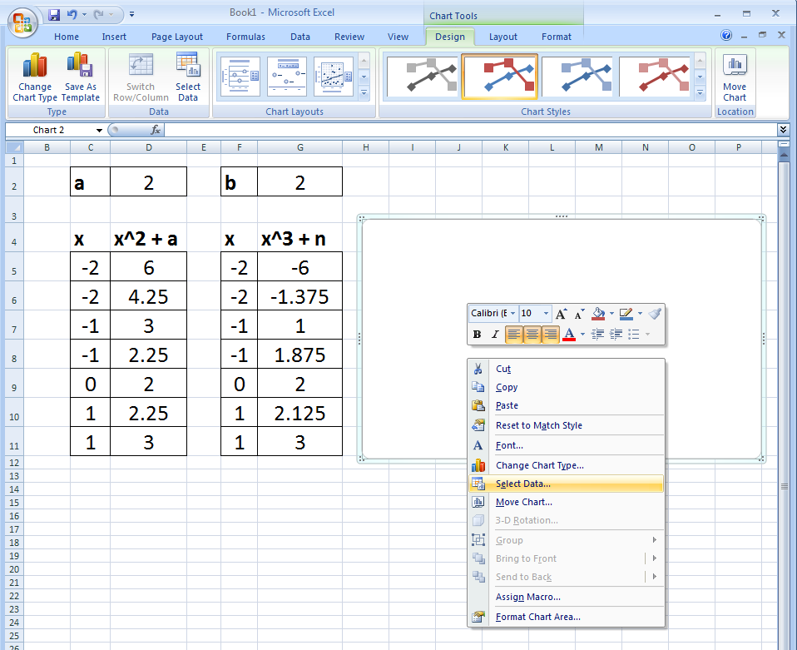
A white box will appear. Move it
so it doesn’t obscure the data, then
right click inside. Choose the Select Data
option from the context menu which will appear.

Slide 5
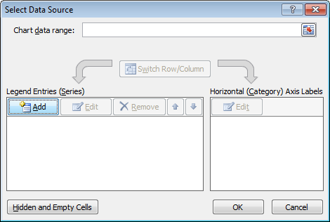
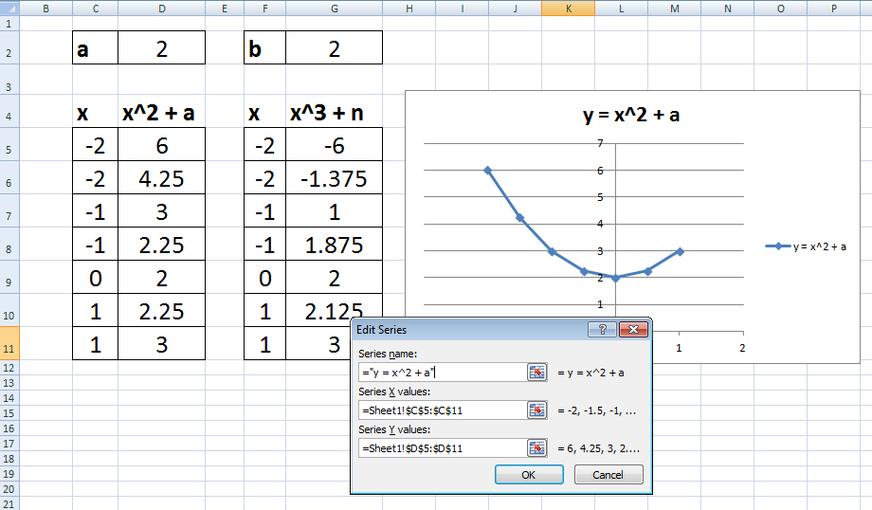
Select Data .... menu option
Type in range of data
(or use the button on the right to select it with a mouse)
Graph will
automatically update

Slide 6
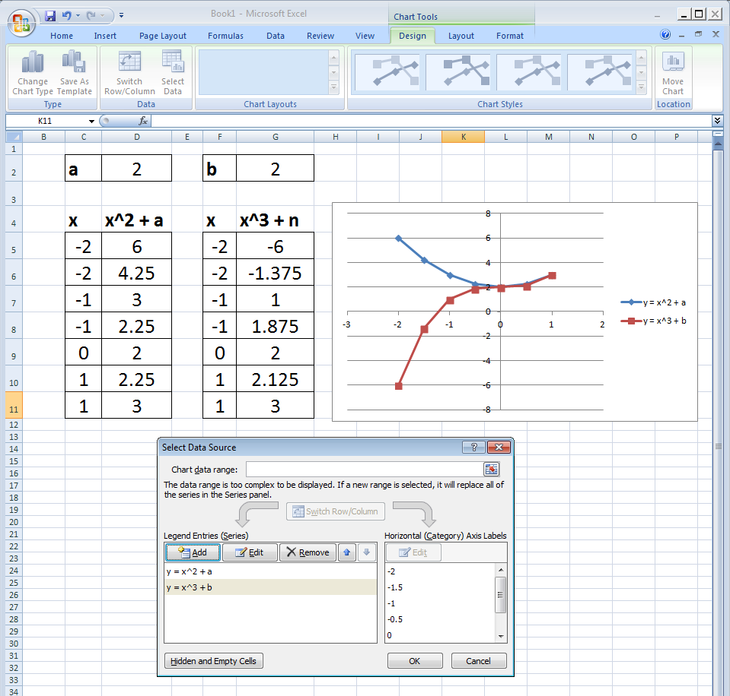
Click on the Add button to add additional lines.
The repeat the same procedure as before.

Slide 7
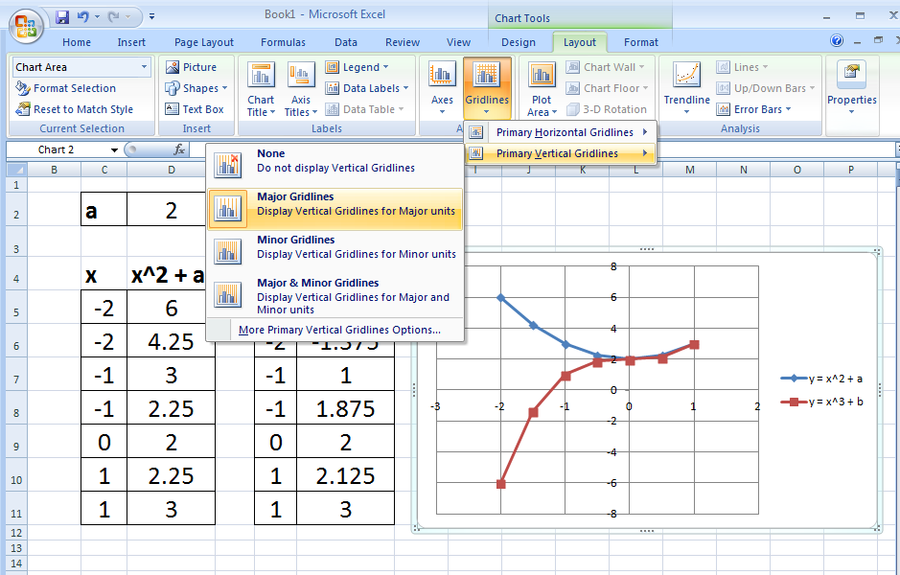
Set chart options such as gridlines using the Chart Tools options, which will appear on the ‘ribbon’ if you click on the chart area.

Slide 8
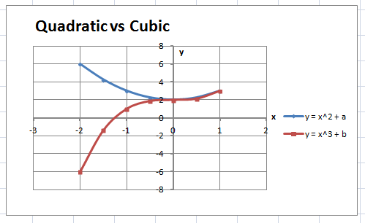
Many aspects of a graph can be customized via the Chart Tools part of the ‘ribbon’ icon bar.
Chart title added
x and y axis labels have been added
Right clicking on the data point markers enable their appearance to be modified. In this case the marker sizes have been changed from 7 to 4 points.
Graph type changed from ‘straight line scatter’ to a scatter connected with smooth curves. These are probably cubic splines.
Weight (thickness) of axes gridlines
have been modified, to more clearly
identify where the axes are in the grid

