Slide 1



VBk Practical Mathematics
and Microsoft Excel Course
Menus & VLOOKUP
WINCHESTER
COLLEGE

Slide 2
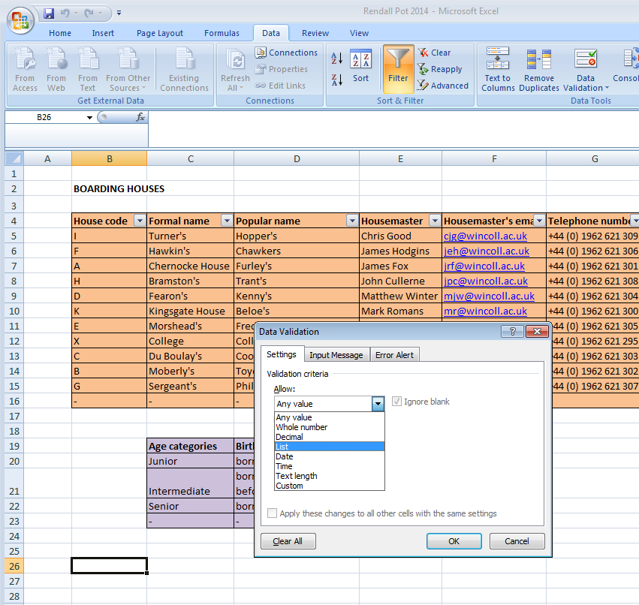
Menus are a useful feature in Excel if you want a user to choose an input from a finite set of responses. These responses may need to be spelled correctly, as they may well link (via VLOOKUP) to a table which will automatically populate other cells. Hence a menu rather than a ‘free text field’ is a very good idea.
Select the Data Validation button
and choose List from the range of options
Select a cell which you want to be a menu item.

Slide 3
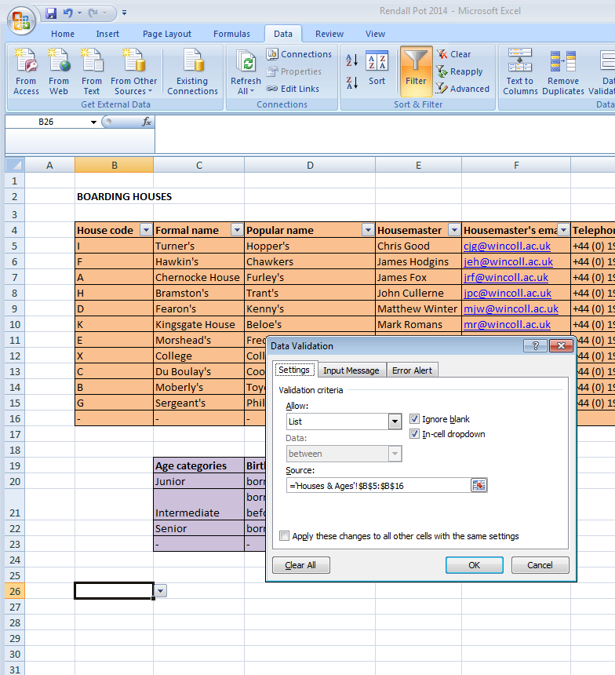
If the List option
is selected, you will be asked for the Source
of the table which constitutes the menu options. You can type this or use the button on the right of the box to drag and select cells.
The name in ‘... ‘! is the name of the worksheet. The code $B$5:$B$16 defines a fixed array between cells B5 and B16. The dollar sign forces this not to change if another menu cell is added somewhere else.
=‘Houses & Ages’!$B$5:$B$16

Slide 4
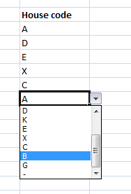
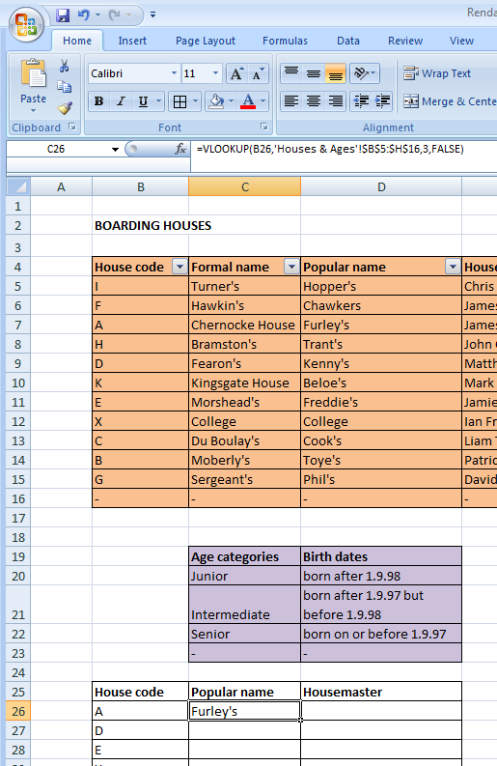
Cells can be copied to create a table. Clicking on each cell will bring up a menu, from which the user can make a selection.
Now let’s use VLOOKUP to automatically populate cells depending on the menu item chosen.
In this example the code is:
= VLOOKUP(B26,'Houses & Ages'!$B$5:$H$16,3,FALSE)
This means: “ based on data table B5 to H16 in worksheet ‘Houses & Ages’, give me column 3 of this array which is an exact match to the column 1 entry, which corresponds to the content of cell B26.”
For VLOOKUP to work, column 1 of the VLOOKUP array must be correspond to the menu items.

Slide 5
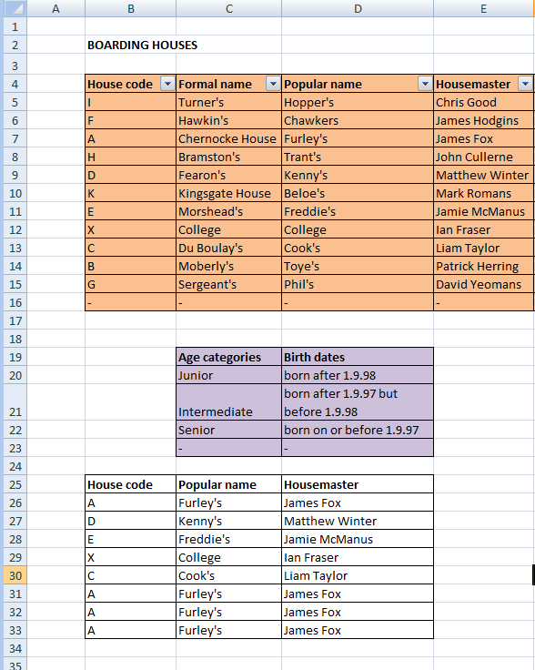
Copy and paste the VLOOKUP
cell to automatically populate
a table.
Note the $ sign is omitted
from the first argument of VLOOKUP. This means
B26 will automatically become B30 as the cells are ‘replicated down’ or pasted.
= VLOOKUP(B26,'Houses & Ages'!
$B$5:$H$16,4,FALSE)
= VLOOKUP(B30,'Houses & Ages'!
$B$5:$H$16,4,FALSE)
If TRUE is chosen, the match will be the nearest, but perhaps not an exact match. Use with caution!

