Slide 1



VBk Practical Mathematics
and Microsoft Excel Course
Replicating
Formulae
WINCHESTER
COLLEGE

Slide 2
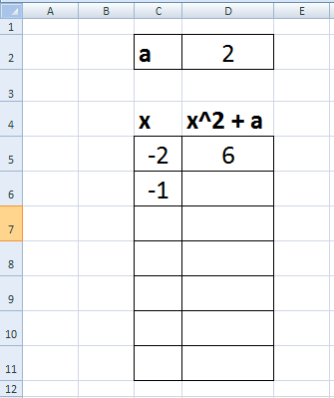
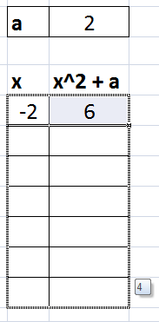
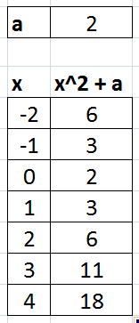
In Excel one can use formulae to relate cells, i.e. compute the value of one cell based upon the value of another. c5 refers to column C and row 5.
= c5^2 + $d$2
= c5+1
Dragging a cell downwards
(or copying then pasting it elsewhere)
will replicate the formulae. $ prefixes will fix the cell reference (e.g. the parameter a = 2 in cell D2). Otherwise the cell reference in the formula will change with the cell position.
= c10+1
= c11^2 + $d$2

Slide 3
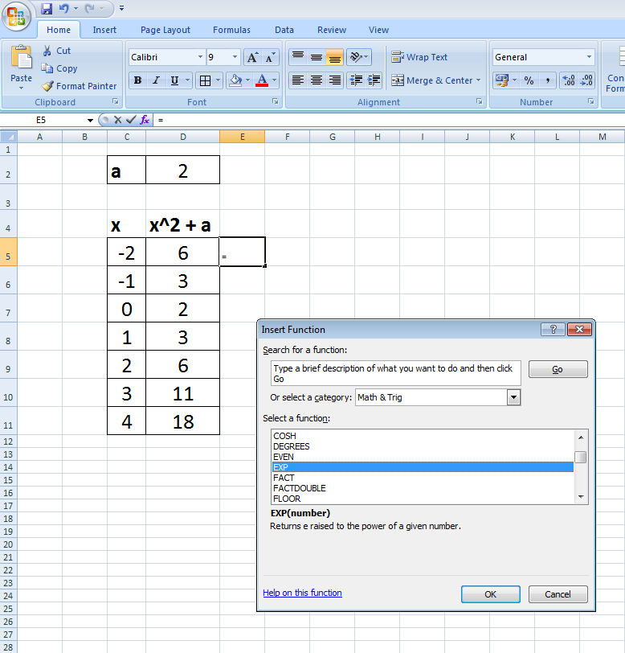
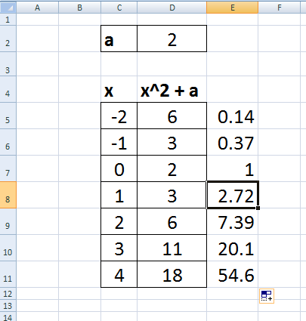
The f_{x} function button allows one to choose from a wide variety of cell formulae. Explanation and syntax is given in the Insert Function box. Note functions can be typed in directly if you can remember them!
=EXP(C8)

