Slide 1



VBk Practical Mathematics
and Microsoft Excel Course
Using Filters
WINCHESTER
COLLEGE

Slide 2
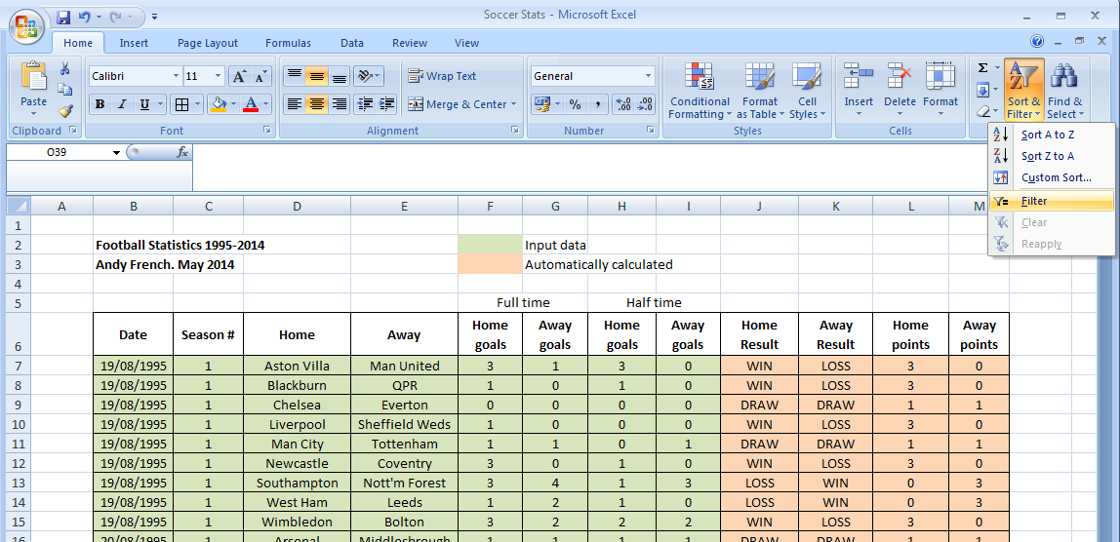
Filters are a very powerful feature in Excel. They enable data to be sorted based upon
the set of entries in one column. This enables Excel to act like a database i.e. logical queries
can be asked of a potentially large dataset.
To activate filters, first mark block the headings you are interested in.
Then click on the Sort & Filter button.
Select Filter from the menu that appears.

Slide 3
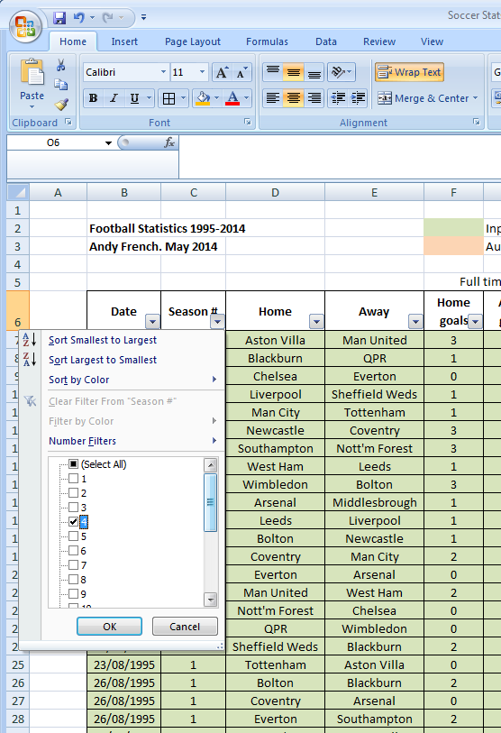
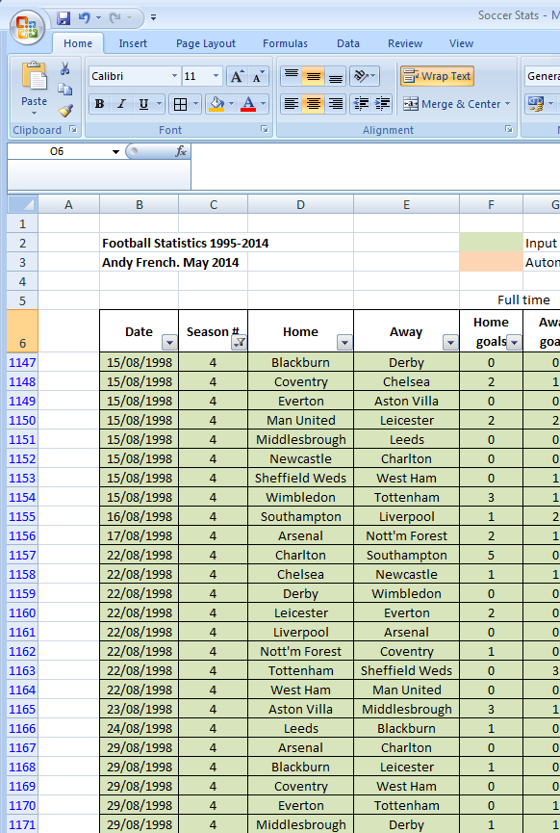
Click on the grey square with the black triangle which will now appear. This brings up the filter options. You can select specific entries (in this case only results from Season 4) and also sort by number and by colour. Note all other columns will be sorted accordingly!

Slide 4
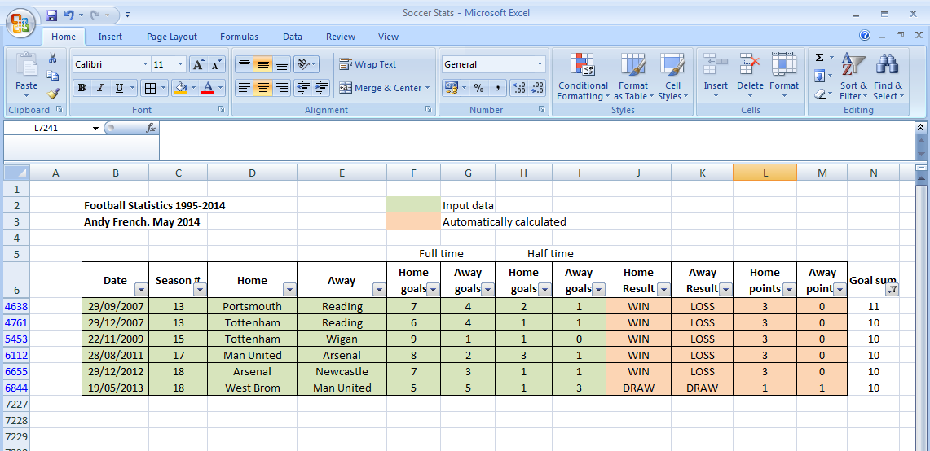
You might want to add an extra column to enable more sophisticated sorting of the data.
In this example, the query would be “how many Premiership matches were 10 or more goals scored?” Adding a ‘Goal sum’ column, which sums full time scores in columns F and G achieves this. Filtering on this new column, and selecting ’10’ and ’11’ displays the results above. Only 6 matches out of 7,220 - quite a rare occurrence!

