Slide 1
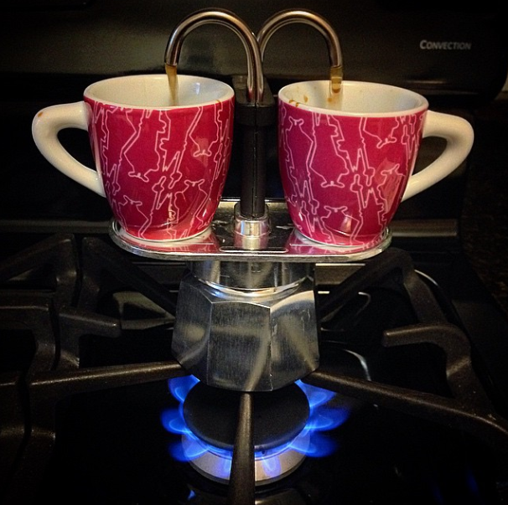
The science of brewing coffee
Notes:
http://wiki.triestecoffeecluster.com/index.php?title=Main_Page this page is from illy…has everything!

Slide 2
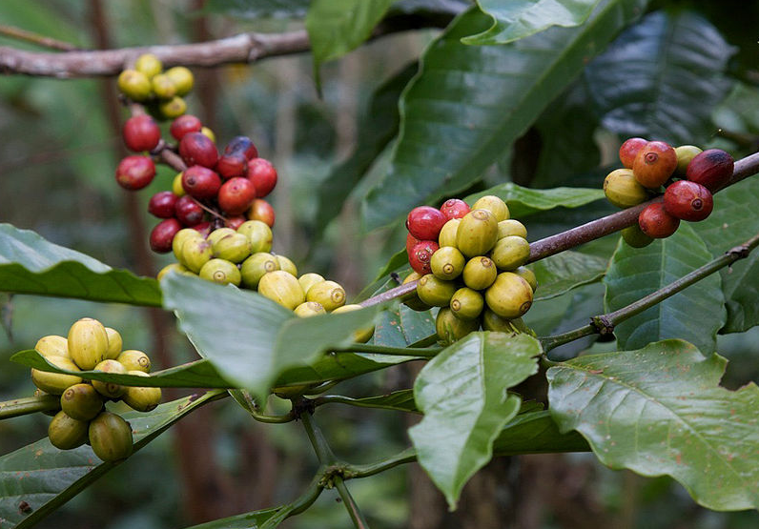
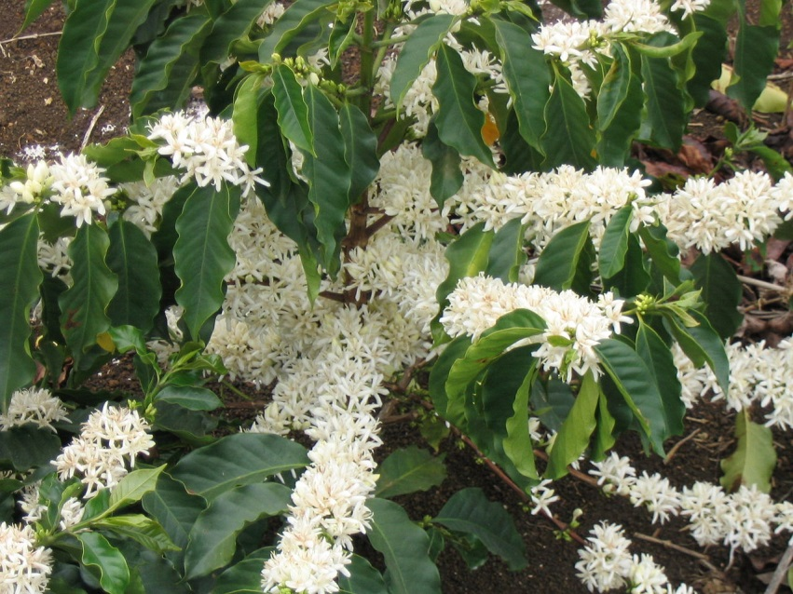
The coffea plant
Kingdom: | Plantae
Division: | Magnoliophyta (Angiosperms)
(unranked): | Eudicots
Class: | Magnoliopsida
(unranked): | Asterids
Order: | Gentianales
Family: | Rubiaceae
Subfamily: | Ixoroideae
Tribe: | Coffeeae
Genus: | Coffea
Over 20 species, but only two of importance: arabica and robusta
http://en.wikipedia.org/wiki/Coffea
Notes:
The Arabica bean is typically grown at heights between 1500ft and 6000ft and requires better soils than the Robusta to germinate. The Arabica bean is considered tastier and higher quality than the Robusta, but its elevation requirements and fragility to disease make it more difficult to grow.
It is possible to propagate coffee plants from cuttings, but most commercial farmers choose to start new trees from seeds picked from the hardiest plants. With ideal conditions, it takes 5 to 8 weeks for seedlings to make their way to the surface of the soil. Within 9 to 18 months the plants will be around a foot tall, but it will take another five to six years for the coffee seed to grow to full maturity, producing its first full crop of berries.

Slide 3
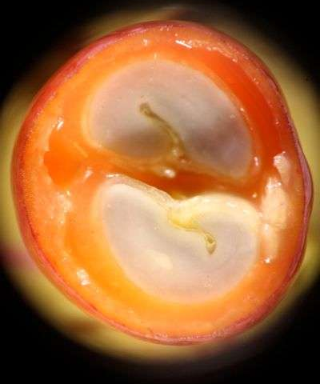
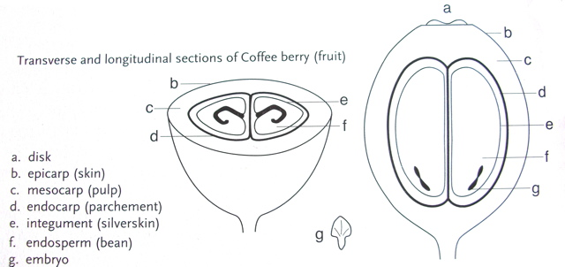
Inside the berry
https://desertsuncoffee.wordpress.com/2011/10/13/the-life-cycle-of-coffee/
https://www.sweetmarias.com/Macro_Coffee_Images09/Images/11.jpg
Notes:
Harvest time varies according to geographic zone, but generally, north of the Equator, harvest takes place between September and March, and south of the equator between April and May. What we call a coffee bean is actually the seeds of a cherry-like fruit. Each year coffee is harvested during the dry season when the coffee cherries are bright red, glossy, and firm. The skin of a coffee cherry is called the epicarp and is thick and bitter. However, the fruit beneath it is intensely sweet and has the texture of a grape.

Slide 4
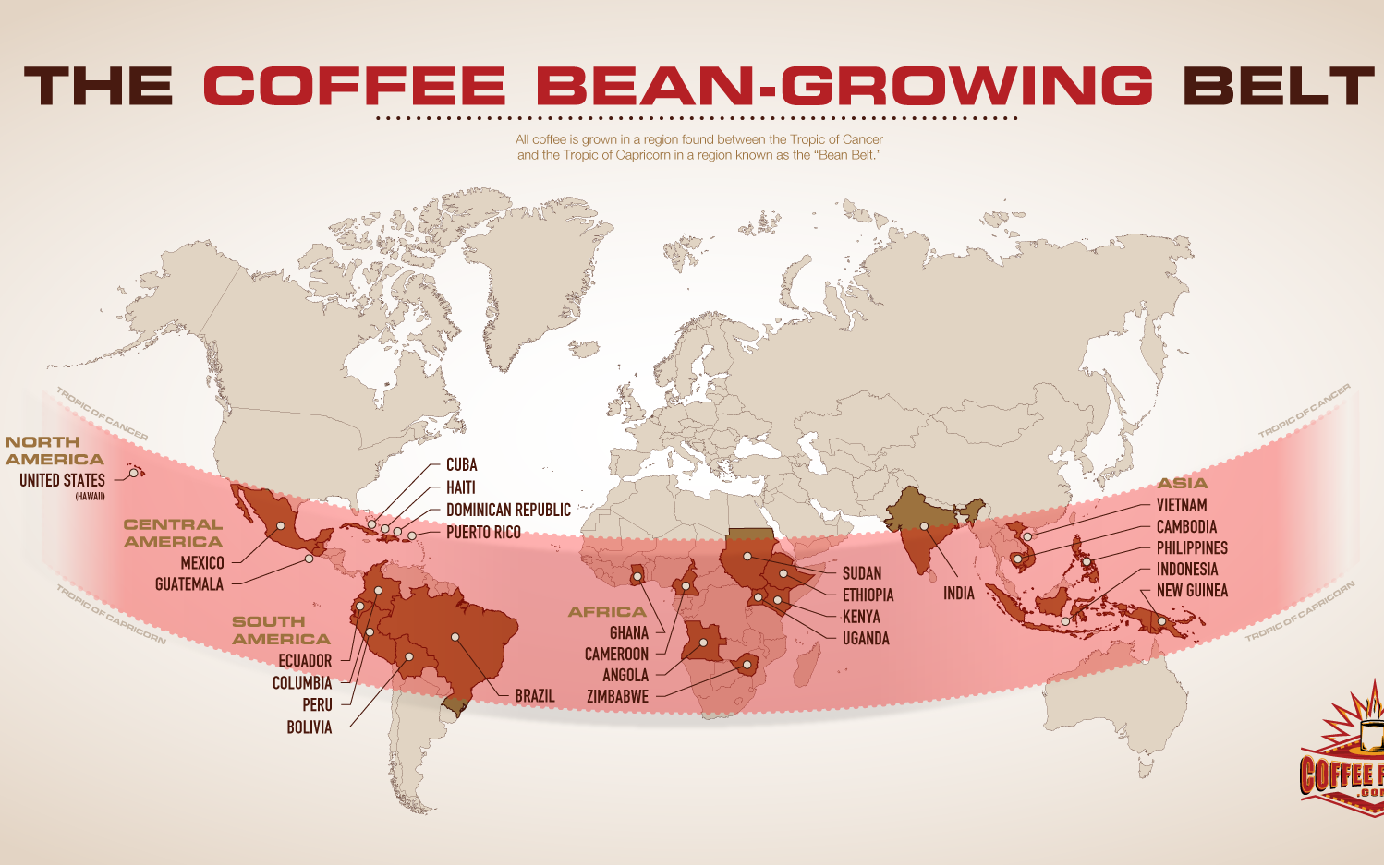
WHERE coffea plants are grown
http://www.coffeeforless.com/articles/coffee-articles/coffee-bean-growing-belt.html

Slide 5

Effect of altitude on taste
http://www.scribblerscoffee.com/flavor_effect_of_altitude
Notes:
The influence of geography on the flavor of a coffee bean is profound. All coffee grows in the tropics, but the altitude at which it is grown contributes significantly to a coffee’s taste profile. Mountainous regions of the Coffee Belt, a tropical band extending approximately 30º north and south of the equator, produce the world’s truly great arabica coffees. Central and South America, southern Asia and some Pacific islands, and mid to southern Africa represent the world’s foremost coffee growing regions.
High elevations above 3,000 feet to 6,000 feet and beyond provide ideal growing conditions for the coffee tree: a frost-free climate averaging 60-70º F year-round, moderate rainfall of about 80 inches, and abundant sunshine. Cooler mountain temperatures provide a slower growth cycle for the coffee tree which prolongs bean development. This longer maturation process imbues the coffee bean with more complex sugars, yielding deeper, more interesting flavors. Better drainage at high elevations also reduces the amount of water in the fruit resulting in a further concentration of flavors. The soil in which the finest arabica coffees are grown is extremely fertile, and often volcanic.
High-grown beans are hard, dense, and possess the potential for exceptional coffee flavor. The truly stunning coffees are grown between 4,000 and 6,000 feet. These coffees are produced from fruit that is picked only when ripe and prepared with care following harvest. Central America grades the quality of its coffee based on the altitude at which it is grown. A strictly hard bean (SHB) designation in Guatemala, for example, signifies coffee grown at or above 4,500 feet. Mexico applies the term altura, meaning “high” in Spanish, to identify its high-altitude coffees while Papua New Guinea attaches a "Mile High" designation to its mountain-grown beans.
Generally, as growing elevation increases, a coffee’s flavor profile becomes more pronounced and distinctive (see graphic below). From the mild and sweet taste qualities of a low-grown Brazilian bean at 3,500 feet to the soaring floral notes of an Ethiopian grown above 6,000 feet, altitude heightens a coffee’s ability to deliver bigger varietal nuance and complexity.
Although the world's finest coffees are found at elevations of at least 4,000 feet, some rare exceptions exist. Hawaiian Kona, for example, is so far north of the equator that coffee cannot be grown higher than 2,000 feet in that region. The microclimate is simply too cold to sustain a coffee tree that cannot tolerate frost.
Very low-elevation coffee regions impose harsher growing conditions on the coffee tree. Higher temperatures and less rainfall cause coffee to ripen more quickly resulting in beans with taste qualities that range from simple and bland to earthy or murky. The bean structure of these coffees grown downslope tends to be softer than the hard-bean coffees grown above 4,000 feet. Consequently, these more delicate coffees do not tolerate darker roasts well and suffer from increased flavor loss when stored.
High-altitude specialty coffees, on the other hand, generally command a far better market price due to their exceptional flavor and vibrancy, lower yield per coffee tree, and the challenge they pose to coffee farmers in remote mountainous areas who must produce and market the crops. Yet, altitude is but one factor that shapes a coffee’s overall flavor profile. To understand the two primary influences on the flavor of roasted coffee—the quality of the green (unroasted) coffee bean and the roast style applied to it—see the first two links below.

Slide 6
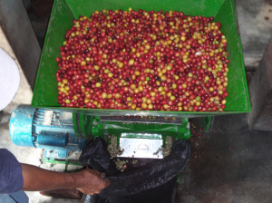
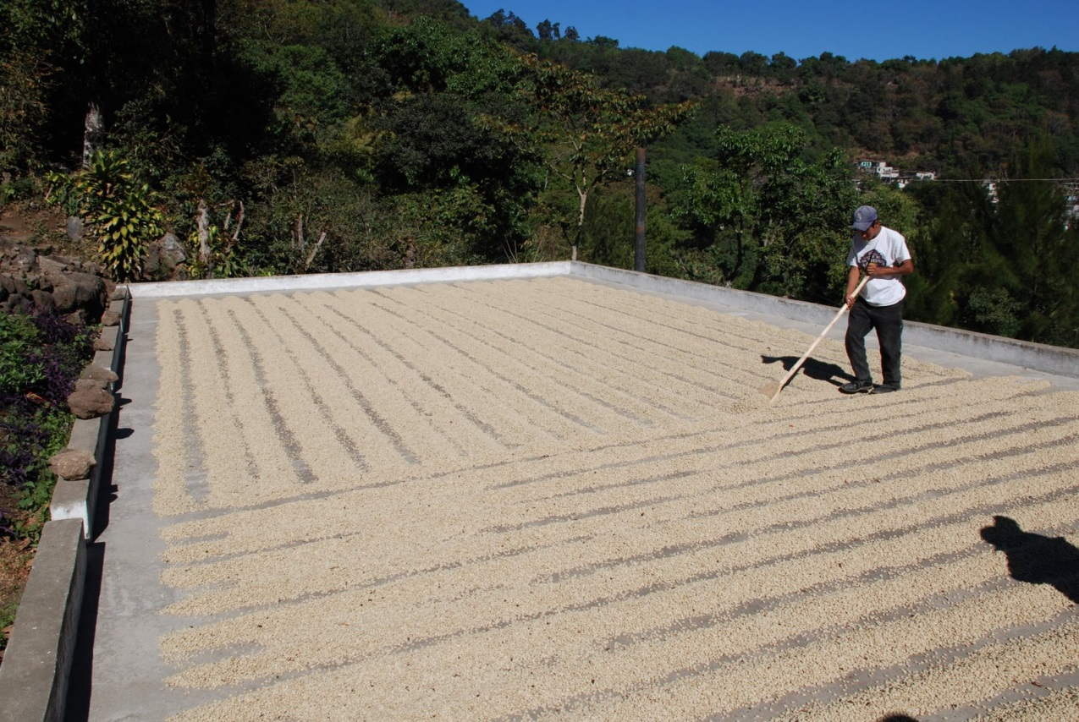
After harvesting: Processing
De-pulping
Drying
https://desertsuncoffee.wordpress.com/2010/12/29/journey-of-the-coffee-bean/
https://wideanglewords.files.wordpress.com/2010/02/coffee-drying.jpg
Notes:
The next step in the life cycle of a coffee bean is processing, which means converting the raw fruit of the plant into actual coffee. Both the pulp and the parchment need to be removed before the coffee can be roasted. The two methods of processing include wet and dry.
During wet processing the cherries are sorted by immersion in water. Bad or unripe fruit will float and the ripe fruit will sink. Dry processing, also known as unwashed, is the oldest method of processing coffee. The cherry is cleaned and then placed in the sun to dry on tables or in thin layers on patios. It may take up to four weeks before the cherries are dried to the optimum moisture content. On larger plantations, machine-drying is sometimes used to speed up the process after the coffee has been pre-dried in the sun for a few days.
The drying operation is the most important stage of the process, since it affects the final quality of the green coffee. A coffee that has been over dried will become brittle and produce too many broken beans during hulling (broken beans are considered defective beans). Coffee that has not been dried sufficiently will be too moist and prone to rapid deterioration caused by the attack of fungi and bacteria. For more information on processing coffee check out Zach’s post on the Journey of the Coffee Bean.
After all of the processing, drying, and sorting has taken place the coffee beans are finally ready for export.
On the farm the cherries are put into a machine that removes the cherry pulp from the seeds. The discarded red pulp will be used as compost in the fields. The beans, still covered in a slimy coat called mucilage, then get soaked in water to break down their slimy covering. The layer of mucilage, mainly composed of pectin and sugars, is fermented by naturally present micro-organisms for up to 24 hours, and is critical to the value and flavor of the coffee. Fermentation ends when the beans lose their slimy feel. The beans, now held together by an outer covering called a parchment, must then be washed thoroughly to ensure the removal of any trace of mucilage.
The Dry Method or the Natural Method is the simplest and oldest method of preparation. Over 60% of the world’s coffees are processed this way. Harvested cherries are laid out on cane matting or brick patios under the hot sun. To ensure even drying and prevent spoilage, they are raked and turned several times a day. They are covered at night or in the event of rain. It takes 2-3 weeks of good, dry weather to thoroughly dry the cherries. Success depends on good weather.
The Wet Method or Washed Method is used where fresh water is abundant. There are several variations of the wet method but generally, harvested cherries are poured into large, water-filled tanks to soften the outer husk and pulp. Thus softened, the cherries are run through a pulping machine to actually remove and wash away the husk and pulp from the parchment covered beans. These beans, still covered in their silver skin, are sorted by weight via water channels and then by size in rotating drums. The separated beans are placed in large tanks filled with water. Sitting in these tanks for 12 to 48 hours a natural enzyme causes a fermentation process in which the layer of mucilage (parenchyma) attached to the parchment is dissolved. They are then dried in much the same way as the Dry Method. In some cases, these beans may be dried in large drying machines that shorten drying time of parchment coffee to 24 to 36 hours.
The next step that takes place on the farm is the drying process. This gives the farmer a tangible product that they can sell to the coop where Desert Sun gets its coffee. The parchment beans are spread out to dry on patios and frequently mixed for even drying. Once the parchment is dried to a proper level, they are ready to be taken off the farm to the coop where the farmer will sell his/her goods.
drying of the beans to 11% moisture content

Slide 7
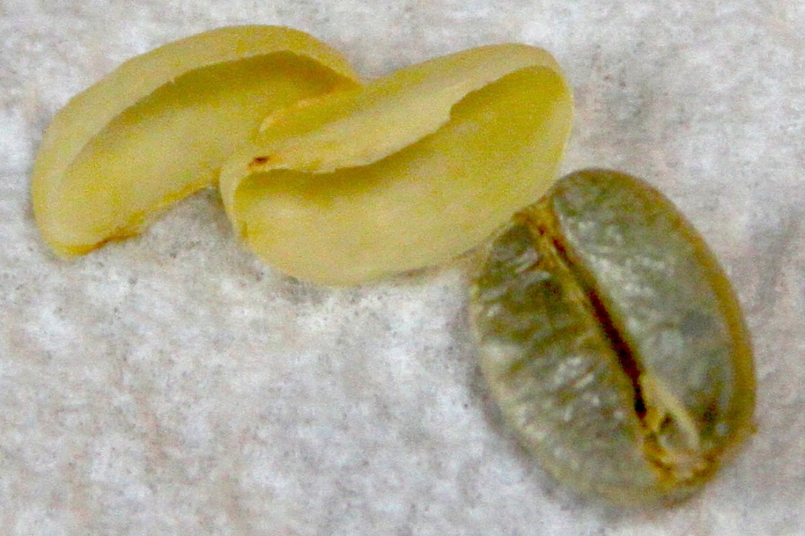
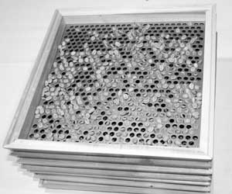
Parchment removal, Grading & Sorting
Parchment Removal
Grade = Bean size
For example, Grade 18 beans, also called AA, will pass through a sieve with 18/64” diameter holes, but are retained by the next smaller sieve with 16/64” diameter holes.
General correlation between bean size and flavour, but there are many exceptions.
http://thevirtualbarandgrill.com/wordpress/wp-content/uploads/2014/02/IMG_1734.jpg
http://www.zecuppa.com/coffeeterms-bean-grading.htm
Notes:
The drying operation is the most important stage of the process, since it affects the final quality of the green coffee. A coffee that has been over dried will become brittle and produce too many broken beans during hulling (broken beans are considered defective beans). Coffee that has not been dried sufficiently will be too moist and prone to rapid deterioration caused by the attack of fungi and bacteria.
The coop is the where all the farmers of a region will bring their product to sell. It is the last place the coffee will be before leaving the country to head to our warehouse. Inside each parchment that the farmer sells to the coop, there are two beans (or seeds), lying flat sides pressed together, (On rare occasions, there is one bean; called a peaberry.). These are the green beans that a roastery such as Desert Sun will receive. Upon receiving farmers’ product, the coop will remove the parchment from the green beans by placing them in a machine that uses friction to remove the shell. During this process, beans can be damaged and broken if the machine is not calibrated properly. Green coffee is then separated according to size and graded.
Grade is generally used to indicate coffee bean size. The process of determining coffee bean size, or grading, is done by passing unroasted beans through screens of different sizes, or sieves. For example, Grade 18 beans, also called AA, will pass through a sieve with 18/64” diameter holes, but are retained by the next smaller sieve with 16/64” diameter holes. After the beans have been graded, they will be sorted and defective beans will be removed. At this point, the green coffee is stored in bags and ready to be shipped.
Coffee beans grown at higher elevations tend to be denser, larger, and have better flavor.

Slide 8
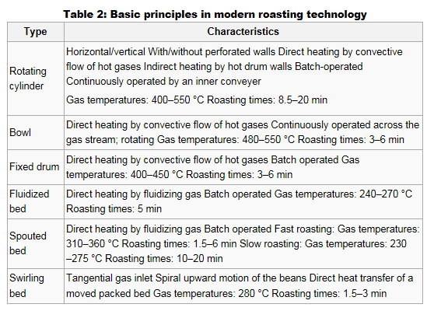
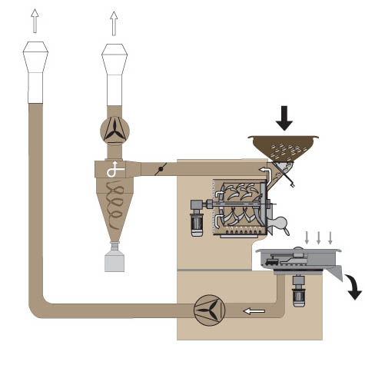
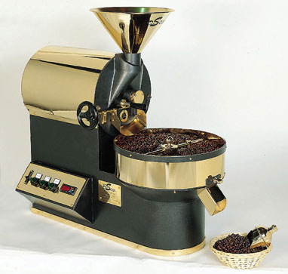
roasting
http://wiki.triestecoffeecluster.com/index.php?title=Roasting
Notes:
https://desertsuncoffee.wordpress.com/2011/02/25/roasting-coffee-part-1-roast-level/
https://desertsuncoffee.wordpress.com/2011/04/06/roasting-coffee-part-2-technical-aspects/
http://www.coffeereview.com/coffee-reference/from-crop-to-cup/professional-coffee-roasting/two-schools-of-roasting/
The bean has a finite geometry of complicated shape; its inner structure is heterogeneous; by heat admission its volume swells and the inner structure changes. Mathematically, temperature becomes a three-dimensional function of non-steady-state character with unknown moving boundaries. From a chemical-engineering point of view the roasting process consists of a combined heat and mass transport superposed by endothermic and exothermic reactions. Thus the application of heat to the coffee beans not only generates a temperature field, it also causes inner pressures and a re-distribution of moisture depending on time and location.
These effects are illustrated in Figure 4: Heat energy is admitted to the surface of the whole green bean, mainly by external hot gas flow, with additional radiation and contact heat transfer depending on the type of roaster.
The temperature of the bean surface increases – with heat conduction into the porous material – due to the temperature gradient. When the local temperature reaches the evaporation temperature of the bean moisture, a front of evaporation starts moving towards the centre of the bean. During this first part of the roasting process the walls of the whole bean are still relatively firm. Thus the vapour that has been generated cannot permeate and the pressure build-up makes the bean volume expand. Evaporation of the bean moisture, being an endothermic operation, needs latent energy leading to a slowed down kinetic in the temperature rise within the bean. The swelling and drying result in a strong decrease in heat conductivity within the section between the vaporization front and the outer surface of the bean. As a consequence the temperature gradient is steeper in the dried region of the bean because of the enhanced resistance to heat transfer. Mechanical and thermal stresses moving towards the centre of the bean are created, which make the beans crack or even burst if the superposed stresses overcome the tensile strength of the bean.
Roasting reactions – browning with formation of flavour compounds at elevated inner pressures – begin at higher temperatures (T>160°C) –starting at the bean surface and moving towards the inner dry preexpanded structure of the bean. This second front of moving latent heat is exothermic. Gaseous reaction products – mainly carbon dioxide – are generated and entrapped within the cell structure, increasing inner pressure until they permeate through the walls that are weakened and partly destructed by the high temperatures as well (Perren et al., 2001).
The roasting process is then a counter-current process with heat transport inside and mass outside. The phenomenological temperature profile (Figure 4) shows that the distance between the two moving zones of evaporation and roasting depends on the outer heat transfer, given by the roasting technique applied, and on the structure of the bean. The latter is linked with the geographical origin of the coffee to be roasted (Figure 5).
In order to achieve a roasting profile as homogeneous as possible, the process must be precisely controlled, aiming at small temperature gradients throughout the bean; on the contrary, fast roasting leads to an overlapping of the evaporation and roasting steps and to an inhomogeneous profile.
When the desired degree of roast is reached, the beans have to be cooled down rapidly by water quenching or cold air in order to stop further changes in colour, flavour and volume. The roasting loss is either measured by the dry mass loss (the weight loss based on dry green beans) or by the total mass loss (moisture plus organic matter loss). Table 1 shows the correspondence between roasting degree and dry mass loss (Clarke, 1987). During roasting the density of the beans decreases to nearly half its initial value.
The shape of a coffee bean can be defined as half an ellipsoidal body. Attempts at modelling the temperature field of a coffee bean during roasting have been made. The influence of the endothermic vaporization enthalpy as well as of the exothermic reaction enthalpy is shown in Figure 6. In the comparison the temperature increase has been calculated without taking into consideration latent energies. The results, when latent energies are introduced, indicate a delayed temperature rise up to 150°C caused by vaporization followed by an accelerated exothermic temperature increase above 180°C. Additional measurements of three temperatures – at the surface, between core and surface and in the core itself – show some remarkable aspects of roasting in a roasting experiment lasting 600 seconds (Figure 7).
Starting at ambient conditions all three temperatures increase with declining slope until nearly constant temperature has been reached.
During the first period (0–50 sec) of heating up the bean the difference between core and surface temperatures passes a maximum of at least 70 degrees, whereas the temperature difference between core and half distance to the surface of the bean slowly increases up to a maximum of approximately 10 degrees throughout nearly the whole roasting time.
Obviously, the roasting process is much faster in the outer sections of the bean compared to the core, probably leading to high thermal stresses in the outer parts of the bean.
A small temperature drop occurs suddenly after 200 seconds’ roasting time. At this time the inner temperature differences are clearly higher in comparison to the outer temperature differences. However, the temperature course drops slightly simultaneously throughout the whole bean.
After this unsteady phenomenon, temperatures increase more rapidly than before! This could be explained by a pressure built up in the centre of the bean due to water evaporation starting from the surface towards the central region, but proceeding with decreasing velocity because the driving force of heat transfer – the temperature difference to the ambient – is diminishing all the time. So the pressure inside the bean increases until the temperature overcomes the vaporization temperature, which is higher at elevated pressure. Thus the remaining water in the centre of the bean evaporates spontaneously and an endothermic flash creates the slight temperature drop. Immediately after flashing the full exothermic roast reaction is enabled to run to the core of the bean.
In order to roast the bean as homogeneously as possible, a stepwise process with a slow increase of the temperature of the heating gas seems to be advantageous. Further, a build-up of pressure in the bean is important for the generation of sufficient aroma. Thus, temperature control of the heating gas, permitting not only temperature profiles with moderate differences, but also a sufficient pressure built up inside the bean, has to be the objective of roasting.

Slide 9
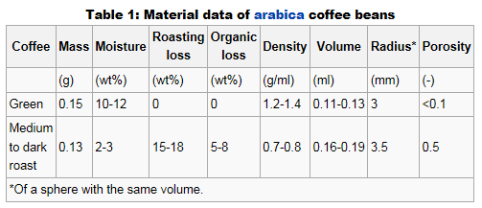
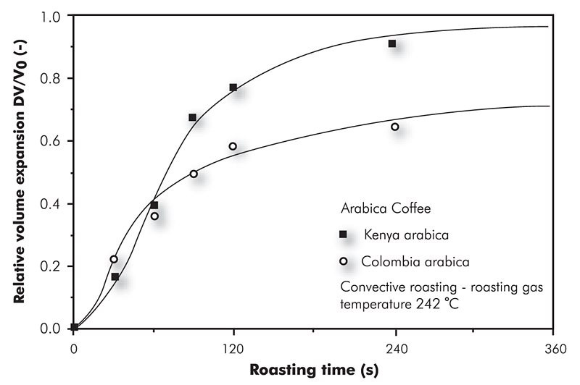
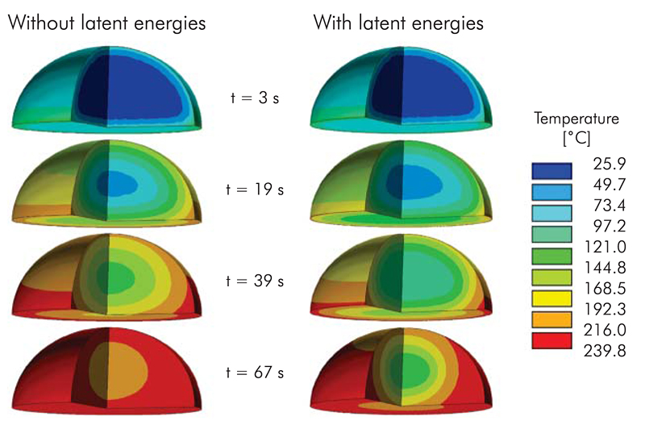
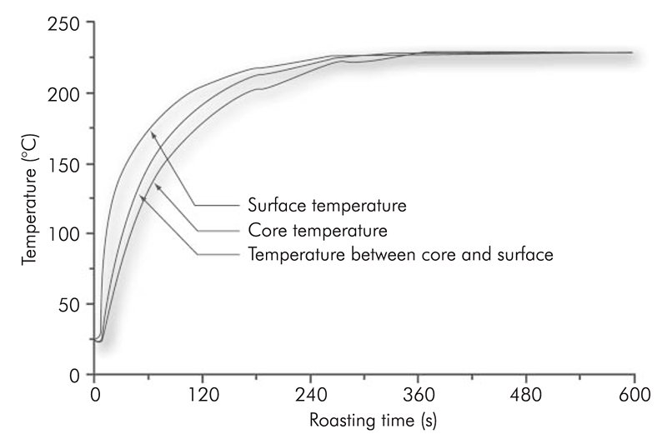
Changes to bean during roasting

Slide 10
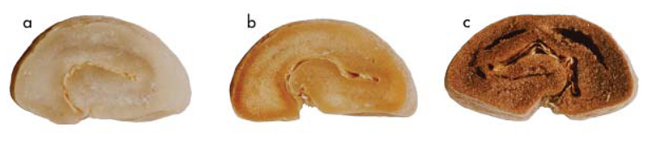
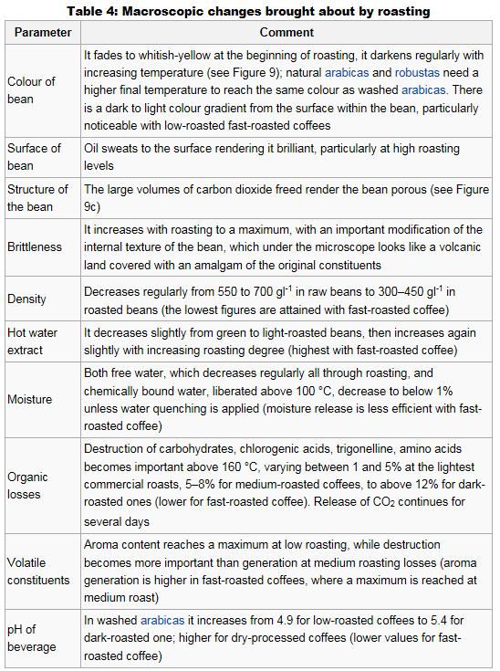
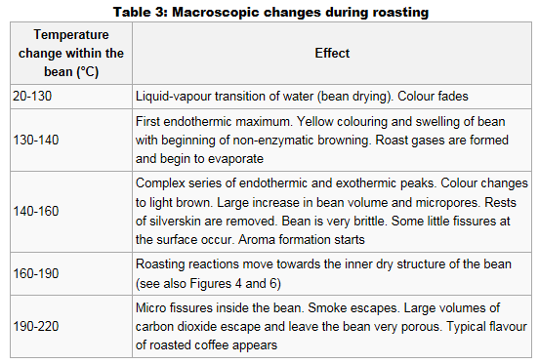
Changes to bean during roasting
a. Green b. Toasted to 70 deg C c. Roasted (porous)

Slide 11
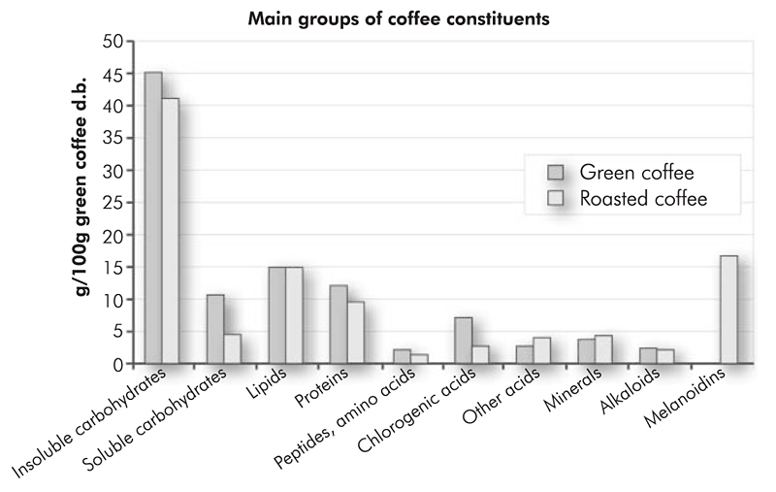
What’s left
Notes:
Typically, only small amounts of monosaccharides can be found in the brew, but no sucrose is present, because it has already been transformed on roasting into bitter tasting Maillard compounds (Trugo and Macrae, 1985).

Slide 12
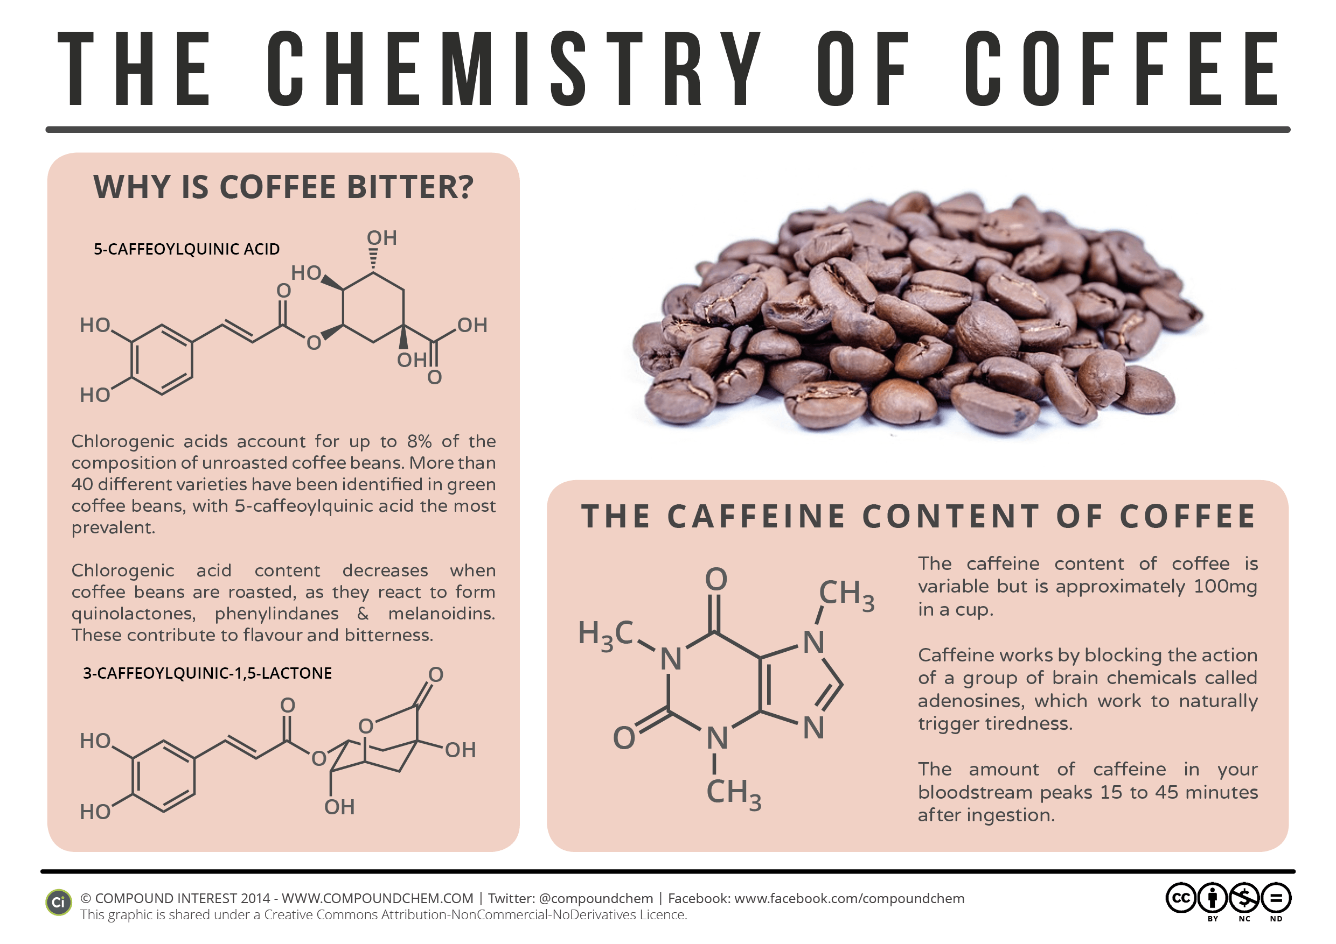
Chemistry: Chlorogenic acid and caffeine
http://www.compoundchem.com/wp-content/uploads/2014/01/The-Chemistry-of-Coffee-Sept-14-v2.png

Slide 13
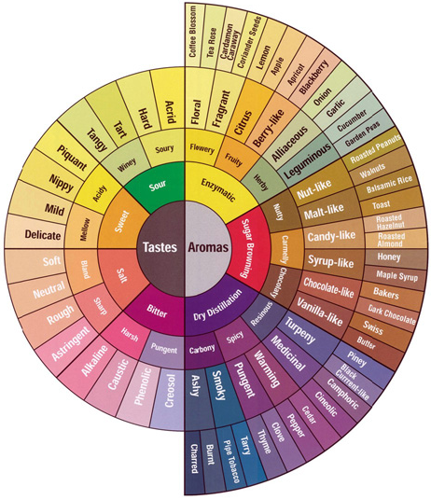
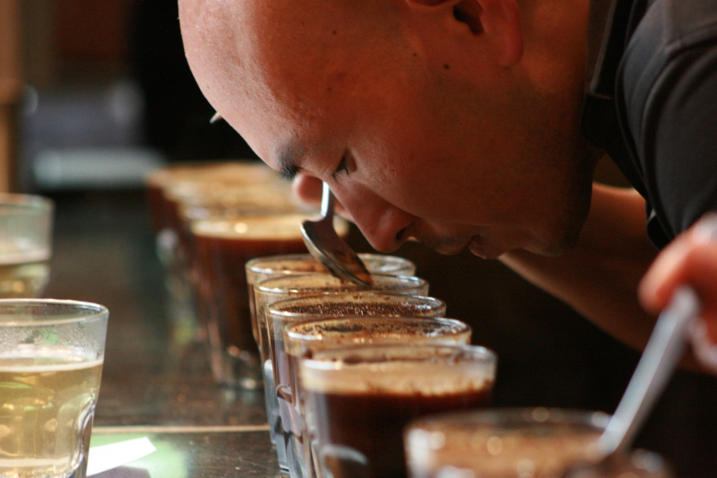
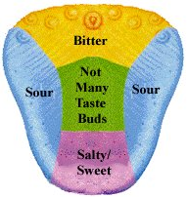
cupping
The process used by professionals to evaluate and compare the characteristics and quality of coffee.
Aroma
Acidity
Body
Flavour
Finish
https://desertsuncoffee.wordpress.com/2011/08/30/experiencing-coffee/
http://wiki.triestecoffeecluster.com/index.php?title=Perception
Notes:
https://desertsuncoffee.wordpress.com/2011/08/30/experiencing-coffee/
Three semi-independent molecular sensors to check the external environment have been identified in mammals:
• The vomeronasal organ (VNO) in the nasal septum is specialized in the detection of particular chemical signals, called pheromones, which are correlated to mating and aggressive behaviours. Recently, evidence of this organ has been found also in humans – to the great joy of perfumers (Meredith, 2001; Thorne et al., 2002).
• The main olfactory epithelium (MOE) in the back of the nasal cavity detects volatiles. Its main features are an extraordinary sensitivity; the human threshold of detection can be as low as 10-11 M for trichloroanisole – rio corky flavour. Humans are thought to be able to discriminate between several thousands of different odours, even if in theory the number is billions, but bloodhound dogs have been shown to detect some odours at a concentration of 10-17 M (Dulac, 2000a), and to possess an extremely large discriminatory power.
• The taste sensory epithelium of the mouth responds principally to water-soluble chemicals present in the oral cavity. Chemicals from food termed tastants dissolve in saliva and contact the taste cells through the taste pores, to give a fast response, in terms of acceptance or rejection, to food to be ingested.
The five primary characteristics used to evaluate coffee; aroma, acidity, body, flavor, and finish are evaluated independently, but it’s important to understand that all five of these features work in tandem to create a truly great coffee.
Aroma is the Godfather of the senses because it requires more than 1,000 receptors in the brain to function, whereas hearing has two receptors and vision has three. It’s estimated that 80% of the “flavor” of coffee is actually aroma. If you think back to the last time you caught a cold and how hard it was to taste the food put in front of you this makes sense. Without smell, we’re lost. Aroma is attached directly to the limbic system, part of the brain that controls emotion, mood, and pain, among others. On the SCAA ( Specialty Coffee Association of America) taste chart, aroma is first broken down into three categories: enzymatic (earthy), sugary, and dry. It’s helpful to focus on these three first before moving onto the next set of subcategories.
Acidity refers to the liveliness in the cup. The verve, the energy. Coffees are celebrated within the competition circuit for having vibrant, piquant, bright, or refreshing acidity. There’s something valuable in having acidity in coffee, and it’s commonly associated with higher quality Arabica beans grown between 2,000 and 7,000 feet above sea level. They’re often sweeter and more flavorful than some of the beans grown at lower elevations so they’re a popular choice for gourmet coffee shops and roasters.
Body refers to the way the coffee feels in your mouth, its heaviness. It’s the tactile impression of weight and texture when you drink the coffee. Body can be thin, light, full, syrupy, or rich. A common method to discern the body of a cup is to add an equal amount of milk to two different types of coffee. The one with the heavier body will retain more of its flavor when diluted.
Flavor comprises two definitions in the coffee world, which sometimes leads to confusion. Flavor refers to the specific taste of the coffee itself, caramel, spice, nuts, chocolate, and also refers to the total impression of aroma, acidity and body combined. If the total experience of drinking the cup of coffee you’re evaluating is pleasant and strong the coffee is described as flavorful, rich, complex, or balanced and can be ranked on a scale.
Finally there’s the finish of the coffee. How long does the flavor stay in your mouth? Is it strong? Does it taste different than during the act of drinking? Aftertaste can be described as strong, light, mild, or bold.
Of course, there’s the act of drinking itself. Your mouth has taste buds, and different parts of your mouth have greater sensitivities to salt, sweet, sour, bitter, and savory.
The best way to improve your tasting and sensory experience when drinking coffee is to actually think about what you’re putting in front of you. We’re often running about town, talking on the phone, or writing correspondence along with drinking our daily coffee. The easiest way to improve your skills is to slow down and actually think about the drink in front of you.
Most of all trust your senses. Your first impression of how something tastes is often correct.
Haptic senses: mouthfeel
Mouthfeel is a tactile sensation perceived by buccal mucous membranes, along with the thermal response due to the temperature of the beverage.
Most of its nature is related to small movements of the tongue against palate and gums, which apply a shear stress to the liquid performing a sort of rheological measurement of viscosity and texture. Body, an important attribute of espresso coffee, is felt in this way and can be considered either as a synonym of mouthfeel or, with astringency, as part of its definition.
It is sometimes claimed that body is a peculiarity of robusta espresso brews, and, as a matter of fact, those beverages ‘fill the mouth’. It is difficult to believe that oil droplets of colloidal size are present in higher amounts in robusta than in arabica espresso, given that the lipids content of roast and ground robusta is much lower than that of arabica (some 9% as opposed to 13%). Cup-testing experiments have been reported, indicating that freshly percolated robusta espresso has actually a stronger body than arabica, but only as a first sensation: if the sip is held in the mouth, after some seconds arabica’s body is still present while robusta’s fades away. Moreover, an inversion of assessment takes place if the beverage is allowed to rest for 2 minutes or so, with arabica again displaying stronger body. It has been postulated that this behaviour could derive from a transient viscosity rise induced by gas bubbles of colloidal size, possibly more evident in robusta (Petracco, 1989).
Haptic senses: astringency
Another tactile sensation, astringency, reminds one of medicine and is always considered as negative. It is related to a chemical phenomenon, namely the precipitation of the proteins of saliva due to specific phenolic compounds present in some beverages and unripe fruits (Rider, 1992). In coffee, it has been ascribed to the presence of immature beans containing dicaffeoylquinic (dichlorogenic) acids (Ohiokpehai et al., 1982), which are deemed to be astringent to mucous membranes. Deplorably, immature beans are nowadays found more and more frequently, because green coffee producers seem to pay less attention to the quality of their crops due to the low price of recent periods.

Slide 14
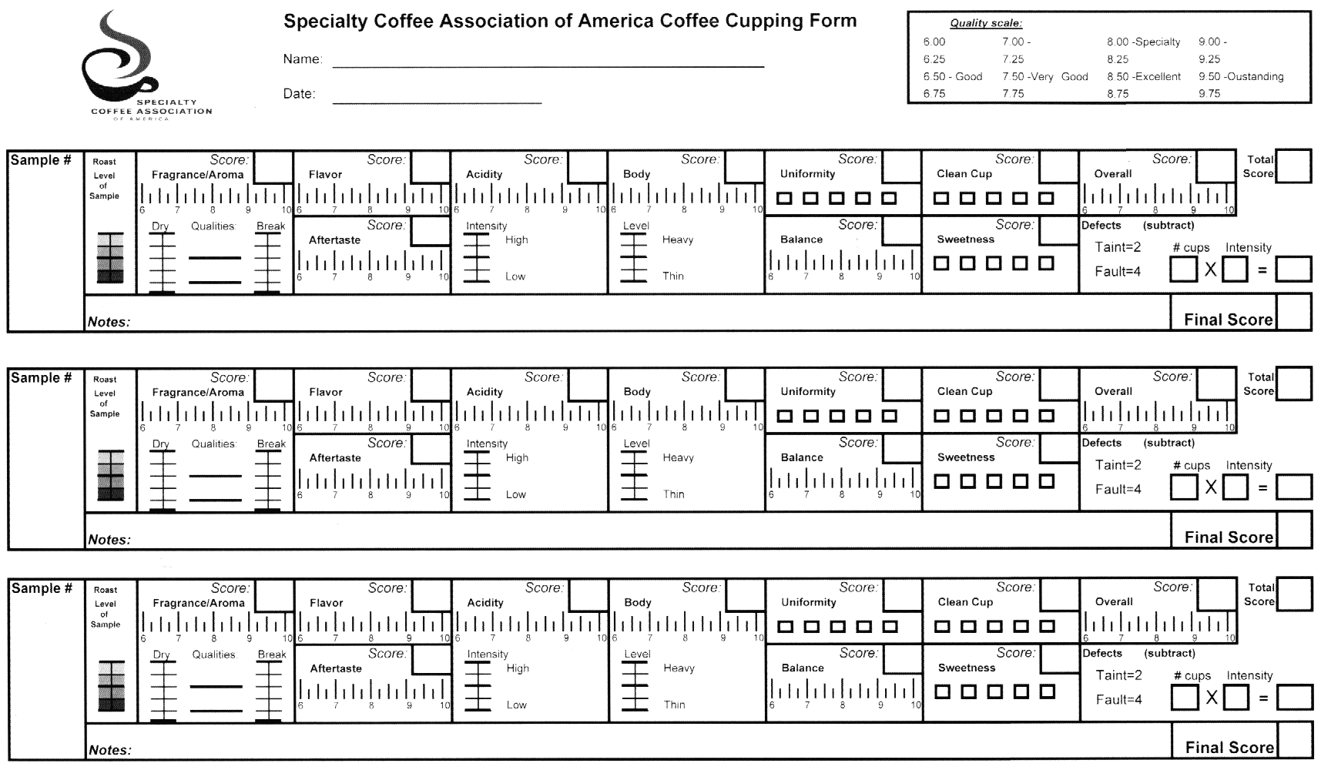
CUPPING
https://roastlog.files.wordpress.com/2010/08/scaa-form.gif
Notes:
http://wiki.triestecoffeecluster.com/index.php?title=Espresso_cupping_technique
Cupping methods followed in the industry are quite heterogeneous. In the following some general rules will be given for a correct cupping procedure. These are valid for all brewing methods, espresso included.
Cupping should be performed alone, without external stimuli, in order to minimize noise and bias introduced by interaction with other assessors.
A sip of some 10–15 ml of coffee should be taken. Salivary-induced changes in pH of sour taste stimuli affect taste perception, and therefore smaller volumes of espresso would be perceived as less sour than larger volumes. Saliva induces an increase of solution pH, and a small quantity (4 ml) can be totally buffered by saliva (Christensen et al., 1987), thus distorting the perception of acidity.
In order to avoid the consequences of caffeine intake, when evaluating many samples a sip-and-spit procedure is recommended. Flavour perception during eating or drinking depends on the movement of odorants released in the mouth via the retronasal cavity to the olfactory epithelium. An accurate analysis of the swallowing process, by means of real-time magnetic resonance imaging (Büttner et al., 2002) has proved (what already was well-known in medicine) that during mastication and swallowing there is no connection to the dorsal oropharynx, the nasopharynx and the airways, preventing leaking and aspiration of food.
When the bolus has left the pharynx, the upper oesophageal sphincter is closed and the larynx, epiglottis and velum palatinum return to their original position, followed by a short pulse of respiration, the so-called ‘swallow breath’, by which volatiles reach the retronasal cavity. A simple proof of this phenomenon can be performed by drinking an espresso with a nose-clip: only 5% of the population would recognize it as coffee.
The ‘slurping’ technique (Heath, 1988), that is the deliberate opening of the velum palatinum border when coffee is in the oral cavity, is used to avoid swallowing and yet perceive the aroma. In this way the amount of volatiles reaching the olfactory epithelium ranges from 30% to 130% of the values observed with swallowing, depending on how effective each panellist is in the control of exhaling (Büttner and Schieberle, 2000).
Frequent rinsing has been prescribed to minimize adaptation of salivary influence to taste perception, as well as to eliminate or minimize saturation or carryover effects, and to enhance discrimination among samples. Palate cleansers are commonly employed in sensory evaluation to rinse the mouth before and in between samples. Despite the widespread use, little literature regarding the effectiveness of these materials or methods is available, and some studies report that no significant differences between palate cleansers were found on any measure (Johnson and Vickers, 2002), unless in very particular test conditions.
When tasting coffee, several main aspects have to be evaluated and their definitions ought to be stated unequivocally. Unfortunately, between areas of investigation there is a wide range of definitions for the same terms used for describing a sensory experience. In the following, a brief survey of most commonly used definitions will be given with a stress on our own interpretation, which tends to align with the consensus in the field of sensory science.
Appearance
Appearance, mainly that of the crema, attracts consumer attention. It has been said that espresso is consumed first by sight. This is true also for other beverages, like wine, where wine tasters create perceptual illusions, describing the odours of a wine according to its colour (Morrot et al., 2001). The crema should be persistent (some minutes), and made up of very small, hazelnut-coloured bubbles.
Gustatory sensations
Gustatory sensations, produced by the beverage’s taste, encompass acidity, bitterness and sweetness (no salt or umami sensations are reported in coffee literature), whose perception-transduction mechanisms have already been discussed.
The stimulus eliciting acidity/sourness sensations acts on the same receptors – and sensory scientists use them as synonyms. Nevertheless, the reaction to it can have both positive and negative connotations, due to the fact that this stimulus is often coupled with other sensations. Therefore, two distinct terms are commonly used in the coffee field, according to the hedonic reaction that the stimulus causes:
• Acidity, a basic taste produced by the solution of an organic acid. The International Coffee Organization defines it as ‘A desirable sharp (producing a strong physical sensation as if of cutting) and pleasing taste is particularly strong with certain origins’ (ICO, 1991), which applies, for instance, to Central American wet-processed coffees.
• Sourness, a different basic taste descriptor that ‘refers to an excessively sharp, biting and unpleasant flavour’ (ICO, 1991). It is used when associated to an astringent or metallic sensation, typical of fast roasted coffees where the short time does not allow the extensive elimination of chlorogenic acids (Ohiokpehai et al., 1982).
As in the case of acidity, the definition of bitterness has hedonic connotations. Bitterness is ‘considered desirable up to a certain level’ (ICO, 1991). When it brings about an unpleasant reaction, the attribute ‘harsh’ (rough or sharp in a way that is unpleasant, especially to the senses) is associated with the product.
In coffee cupping, sweetness is a marker of good quality coffee, and it is often associated with aroma descriptors such as fruity, flowery, ‘chocolatey’ and caramel-like (ICO, 1991).
Olfactory sensations
Olfactory sensations, produced by the beverage’s aroma sensu lato, are commonly described by the terms odour and/or aroma.
Aroma can be defined as ‘the property of certain substances, in very small concentrations, to stimulate chemical sense receptors that sample the air or water surrounding an animal’ (Encyclopaedia Britannica, 2003).
According to the ASTM, it is the ‘perception resulting from stimulating the olfactory receptors; in a broader sense, the term is sometimes used to refer to the combination of sensations resulting from stimulation of the nasal cavity’ (ASTM E253-03). ISO does not give a unique definition, describing it as ‘an odour with a pleasant connotation’, according to English sense and French informal language, or, according to French sense, as an ‘organoleptic attribute perceptible by the olfactory organ via the back of the nose when tasting’ (ISO, 1992a). Other sources characterize aroma as ‘a sensory perception based on one’s olfactory senses; i.e., sense of smell’ (IFT, 2003), or prefer to define it from a chemical point of view, leaving the term odour to describe olfactory perception. One author in the coffee field states that it is due to the volatiles, perceived retronasally after swallowing, or by the ‘slurping’ technique (see above) (Heath, 1988). In other fields of research the definition is applied to pleasant sensations perceived by direct inhalation in non-specialized language (i.e. orthonasally), whereas, technically speaking, aroma is referred to as ‘pleasant sensations perceived indirectly (i.e. retronasally) by the olfactory organ when tasting food or beverages’ (Consejo Oleicola International, 1987).
Odour is the sensation arising from the ‘sniffing’ of the cup (i.e., the volatiles smelled orthonasally). Sensory scientists tend to use the term odour to indicate an ‘organoleptic attribute perceptible by the olfactory organ on sniffing certain volatile substances’ (ISO, 1992a).
Flavour
Flavour is by far the most debated term and it varies according to the field of research. An early sensoric definition was ‘the sensation realized when a food or a beverage is placed in the oral cavity. It is primarily dependent upon reactions to taste and olfactory receptors to the chemical stimulus.
However, some flavours also involve tactile, temperature and pain receptors’ (Beidler, 1958). Several standards have accepted it: for example, ‘complex combination of the olfactory, gustatory and trigeminal sensations perceived during tasting. The flavour may be influenced by tactile, thermal, painful and/or kinaesthesic effects’ (ISO, 1992a). The definition by ASTM is similar: ‘Flavour is the complex effect of the basic tastes, olfactory sensations – perceived retronasally – and chemical feeling factors all stimulated by foods and/or other materials in the mouth’ (Civille and Lyon, 1996). Or, ‘flavour is the combined perception of mouthfeel, texture, taste and aroma’ (British Standards Institute, 1975). A recent definition (Encyclopaedia Britannica, 2003) is: ‘in sensory perception, attribute of a substance (apart from its texture and temperature) that is produced by the senses of smell, taste and touch and is perceived within the mouth. These sensations help to identify substances and are sources of enjoyment when eating and drinking’. One independent author proposes to reserve the term flavour for a pure olfactory sensation (Petracco, 2001): this would ask for a new term to cover the overall feeling produced by aliments in the mouth. Summarizing, we could take as our definition the conclusion from a recent survey (Delwiche, 2003), defining flavour as a complex reaction to chemical stimuli, generated in the orbitofrontal cortex. Taste and smell are considered to be essential in the perception of flavour.
After-flavour
After-flavour is the sensation produced by the lingering of taste and aroma for a while (up to 15 minutes in the case of espresso) after having swallowed a beverage. It might be ascribed to the mouth-coating effect of the espresso, which has been related to the wetting properties of the beverage on the oral cavity, deriving from its surface and interfacial behaviour (Navarini et al., 2002).
Astringency
Astringency, a tactile sensation belonging to ‘mouthfeel’ with a negative connotation for espresso coffee, is described as ‘the shrinking of the epithelium probably related to precipitation of proteins of the saliva, and somehow related to pH viscosity and anion species’ (Smith and Noble, 1997; Sowalsky and Noble, 1998). It is characteristic of an after-taste sensation consistent with a dry feeling in the mouth (ICO, 1991). A typical case is tannic acid, which precipitates gelatine to give an insoluble compound used to perform the task of tanning leather.
Texture
Texture is primarily the response of the tactile senses to physical stimuli that result from contact between the oral cavity and the food. It is a multi-parameter attribute, which derives from the structure of the food and is detected by several senses (Szczesniak, 2002). This is another difficult term to define since it means different things to different people (Bourne, 2002). Texture refers mostly to solid foods. When liquids are studied, other terms are used, like body and mouthfeel.
Body is defined by ASTM as ‘the quality of a food or beverage relating either to its consistency, compactness of texture, fullness, flavour, or to a combination thereof’ (ASTM E253-03). In the coffee field this attribute descriptor is used to characterize the physical properties of coffee beverages (ICO, 1991). We would tend to eliminate olfactory sensation from its definition, and describe the body of an espresso coffee as the integration of tactile sensations due to the interaction between the beverage and the oral cavity, the tongue and the palate. This definition cannot easily be applied to other brewing methods, where differences in tactile properties are minimal and not supported by scientific literature. However, with the term ‘body’ having so wide a range of definitions, and espresso being a typically Italian brewing method, we could propose the Italian term corpo to describe it. Adapting Szczesniak’s definition of texture (Szczesniak, 2002), corpo is a sensory property and, thus, only a human being can describe it. It is a multiparameter attribute not just oiliness or creaminess but a set of characteristics; it derives from the structure of the beverage (molecular, microscopic or macroscopic) and is detected by the senses of touch, pressure and sight (Navarini, 2003).
Mouthfeel is often explained as ‘the mingled experience deriving from the sensations of the skin in the mouth during and/or after ingestion of a food or beverage. It relates to density, viscosity, surface tension, and other physical properties of the material being sampled’ (Bourne, 2002).
The literature on the subject is of little help, apart from the pioneer work of Szczesniak (1979), who performed numerous studies in order to define and measure mouthfeel for a vast range of food and beverages (coffee included). In her survey, commonly used definitions for mouthfeel are categorized. Starting from Szczesniak’s categorization, a set of descriptors, which apply to espresso coffee, can be found. They are divided into viscosity-related terms (thick, viscous), feel on soft tissue surfaces (smooth, creamy), body-related terms (heavy, light, watery), chemical effect (astringent), coating of oral cavity (mouth-coating), resistance to tongue movement (syrupy), after-feel in the mouth (lingering). Body thus represents a category of mouthfeel, relating to sensations apparently caused by the denseness of the rheological structure, therefore purely tactile. However, most terms in this group can be interpreted as having both flavour and mouthfeel characteristics (Szczesniak, 1979).
When dealing with coffee in general many definitions are found, most of them relating mouthfeel with olfactive properties connected to the intensity of the aroma perceived (Pictet, 1989), and describing it with rather vague terms such as ‘rich’ or ‘round’. But, according to the International Coffee Organization, the descriptor mouthfeel comprises only body ‘to describe the physical properties of the beverage’, and astringency, ‘characteristic of an after-taste sensation consistent with a dry feeling in the mouth’ (ICO, 1991).
With regard to espresso, little is found in the scientific literature, where body is linked with physical parameters like viscosity or dry matter (Petracco, 1989). The body of an espresso coffee is, in our opinion, better described as a purely tactile sensation due to the interaction between the beverage and the oral cavity.
To conclude, it must be pointed out that words that have different meanings to different panellists (i.e., words that a panel might have difficulty reaching agreement on) should be avoided at all costs. Therefore, an accurate definition of the vocabulary must be developed, on which every panellist should agree.
Psychophysical measurement: from stimulus to perception
Psychophysical studies require essentially two parameters: the variation of specific aspects of a physico-chemical property of the stimulus, and the measurement of a dimension of the subject’s response. Therefore a fundamental issue of sensory studies is the correct delivery of the stimulus.
Only in this way can we hope to get a reliable answer from an instrument (in our case, a panel) that is characterized by a low signal-to-noise ratio and presents problems with offset, gain and drift with time.
It is highly probable that different judges will have different thresholds of perception for chemical compounds (both gustative and olfactive) (Bi and Ennis, 1998; Bartoshuk, 2000; Linschoten et al., 2001); also, thresholds and sensitivity change with age (Doty, 1989). The rating of two assessors on an intensity scale will differ, even if the same stimulus is applied. Furthermore, perception scales are non-linear, meaning that when the concentration of the stimulus is doubled, a double intensity on a perception scale will seldom be rated. Finally, the repetition of the delivery of the stimulus over time (e.g., coffee brewed from the same blend in successive days) will not lead to the same answer from the panel (Vanne et al., 1998).
These problems lead to the following considerations. The number of panellists involved in an evaluation must be high enough to assure an averaging of the responses, representative of the population. Relying on the judgement of just one or a few assessors for determining the sensory properties of one product can be misleading because of specific anosmias or hypersensitivity of the judge. The number can be determined by simple algorithms, starting from a binomial distribution, in the case of discriminative tests. Once the significance of the result is set; as far as profiling is concerned, the assumption is that the scores given by the judges would distribute around an average value with normal distribution. Thus, analysis of variance (ANOVA) procedures can be followed to evaluate the characteristics of the product. In this case the central limit theorem states that the minimum number of measures for a distribution to be approximated to a normal distribution should be 10. This requirement can be met in a university laboratory performing basic tasks, but it is seldom fulfilled in industry’s everyday experience. However, the risk of reducing the number of assessors in a panel too far must be kept in mind. A cost–risk analysis should be performed before planning the campaign.
In order to perform an analytical task, such as discrimination between products or profiling, the panel must be recruited, checked for sensitivities, then calibrated and trained, in order to share a common vocabulary and provide homogeneous results. Continuous monitoring of the panel should be done to check for possible outliers and to verify when recalibration might be needed (McEwan, 2001; Stucky et al., 2001).
A set of ISO Standards has been developed in order to assure maximum reliability of the results. They deal with the design of the test rooms (ISO, 1988a), the recruitment and training of the panel (ISO, 1992b, 1993, 1994a) and propose the descriptive and discriminative tests (ISO, 1983a, 1983b, 1985a, 1985b, 1987a, 1987b, 1988b, 1991a, 1991c, 1992a, 1994b, 1994c, 1999a, 1999b, 2002a) to be performed. As far as coffee is concerned, there is one standard on sample preparation and one on vocabulary (ISO, 1991b, 2002b).
Statistical analysis of sensory data
Once data have been collected, they have to be ‘transformed’ into results.
Because of the complexity of the stimulus and the low signal-to-noise ratio, sophisticated statistical techniques must be employed, in order to obtain reliable results.

Slide 15
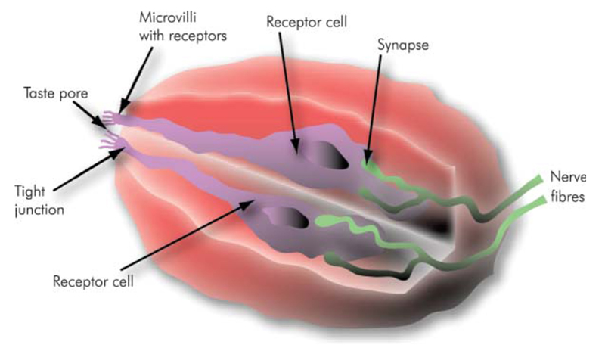
More on taste (Gustation)
Tastebud with two receptor cells (Lindemann, 2001). On the top surface of the bud, microvilli are noticeable; on the bottom part the synapses are shown. Tastants enter the bud through the pore, are processed in the cells, and a signal is sent to the brain by the nerve fibres.
http://wiki.triestecoffeecluster.com/index.php?title=Gustation
Notes:
Gustation has been studied for many years, but only recently has progress in genetics and molecular biology enabled greater understanding of its fundamental characteristics, namely reception and transduction mechanisms.
Lately many reviews have appeared, among which should be mentioned (in alphabetical order) Dulac (2000a), Kinnamon (2000), Lindemann (2001) and Smith and Margolskee (2001).
Even though people often use the word ‘taste’ to mean ‘flavour’, in the strict (and correct) sense, the word is applicable only to the sensations coming from specialized cells in the oral cavity. Gustation or taste is the sensory system whose scope is essentially an evaluation of the food to be ingested, and in fact all organisms, be they bacteria or mammals, perform this check by chemoreceptive evaluation. Taste evolved in order to help organisms to detect hazardous substances, such as acids or alkaloids, and to recognize nutritionally important compounds like sugars, salts and aminoacids (Lindemann, 2001). Actually, even a few days’ old baby is able to discern between sweet and bitter and react with a smile when tasting a sweet substance, or with a cry when tasting a bitter one (Ganchrow et al., 1983).
While the olfactory system can recognize and discriminate a huge number of different odours in humans, the taste system discriminates only a few basic taste qualities: sweet, salty, sour, bitter and umami – the sensation elicited by monosodium glutamate.
Taste receptor cells (TRCs) supply information for the recognition and response to the nutrients we need. The sweet taste of sugars, for example, is a stimulus for eating carbohydrate-rich foods. Salty and acid tastes are markers for ions in food: evidence is reported that humans and other animals with sodium and other dietary deficiencies will seek foods rich in sodium and minerals, as well as vitamins (Smith and Margolskee, 2001).
Umami can be considered a signal coming from protein-rich food, whereas the perception of bitterness is fundamental for its protective role, since many harmful substances, like strychnine and other alkaloids, often present a strong bitter taste (Dulac, 2000a). The sour taste of spoiled foods also contributes to their avoidance. All animals, including humans, generally reject acids and bitter-tasting substances at all but the weakest concentrations. And in fact thresholds of perception are very different, ranging from about 10-10M for denantonium benzoate (benzyldiethyl [(2,6-xylylcarbamoyl)methyl] ammonium benzoate), the most bitter substance known, to 8 x 10-4 M for citric acid and 9 x 10-3 M for sucrose.
Taste signals also evoke physiological responses, such as insulin release, that aid in preparing the body to use the nutrients effectively. Individual taste stimuli, even within one quality, often differ greatly in molecular size, lipophilicity and pH (Kinnamon, 2000). For example, as far as sweet taste is regarded, the molecular weights can be as low as 92 for glycerol, up to 180 for glucose, 205 for saccharin, 342 for sucrose, but also as high as 11 233 for monellin or 22 204 for thaumatin.
It is easy to understand that there may be multiple mechanisms for transducing even a single taste quality such as sweetness. Moreover, there is a wide range of variation in people’s sensitivities to compounds belonging to the same ‘taste-category’ (Delwiche et al., 2001), and in fact some researchers provocatively assert that there may not be any ‘fundamental’ tastes (Ishii and O’Mahony, 1987; Delwiche, 1996). The division of responses to taste stimuli into five types might be nothing but a useful categorization that humans do, according to the particular function that the molecules associated to those chemical stimuli have.
Reception: Taste Buds
A field of taste research is devoted to the comprehension of how molecules corresponding to the taste qualities become electrical signals that carry information to the brain about what substance is in the mouth. This process is called transduction and starts in the oral cavity.
Human TRCs can be found as single cells or packed in onion-shaped structures called taste buds (Figure 1), which consist of up to one hundred cells. Taste buds are located predominantly on the tongue, but can be found also in the soft palate, in the epiglottis. The taste marker molecule gustducin can be found even in nasal mucosa and in the stomach (Lindemann, 2001).
Gustducin is a taste-specific G-protein: the name ‘G-protein’ derives from the fact that the activity of such proteins is regulated by a chemical called guanosine triphosphate (GTP).
G-proteins are made up of three subunits: an α subunit that can be considered the active portion, and β and γ subunits that regulate. When a tastant binds to G-protein coupled receptors (GPCRs) on a taste cell’s surface, the α subunit dissociates from the βγ portion, and activates a nearby enzyme. The enzyme starts a transduction cascade, ending with a firing of an electrical impulse, which is sent to the brain. The same transduction mechanism can be found in olfaction.
In humans the tongue contains around 5000 taste buds, but the number of buds can vary considerably from one person to another. Most of taste buds on the tongue are located within specialized structures called papillae, which give the tongue its velvety appearance (Smith and Margolskee, 2001).
Taste buds in the anterior two-thirds of the tongue reside in fungiform papillae, each containing one or at most a few taste buds. The posterior region of the tongue contains the papillae circumvallatae and the papillae foliatae, each of which contains hundreds of taste buds (Dodd and Castellucci, 1991). The most numerous papillae on the tongue, called ‘filiform’, lack taste buds and are involved in tactile sensation.
Taste coding in the brain:
Many research papers on animals and humans demonstrate that there is not always a strict correlation between taste quality and chemical class, particularly for bitter and sweet tastants. Bitter compounds can be salts like magnesium sulphate, aminoacids like L-phenylalanine, alkaloids such as caffeine, or glycosides of phenolic compounds (naringin in grapefruit).
Many carbohydrates are sweet but some are not. Furthermore, very disparate types of chemicals can evoke the same sensation: the chemical structures of artificial sweeteners aspartame and saccharin have nothing in common with sugar. On the contrary, the compounds that elicit salty or sour tastes are less diverse and are typically ions.
Coding in the periphery of the taste system could occur at two levels: taste receptor cells and afferent fibres. In principle, a taste receptor cell could be tuned to a single modality (e.g., sweet, sour, bitter, or salty), or to more than one modality. Likewise, subsets of cells having similar response profiles could be innervated by a common fibre, or single fibres may carry information from different types of cells. Whether and how individual taste cells respond to multiple chemical stimuli is still a matter for debate.
Salty and acid tastes:
Two tastes can detect ions in the oral cavity: salty and sour.
Salty taste can regulate the assumption of NaCl and other minerals, and it is therefore very important for homeostasis processes; it is elicited by many ionic species, but the component that is probably most important, and surely most studied, is the one due to the presence of sodium ions. Sodium ions penetrate into TRCs through Na-channels, which are located on the top or lateral surface. The accumulation of sodium ions leads to an electrochemical change, called depolarization, which eventually is transformed into an electrical impulse that is sent to the brain through nerve cells. TRCs then repolarize, that is, reset.
Na+-channels play a role in NaCl taste transduction, as well as in the transduction process of other salts, like KCl or NH4Cl. Thus salty taste detection and transduction can both depend on the use of certain combinations of common and specific transcellular pathways (Lundy et al., 1997).
Acidity can be considered a quality in many foods and beverages when of low intensity, and it is in fact a marker for good quality coffee, but it becomes unpleasant as intensity grows (Ganchrow et al., 1983). Its role for the organism could be to give an alarm for an unripe fruit or spoiled food. Acids taste sour because they dissociate into hydrogen ions (H+) in solution. Those ions act on a taste cell in three ways:
• By directly entering the cell as ions or undissociated weak acid.
• By blocking potassium ion (K+) channels on the microvilli: K+-channels are responsible for maintaining the cell membrane potential at a hyperpolarized level. Block of these channels causes a depolarization, Ca2+ entry, transmitter release and increased firing of electrical signals.
• By binding to and consequently opening channels and thus allowing other positive ions to enter the cell. These positive charges eventually depolarize the cell and an electrical signal is then sent to the brain.
A fundamental issue surrounding sour taste reception is the identification of the sour stimulus. It must be pointed out that no strong correlation has been found between the pH of a solution (e.g., coffee) and the perceived sourness, even if to some extent the intracellular pH of taste cells is correlated with extracellular changes in pH (Figure 2). Recently a hypothesis has been successfully tested, that acids induce sour taste perception by penetrating plasma membranes as H+ ions or as undissociated molecules and decreasing the intracellular pH of TRCs.
The results evidence that taste nerve responses to weak acids (like acetic acid) are independent of stimulus pH but correlate strongly with the intracellular acidification of polarized TRCs (Lyall et al., 2001).
With regard to coffee, there is so far no clear consensus (Woodman, 1985; Heath, 1988; Balzer, 2001) as to which acids are the most important in determining acidity by pH measurement and perceived acidity, and whether pH or titrable acidity (Maier, 1987) is a good chemical estimator for perceived acidity. Extending the above-mentioned results to humans, titrable acidity at pH 6.5, which is the average pH of human saliva, can be considered the optimal chemical measure of perceived acidity.
Bitter and sweet tastes
The sensations of bitter and sweet tastes derive from the interaction of tastants with GPCRs in the apical membranes of TRCs. The top surface of TRCs, which makes contact with the oral cavity, is rich in microvilli containing GPCRs, ion channels and other transduction elements. The lateral region of TRCs contains ion channels and synapses with afferent taste nerves (Margolskee, 2002).
Like acidity, bitterness is also acceptable when of low intensity, but it becomes absolutely disagreeable when intense. It is usually associated with the idea of something harmful, and in fact many toxic substances (as nicotine and strychnine) taste bitter. Bitterness is elicited by a number of chemically heterogeneous substances, but they present the same transduction mechanism, through GPCRs and second messengers. By scanning mouse genomic databases, a group of new GPCRs, the T2R family, was discovered in 2000 by different research groups (Adler et al., 2000; Chandrashekar et al., 2000; Matsunami et al., 2000). This family of receptors is very large, consisting of 40–80 genes, thus explaining the large number of different bitter-tasting compounds. In humans, the T2R family comprises more than 20 genes coding for GPCRs.
Sweet taste is mainly caused by soluble carbohydrates, and it may represent a stimulus for the intake of calorie-rich food. However, a large number of non-carbohydrate molecules are also sweet. Sweet taste elicits a strong hedonic effect (Ganchrow et al., 1983). Like bitter stimuli, sweet tastants also bind to GPCRs on a taste cell’s surface and trigger the downstream process of secondary messengers, which eventually send the electrical impulse to the brain. The candidate receptor for sweet taste is T1R3, a GPCR, which was found simultaneously by four laboratories in 2001, by means of the latest tools and techniques of genetics and molecular biology (Nelson et al., 2001; Montmayeur et al., 2001).
Ultimately, the study of sweet taste perception should help us explore the hedonic aspects of taste and perhaps understand why ‘a spoonful of sugar helps the medicine [and the cup of coffee] go down’ (Sherman and Sherman, 1964).
Umami taste
Umami, a term derived from the Japanese umai (delicious), corresponds to a taste sensation that is qualitatively different from sweet, salty, sour and bitter. Umami is a dominant taste of food containing L-glutamate, like chicken-broth, meat extracts and ageing cheese. The biological significance of this basic taste, discovered about 100 years ago, is comparable to that of sweet taste, being elicited by protein-rich food.
A taste receptor for L-glutamate could be linked to one of the receptors for glutamate already known from neuronal synapses. Starting from this hypothesis, Roper and colleagues (Chaudhari et al., 2000) found a subset of gustative cells which presents a structure adapting the receptor to the concentrations of glutamate present in food: thus a receptor has been identified which responds to aminoacids.
Other laboratories (Matsunami et al., 2000; Nelson et al., 2002), have identified and characterized a mammalian aminoacid taste receptor, which respond to L-aminoacids and monosodium glutamate, belonging to another family of genes, sharing many analogies with T2Rs, recognized as receptors for bitter compounds.
Umami stimuli are known to bind to G-protein-coupled receptors and to activate second messengers. But the intermediate steps between the second messengers and the release of neurotransmitters are unknown.
Challenging the tongue map myth
One of the greatest myths about taste – which is unfortunately still found in textbooks – is the so-called ‘tongue map’, showing a regional specialization of the tongue for a particular taste quality, indicating that sweetness is detected by taste buds on the tip of the tongue, bitterness at the back and saltiness and acidity on the sides.
The misconception arose early in the twentieth century as a result of misinterpretation of a German work (Hänig, 1901), and still resists in the literature. In the actual research it had been, on the contrary, determined that each chemoreceptive area of the human tongue responds to each of the qualities of sweet, sour, salty and bitter taste. Only minor differences in subjective sensitivities, computed as the inverse of the detection threshold, were noted across areas (Lindemann, 2001). The misinterpretation and the lack of check of the original reference led to an interesting graphical ‘evolution’ of those images, providing the impression of specialized areas for taste reception. In reality, taste buds responsive to each category of taste stimuli are found in all regions of the oral cavity, even if with minor differences; moreover, each individual taste bud contains taste cells with sensitivity to the different types of tastants. Taking bitter compounds as an example, some of them are perceived more intensely on the tip of the tongue, others on the back of the tongue and others in the throat after swallowing. The lack of specificity of individual taste buds across the tongue is directly confirmed by the large distribution of the T2R genes in taste buds of all types of papillae (Dulac, 2000a).
PROP sensitivity as a marker for food choice
There are both cultural and genetic reasons why we perceive foods differently, and have different habits as far as eating is regarded. For example, thresholds of perception and sensitivity to a bitter compound called 6-N-propylthiouracil (PROP) vary enormously across individuals. The differences are so sharp that scientists tend to categorize people into ‘non-tasters’, ‘tasters’ and ‘super-tasters’, according to their sensitivity to PROP (Bartoshuk, 2000). The general dislike of bitterness led early investigators to suspect that ‘tasters’ and ‘super-tasters’ would tend to dislike bitter foods, coffee included.
However, other scientists are more sceptical (Mattes, 2002). While significant differences in bitter taste perception have been observed under laboratory conditions, their impact on actual food choices and eating habits may be limited. The research has not reached a definitive answer.
As far as coffee is concerned, out of respondents who consumed drip coffee, tasters were more likely to drink coffee with milk/cream and sweetener than non-tasters were. Conversely, a greater percentage of nontasters preferred their coffee black as opposed to tasters (Ly and Drewnowski, 2001).

Slide 16
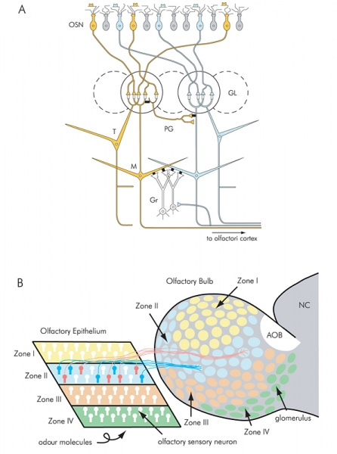
More on Smell (olfaction)
Memories associated with odours are linked to emotions; conversely they appear to play a special role for memories: it is the ‘Proust effect’. In À la recherche du temps perdu, French novelist Marcel Proust described his feelings after consuming a spoonful of tea in which he had soaked a madeleine:
The taste [meaning, of course flavour] was that of a little piece of madeleine which on Sunday mornings in Combray . . . my Aunt Leonie used to give me, dipping it first in her own cup of tisane . . . Immediately the old grey house on the street, where her room was, rose up like a stage set . . . and the entire town, with its people and houses, gardens, church, and surroundings, taking shape and solidity, sprang into being from my cup of tea.
What if he had been drinking an espresso?!?
Schematic synaptic organization circuit, from the olfactory sensory neurons (OSNs) to higher regions in the brain (Mori et al., 1999). The olfactory epithelium is mapped onto the olfactory bulb in the brain with a convergent topography. Axons from OSNs expressing the same odorant receptor converge to defined glomeruli.
Odours: Volatile and hydrophobic
http://wiki.triestecoffeecluster.com/index.php?title=Olfaction
Notes:
Despite the aesthetic and emotional role to which humans have confined olfaction, for most animals it represents a fundamental sense, on which they rely in order to recognize predators or preys, food, kin and mates. Today’s big challenge of olfaction research is to understand how scents are recognized and how recognition of odours in the nose is transferred to the brain to provide interpretation. Coffee, for example, emits a specific combination of some 1000 different odour molecules (Flament, 2002): therefore the central olfactory system has to integrate signals from a huge number of odorant receptors (OR) in order to provide recognition and interpretation, which in the end is translated into a smile of appreciation for a lovely sensory experience or a grimace for unsatisfied expectations.
Olfaction is the chemical sense whose scope is to inform the organism about the chemical composition of the environment. The breakthrough for understanding the mechanisms of this sense came in 1991 with Buck and Axel’s discovery of the genes encoding ORs in mammals (Buck and Axel, 1991), and since then new findings appear regularly in scientific journals, adding to our understanding of this sense. Among the latest reviews on the subject are (in alphabetical order): Axel (1995), Doty (2001), Firestein (2001), Leffingwell (2002), Mombaerts (2001a).
The human nose is an extremely sophisticated device of molecular recognition, still far superior to the electronic noses found on the market (Mombaerts, 2001a). A common misconception is that humans can smell some 10 000 odours; this view arises from confusion between detection, discrimination and identification of odours. Theoretically there is no upper limit to the number of possible detected smells. It is true, however, that humans are very good at detecting odours, but lack the ability to identify them. In other words, our lives are not ruled by smells, whereas odours and chemical signals in general play a fundamental role in the life of most animals, from basic tasks like finding foods to complex functions, like social behaviour.
When we smell an odour out of its normal context (e.g. in a laboratory vial), it is very common to experience the ‘tip-of-the-nose’ phenomenon: we are familiar with it, but just cannot remember its name (Pines, 2001). That is, it is easier to recognize the scent of coffee in a coffee shop than in a theatre, because the context helps to narrow down the list of potential odours. Moreover, the emotional role of smell is high.
Memories associated with odours are linked to emotions; conversely they appear to play a special role for memories: it is the ‘Proust effect’. In À la recherche du temps perdu, French novelist Marcel Proust described his feelings after consuming a spoonful of tea in which he had soaked a madeleine:
The taste [meaning, of course flavour] was that of a little piece of madeleine which on Sunday mornings in Combray . . . my Aunt Leonie used to give me, dipping it first in her own cup of tisane . . . Immediately the old grey house on the street, where her room was, rose up like a stage set . . . and the entire town, with its people and houses, gardens, church, and surroundings, taking shape and solidity, sprang into being from my cup of tea.
What if he had been drinking an espresso?!?
What are odours?
As far as odorants are concerned, olfaction scientists have to face a complex problem: there is no ‘smell scale’, and odorous molecules vary widely in chemical composition and three-dimensional shape (Pines, 2001): there is no comparison with sight, where wavelengths and corresponding colours can be placed on a linear scale. Represented in the olfactory repertoire are aliphatic and aromatic molecules with varied carbon backbones and diverse functional groups, including (in alphabetical order) alcohols, aldehydes, alkenes, amines, carboxylic acids, esters, ethers, halides, imines, ketones, nitriles, sulphides and thiols (Firestein, 2001). The requirements a molecule must fulfil in order to be an odorant are that it should be volatile and hydrophobic. These requirements can be due to the fact that molecules have to reach the nose and have to pass through membranes. Moreover, their molecular weight should be less than approximately 300 daltons (one dalton is one-twelfth the weight of an atom of 12C).
Actually, the largest known odorous molecule is labdane, which has a molecular weight of 296. There is no definitive explanation of this requirement, although there may be some clue in that vapour pressure (and therefore volatility) decreases rapidly with molecular size.
Conversely, some of the strongest odorants present high molecular weights. Moreover, ‘the cut-off point is very sharp: for example, substitution of the slightly larger silicon atom for a carbon in a benzenoid musk causes it to become odourless’ (Turin and Yoshii, 2003). Another hint of the correlation between dimension and chemoreception is that occurrences of specific anosmias are correlated with the molecular weight.
Anosmia (from the Greek; a [no] osmia [smell]), or, more correctly hyposmia, is the decreased sensitivity to some or all odorants. Everybody is anosmic to some compounds, and there are molecules to which up to one-third of the human population is hypo-osmic, as, for example, benzyl salicylate.
Physiology: olfactory sensory systems, olfactory sensory neurons, olfactory epithelium, glomeruli
Receptors of three different neural systems can be found in most land mammals. They are located in the nasal cavity, and their role is to check the external environment. The main olfactory system is the sensor of the environment, responsible in large part for the flavour of foods and beverages. Additionally, this system serves as an early warning system for spoiled food and noxious or dangerous environmental chemicals.
A second olfactory system (the vomeronasal system) has developed for the specific task of finding a receptive mate (Dulac, 2000b). The nature of vomeronasal sensations, if any, is unknown to humans (Doty, 2001), even if chemical communication appears to occur (Meredith, 2001).
The trigeminal system provides a response to both chemical and nonchemical stimuli, inducing somatosensory sensations (e.g. cold, hot, spicy and tickling), and provoking reactions, secretion of mucus and halting of inhalation, in order to minimize possible damage to the organism.
Odorant stimuli are detected by olfactory sensory neurons (OSNs) located in the olfactory epithelium (OE), which is situated in the dorsal part of the nasal cavity. The OE is only a few square centimetres wide and it is composed of some millions of OSNs, which are generated in situ from supporting stem cells. Like in other epithelia, cell renewal persists throughout adult life to replace OSNs, which have a lifespan of weeks to months (Mombaerts, 2001a). The OSNs are bipolar neurons with a single dendrite that reaches up to the surface of the tissue and ends in a knoblike swelling with some 20–30 very fine projecting cilia. These cilia, which actually lie in the thin layer of mucus covering the tissue, are now known to be the site of the sensory transduction apparatus. A thin axon projects from the cell directly to higher brain regions (Dodd and Castellucci, 1991) (Figure 1a).
The OE is a complex melange of different OSN populations randomly distributed, with the aim of maximizing the probability of interaction of an odour molecule with its receptor. All axons of OSNs which express a particular receptor, no matter what their position is in the OE, converge to a single ‘target’ in the olfactory bulb (Mombaerts, 1999), called glomerulus. Glomeruli are spherical specialized synaptic arrangements, in which thousands of axons from OSNs converge (Firestein, 2001).
Olfactory glomeruli have been viewed as functional units since they were first described in the nineteenth century, but their role was unknown until the discovery of odorant receptor genes. A century after its anatomical description, molecular biology has proved that a glomerulus receives the axonal input from OSNs that express a particular OR gene, thus providing for integration of information and for an increase in the signal-to-noise ratio (Mombaerts, 2001a). The concept of glomerular convergence is consistent with a widely accepted view of olfactory coding, in which the particular combination of activated glomeruli informs the brain on what the nose is smelling (Buck, 1996).
Sensory information is processed within the bulb and relayed to the olfactory cortex and several other centres in the brain, where it gives rise to the olfactory perception of, for instance, coffee. The olfactory pathway is unique among the senses because in olfaction the cell detecting the stimulus, the OSN, is a neuron that projects its axon directly to the brain (Mombaerts, 2001b).
Olfactory receptor genes
Scientists have long been convinced that receptor proteins capable of recognizing and binding odorants are on the cilia in the OE, but the discovery happened only in 1991, when Buck and Axel found the family of transmembrane proteins that were believed to be the ORs and some of the genes that encode them, thus giving a partial answer to how the OS responds to the thousands of molecules of different shapes and sizes, i.e. the odorants, and how the brain makes use of these responses to discriminate between odours (Buck and Axel, 1991). They cloned and characterized 18 different members of an extremely large multigene family that encodes the seven transmembrane proteins whose expression is restricted to the OE. All the proteins they found contained sequence similarity to other members of the ‘G-protein’ coupled receptor family (Leffingwell, 2002).
A second giant step in understanding the olfactory reception process happened in 1998, when Firestein and colleagues (Zhao et al., 1998) proved by experiment, measuring the electrical activity in the neurons, what Axel and Buck had found were actually ORs. In 2001, Lancet and co-workers reported a first draft of the human OR repertoire through a data-mining process (Glusman et al., 2001). This dataset includes 906 human OR genes, of which more than two-thirds seem to be pseudogenes (i.e., unexpressed genes) (Mombaerts, 2001b). This extremely high number of genes for ORs in the mammalian genome (it is always approximately 1000) makes it by far the largest family of GPCRs, and probably the largest gene family in the entire genome (Firestein, 2001).
This family represents 1% of the genome, which means that, at least in animals like dogs or rats, where almost all genes are expressed, 1 out of every 100 genes is used for the detection of odours. This astounding number of genes reflects the crucial importance of smell to animals (Pines, 2001).
Transduction and processing in the brain
Once the receptor has bound an odour molecule, a cascade of events is initiated that transforms the chemical energy of binding into a neural signal, which is sent to the brain.
The ligand-bound receptor activates a G-protein, causing a cascade of events that ends with the firing of an electrical signal to the brain. The central olfactory system receives the odour molecule information through axons of sensory neurons. The information is processed and integrated as the olfactory quality of objects. The human perception of an odour is characteristic in that it is usually associated with pleasant or unpleasant emotions (Mori et al., 1999). In order to understand the rules for interpreting the olfactory stimuli, it is useful to use a ‘molecular receptive range’ for OSNs (Figure 1b). Individual OSNs express only one type of OR gene out of a repertoire of up to 1000 genes. It appears that to match the ability of organisms to detect far more than 1000 odours, the odours must participate in some kind of combinatorial processing: that is, one receptor must be able to interact with several discrete odorants. Olfactory sensory neurons should respond to many odorants with varying affinities. Conversely, an odour molecule should interact with more receptors. In other words, an individual odour will activate multiple glomeruli in the olfactory bulb, and different odours activate overlapping but nonidentical patterns of glomeruli. One particularly striking case involves enantiomers (molecules that are optical isomers, or mirror images, of one another).
It seems that receptors that recognize similar odours tend to stimulate the same area of the olfactory bulb (Figure 1b) (Firestein, 2001). Recent studies have proved that the olfactory axon projection follows a specific convergence pattern towards glomeruli (Mori et al., 1999). There are specific zones of activity in the olfactory bulb, caused by odour-specific patterns. These zones seem to correspond to individual glomeruli, since there is a correspondence between the size distribution of the discrete responses and the size distribution of glomeruli (Bozza and Mombaerts, 2001).
Despite these findings, the basic understanding of the functional organization of the axonal projection to the olfactory cortex and of the neuronal circuits in the olfactory cortex is still unknown. The next fundamental step will be therefore the comprehension of the neuronal mechanisms by which the olfactory cortex combines or compares signals from all different glomeruli (Mori et al., 1999).
How many odours can we detect?
Different figures are given in the literature on the number of odours humans can detect, ranging from approximately 2000 to more than 100 000. Theoretically there could be billions, based on the possible combinations of 1000 receptors. In fact, the question is probably irrelevant, just as it makes little sense to ask how many colours or hues we can see (Firestein, 2001). Perfumers, chefs, sommeliers, coffee cuptasters or highly trained animals can discriminate more odours than the average, but this is due to experience, not to a difference in the ‘measurement instrument’. Physical chemistry may be the primary limiting factor, as odour chemicals must possess a certain volatility, solubility and stability to act on the nasal sensory tissue.
The variable sensitivity of individual glomeruli produces distinct maps for different odorant concentrations. It seems that odorants and their concentrations can be encoded by distinct spatial patterns of glomerular activation (Rubin and Katz, 1999). For example, methanethiol, which smells like rotten cabbage at high concentrations, has a sweet coffee-like aroma at low concentrations (Flament, 2002). However, most odours remain constant in their quality over orders of magnitude of concentration. Amylacetate, a pleasant fruity smelling substance also found in coffee aroma, can be easily identified at concentrations from 0.1 μM to 10mM (Firestein, 2001).
Cross-cultural differences
Social and cultural cues provide another interpretation of non-sensory influence on perception, and are potent modulators of responses to odours and foods. Cross-cultural studies show how cultural experience can affect expectations, thereby altering sensory perception (Cristovam et al., 2000; Hübener et al., 2001; Prescott et al., 2002).
Much work has been carried out in the past decade, with increasingly accurate and standardized psychophysical tests leading to the following broad results, reported by Doty (2001):
• Women, on the average, have a better sense of smell than men – superiority that goes beyond cultures and is noticeable already at the age of four; they also retain the ability to smell longer than men.
• There is a substantial genetic influence on the ability of humans to identify odours.
• Starting about in the fourth decade of life, many individuals begin to notice a gradual decline in their ability to smell, affecting both sensitivity and ability to identify odours. Because olfactory stimulation makes up a major component of food and beverage flavours, people with olfactory decrements often report a diminished ability to taste. A major loss of olfactory function occurs after age 65, with over half of those between 65 and 80, and over three-quarters of those 80 years of age and older, having such loss.
• The decrement in olfactory function associated with smoking is present in former smokers and recovery to pre-smoking levels, while possible, can take years, depending on the duration and amount of past smoking.
• The olfactory function is compromised in urban residents and workers in various industries.

Slide 17
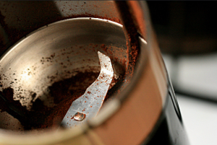

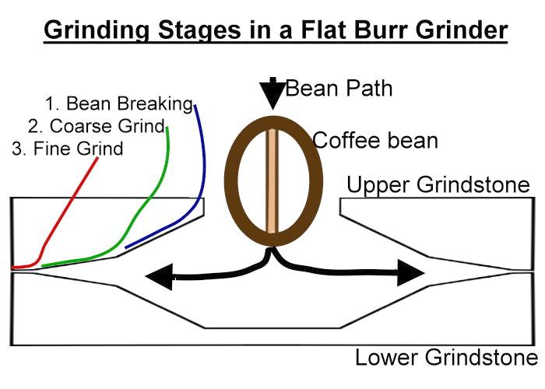

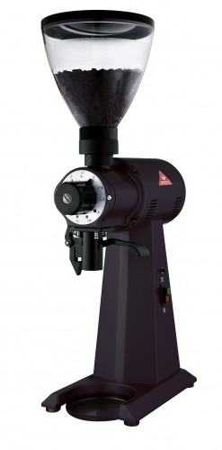
grinding
http://www.coffeeomega.co.uk/image/cache/data/Makhlkonig/EK43%20T%20Black-500x500.jpg
http://knowyourgrinder.com/wp-content/uploads/2015/01/556x191xconical-vs-flat-burrs.jpg.pagespeed.ic_.Xf8EBm0s8R.jpg
https://static.prima-coffee.com/styles/uc_product_full/s3/mazzer/commercial/robur-silver-electronic-angle_0.jpg?itok=238quTtr
Notes:
http://knowyourgrinder.com/best-conical-burr-grinders/

Slide 18
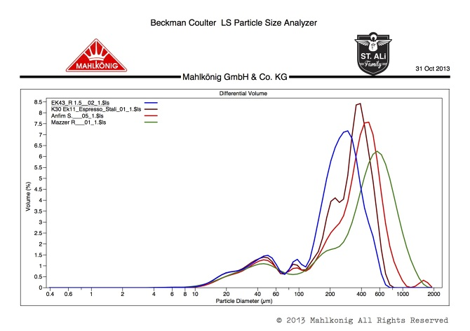
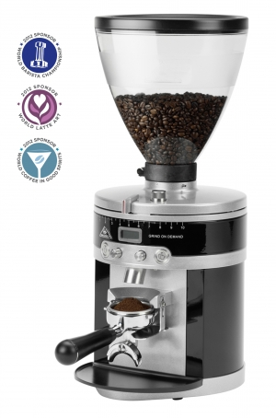
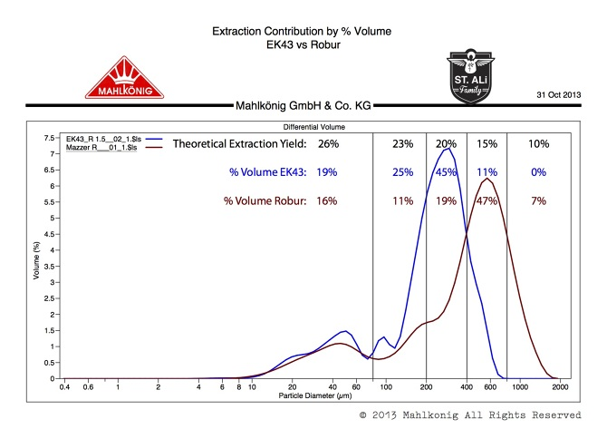
Grinder performance
http://mattperger.com/The-EK43-Part-Three
http://www.mahlkoenig.com/file/file/image/5495?img%5Bw%5D=300&img%5Bh%5D=500
Notes:
Bi-modal distribution
As noted above, grinders do not produce one size of coffee particle, they always generate a distribution of sizes. For espresso, a bimodal distribution appears to be desirable, with most of the particles around 400u in diameter, but some only a tenth that size. The smaller particles are called fines, and apparently help to regulate flow through the puck. For non-espresso brewing, a unimodal distribution is considered better. Too many fines can clog a paper filter in drip brewing, or pass through the metal sieve and yield a muddy cup in French press coffee. Fines may also overextract and impact negatively upon taste.

Slide 19
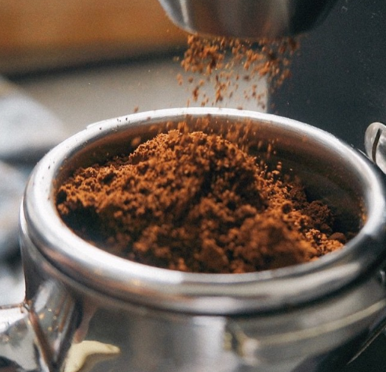

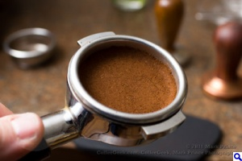
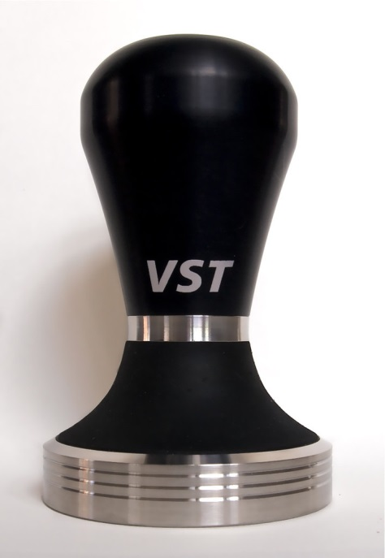
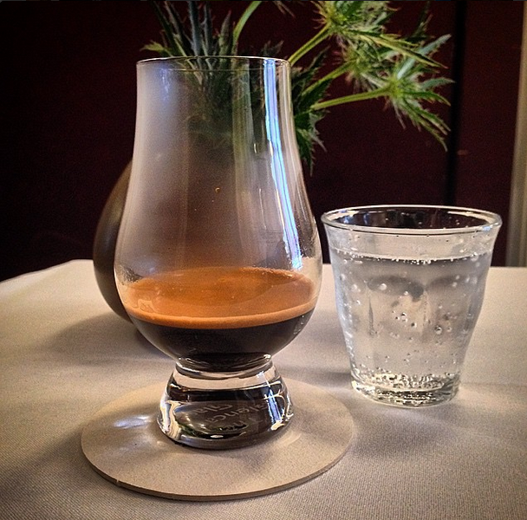
Independent Variables affecting extraction level
Particle size
  Too small – overextracted (bitter)
  Too big – underextracted (sour/astringent)
Temperature
  Higher – faster extraction
  Colder – slower extraction
  Pressure (Flow Rate)
    Higher – faster extraction
    Lower – slower extraction
  Tamper Force
    Higher – slower extraction
    Lower – Faster extraction
  Time
  Longer – overextracted
  Shorter - underextracted
So, how do we get the correct extraction for a bright, fruity, sweet, creamy, heavy espresso that sits in your mouth for hours?
http://cdn.shopify.com/s/files/1/0092/7622/products/Black_Tamper_Image_3_1024x1024.jpg?v=1327947852

Slide 20
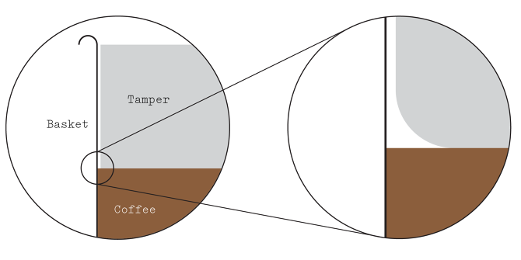
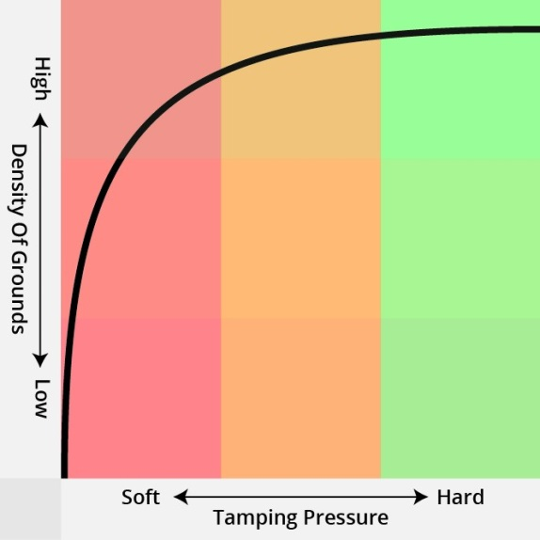
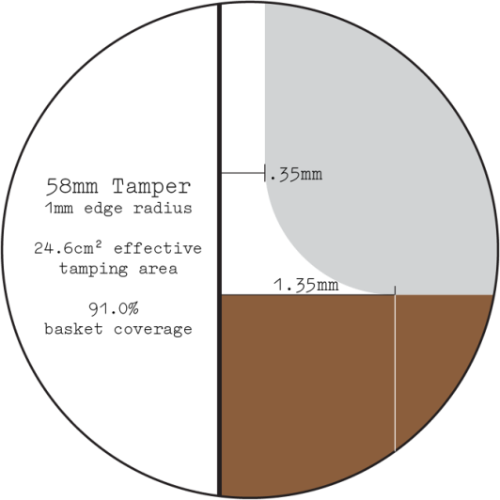
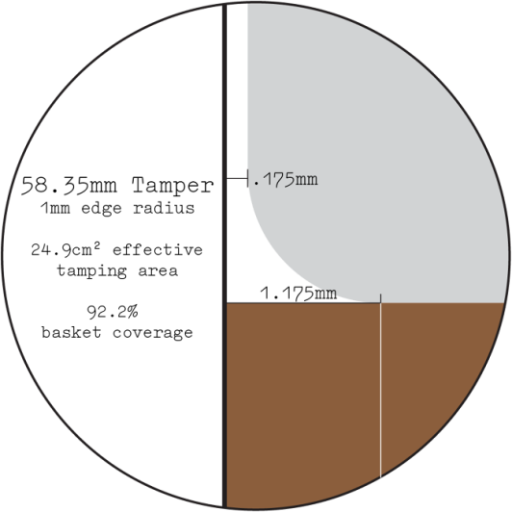
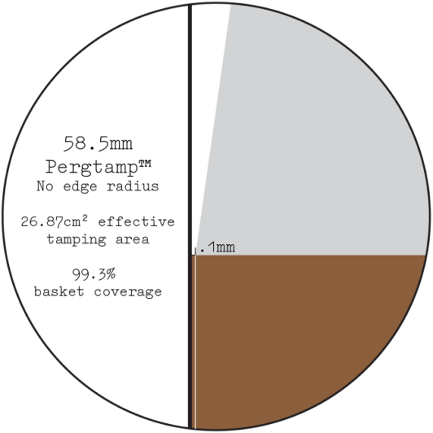
tamping
Extraction yield % increases by average of 1% using the Pergtamp
http://mattperger.com/Pergtamp#.VXFqB4x0y1s

Slide 21
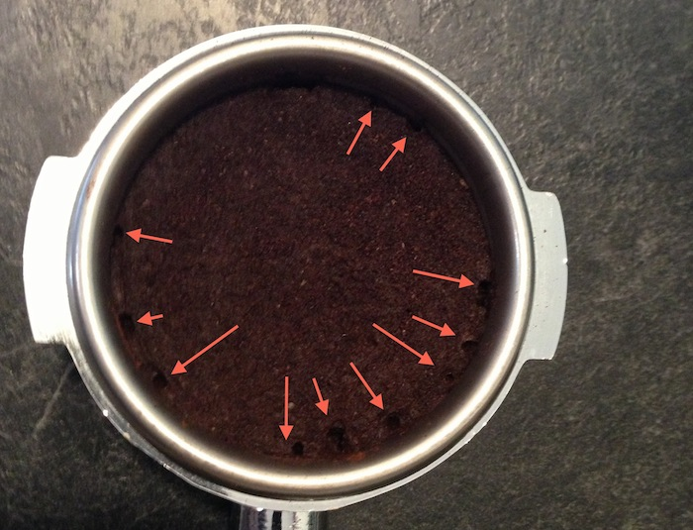
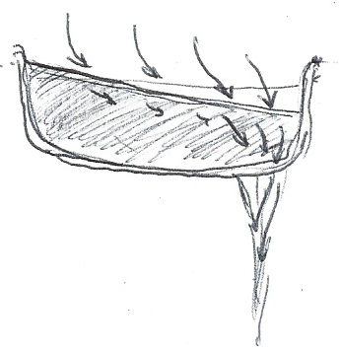
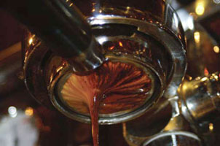
channeling
https://www.home-barista.com/professional-baristas-handbook_files/channeling.jpg
http://static1.squarespace.com/static/4fe98cf4c4aa49ccfa2b2e3c/t/52a89ccbe4b08fc252c44b15/1386781911944/sloped+basket.jpg
http://www.home-barista.com/forums/userpix/14484photo_mar_09__1_03_34_pm_1.jpg

Slide 22
Video on expectation of taste from aroma
https://www.youtube.com/watch?v=FTd2RRewaf4

Slide 23
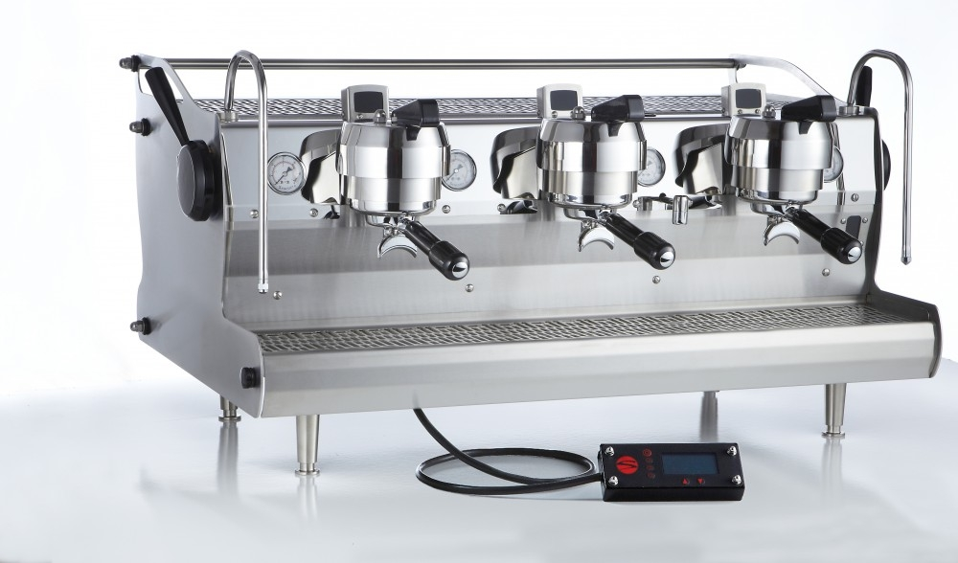
Espresso machines
http://www.idrinkcoffee.com/v/vspfiles/photos/COM-SYN-HYD-2.jpg

Slide 24
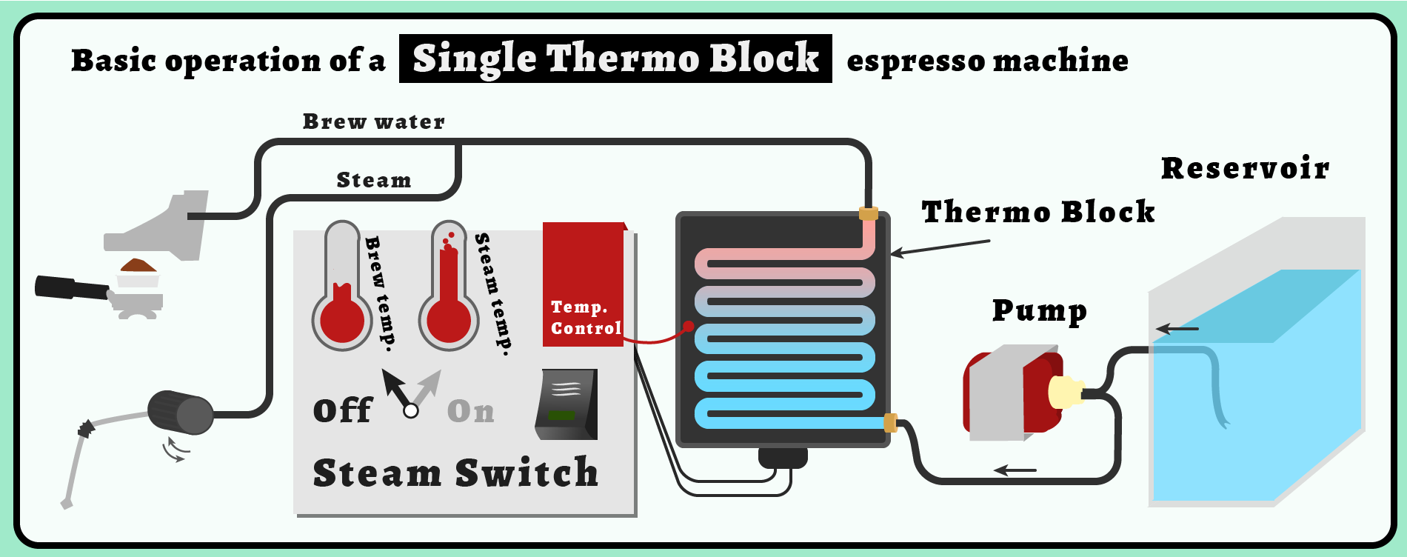
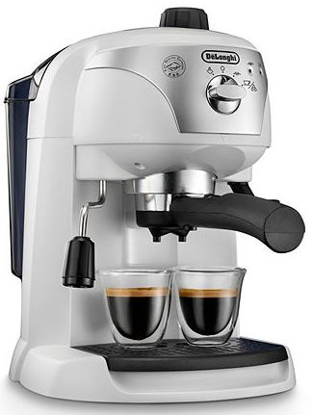
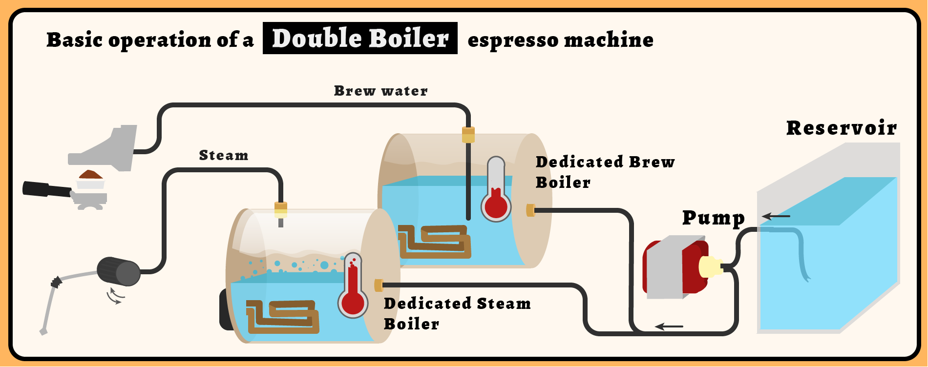

Espresso Machines
http://cdn.shopify.com/s/files/1/0278/1973/files/CupAndBrew-How_It_Works-_Double_Boiler_Espresso_Machine.png?13615
http://cdn.shopify.com/s/files/1/0278/1973/files/CupAndBrew-How_It_Works-_Thermalblock_for_Steam_Espresso_Machine.png?13615
Notes:
Temperature
From Trieste Coffee Cluster Wiki
Jump to: navigation, search
M. Petracco
Quantitatively, this relationship between the rate a reaction proceeds and its temperature is determined by the Arrhenius equation:
k = A e^{–E/RT}
where:
k = reaction rate
A = constant
E = activation energy
R = gas constant (0.082 litre atm/mole °K)
T = temperature
Extraction of coffee, like any dissolution reaction of a chemical species in water, depends on the constant of equilibrium and on the rate. Higher temperatures are matched by increased percentage of extracted material.
It is disputable whether the additional fraction of substances extracted at higher temperature improves the taste of the brew, or enhances any desirable property. The appeal of an espresso prepared under optimal hydraulic conditions is known to increase with temperature, up to a maximum at 92°C. The extraction of bitter and astringent substances at higher temperatures reduces the overall sensory appreciation.
Unfortunately, in practice, temperature cannot be easily singled out from the other percolation variables, because hydraulic resistance of the cake depends on extraction temperature.
For instance, reference to the fact that cold water flows are larger than hot water ones, when obtained through the same cakes and under the same conditions. This difference becomes noticeable when trimming the canonical temperature of 92°C down to 70°C; the effect is slighter, yet significant, at temperatures around the optimal value (Andueza et al., 2001). This makes temperature regulation one of the most important operations in designing an espresso machine.
The control of espresso water temperature in professional machines is established by varying steam pressure in the boiler, where water is heated passing through an immersed coil acting as a heat exchange surface. The temperature of steady water in equilibrium with its own steam is univocally dependent on pressure. Espresso water heated this way has a reasonably constant temperature, thanks to over-dimensioned exchange surfaces.
Home-use machines, when not equipped with a boiler, are fitted with a thermostat controlling the temperature of the metallic block, which acts as a heat exchanger. This thermostat is often built in on the unit, and fixed; in models where it is adjustable its fine-tuning can usually be done using a small screwdriver until the temperature of the water dripping from the empty extraction chamber reaches 90 ± 2°C.
The temperature of the water is certainly the main thermal factor in percolation, but not the only one. Also important is the cake temperature, induced by both the mobile and the fixed equipment constituting the extraction chamber. In order to homogenize temperature in professional machines, a small quantity of circulating boiler water constantly heats up the fixed equipment (the block). When using home espresso machines, it is recommended to pre-heat the extraction group by letting a small quantity of hot water drip through before inserting the cake. The same operation may also be used to pre-heat the empty cup, filling it up with hot water before percolating the coffee; an excellent espresso is always served in a warm cup. To this purpose, professional machines are equipped with a cup-warming grid.
References
Andueza S., Maeztu L., De Peña M.P. and Cid C., Influence of extraction temperature in the final quality of the Colombian coffee cups, Proc. 19th ASIC Coll., 2001

Slide 25





Espresso machines: the PID temperature controller
Proportional-Integral-Derivative Controller
Simple example PID code
previous_error = 0
integral = 0
start:
error = setpoint - measured_value
integral = integral + error*dt
derivative = (error - previous_error)/dt
output = Kp*error + Ki*integral + Kd*derivative
previous_error = error
wait(dt)
goto start
Changing Kp; Ki and Kd constant Changing Ki; Kp and Kd constant Changing Kd; Kp and Ki constant
http://en.wikipedia.org/wiki/PID_controller
Notes:
http://en.wikipedia.org/wiki/PID_controller
A proportional-integral-derivative controller (PID controller) is a control loop feedback mechanism (controller) widely used in industrial control systems. A PID controller calculates an error value as the difference between a measured process variable and a desired setpoint. The controller attempts to minimize the error by adjusting the process through use of a manipulated variable.
The PID controller algorithm involves three separate constant parameters, and is accordingly sometimes called three-term control: the proportional, the integral and derivative values, denoted P, I, and D. Simply put, these values can be interpreted in terms of time: P depends on the present error, I on the accumulation of past errors, and D is a prediction of future errors, based on current rate of change.^{[1]} The weighted sum of these three actions is used to adjust the process via a control element such as the position of a control valve, a damper, or the power supplied to a heating element.
A PID controller relies only on the measured process variable, not on knowledge of the underlying process, making it a broadly useful controller.^{[2]} By tuning the three parameters in the PID controller algorithm, the controller can provide control action designed for specific process requirements. The response of the controller can be described in terms of the responsiveness of the controller to an error, the degree to which the controller overshoots the setpoint, and the degree of system oscillation. Note that the use of the PID algorithm for control does not guarantee optimal control of the system or system stability.
Some applications may require using only one or two actions to provide the appropriate system control. This is achieved by setting the other parameters to zero. A PID controller will be called a PI, PD, P or I controller in the absence of the respective control actions. PI controllers are fairly common, since derivative action is sensitive to measurement noise, whereas the absence of an integral term may prevent the system from reaching its target value due to the control action.
A familiar example of a control loop is the action taken when adjusting hot and cold faucets to fill a container with water at a desired temperature by mixing hot and cold water. The person touches the water in the container as it fills to sense its temperature. Based on this feedback they perform a control action by adjusting the hot and cold faucets until the temperature stabilizes as desired.
The sensed water temperature is the process variable (PV). The desired temperature is called the setpoint (SP). The input to the process (the water valve), and the output of the PID controller, is called the manipulated variable (MV) or the control variable (CV). The difference between the temperature measurement and the setpoint is the error (e) and quantifies whether the water in the container is too hot or too cold and by how much.
After measuring the temperature (PV), and then calculating the error, the controller decides how to set the tap position (MV). The obvious method is proportional control: the tap position is set in proportion to the current error. A more complex control may include another term: derivative action. This considers the rate of change of error, adding more or less hot water depending on how fast the error is approaching zero. Finally, integral action adds a third term, using the accumulated temperature error in the past to detect whether the temperature of the container is settling out too low or too high and set the tap proportional to the past errors. An alternative formulation of integral action is to change the current tap position in steps proportional to the current error. Over time the steps add up (which is the discrete time equivalent to integration) the past errors.
Making a change that is too large when the error is small will lead to overshoot. If the controller were to repeatedly make changes that were too large and repeatedly overshoot the target, the output would oscillate around the setpoint in either a constant, growing, or decaying sinusoid. If the amplitude of the oscillations increase with time, the system is unstable. If they decrease, the system is stable. If the oscillations remain at a constant magnitude, the system is marginally stable.
In the interest of achieving a gradual convergence to the desired temperature (SP), the controller may damp the anticipated future oscillations by tempering its adjustments, or reducing the loop gain.
If a controller starts from a stable state with zero error (PV = SP), then further changes by the controller will be in response to changes in other measured or unmeasured inputs to the process that affect the process, and hence the PV. Variables that affect the process other than the MV are known as disturbances. Generally controllers are used to reject disturbances and to implement setpoint changes. Changes in feedwater temperature constitute a disturbance to the faucet temperature control process.
In theory, a controller can be used to control any process which has a measurable output (PV), a known ideal value for that output (SP) and an input to the process (MV) that will affect the relevant PV. Controllers are used in industry to regulate temperature,pressure, force, feed,^{[8]} flow rate, chemical composition, weight, position, speed and practically every other variable for which a measurement exists.
The PID control scheme is named after its three correcting terms, whose sum constitutes the manipulated variable (MV). The proportional, integral, and derivative terms are summed to calculate the output of the PID controller.
Proportional term:
The proportional term produces an output value that is proportional to the current error value. The proportional response can be adjusted by multiplying the error by a constant K_{p}, called the proportional gain constant.
The proportional term is given by:
A high proportional gain results in a large change in the output for a given change in the error. If the proportional gain is too high, the system can become unstable (see the section on loop tuning). In contrast, a small gain results in a small output response to a large input error, and a less responsive or less sensitive controller. If the proportional gain is too low, the control action may be too small when responding to system disturbances. Tuning theory and industrial practice indicate that the proportional term should contribute the bulk of the output change.^{[citation needed]}
Integral term:
The contribution from the integral term is proportional to both the magnitude of the error and the duration of the error. The integral in a PID controller is the sum of the instantaneous error over time and gives the accumulated offset that should have been corrected previously. The accumulated error is then multiplied by the integral gain () and added to the controller output.
The integral term is given by:
The integral term accelerates the movement of the process towards setpoint and eliminates the residual steady-state error that occurs with a pure proportional controller. However, since the integral term responds to accumulated errors from the past, it can cause the present value to overshoot the setpoint value (see the section on loop tuning).
Derivative term:
The derivative of the process error is calculated by determining the slope of the error over time and multiplying this rate of change by the derivative gain K_{d}. The magnitude of the contribution of the derivative term to the overall control action is termed the derivative gain, K_{d}.
The derivative term is given by:
Derivative action predicts system behavior and thus improves settling time and stability of the system.^{[9][10]} An ideal derivative is not causal, so that implementations of PID controllers include an additional low pass filtering for the derivative term, to limit the high frequency gain and noise.^{[11]} Derivative action is seldom used in practice though - by one estimate in only 20% of deployed controllers^{[11]} - because of its variable impact on system stability in real-world applications.^{[11]}

Slide 26


PID tuning
http://en.wikipedia.org/wiki/PID_controller
http://i00.i.aliimg.com/wsphoto/v0/355749670/2-X-PID-Temperature-font-b-Control-b-font-Controller-font-b-OMRON-b-font-font.jpg
Notes:
Cascade control[edit]
One distinctive advantage of PID controllers is that two PID controllers can be used together to yield better dynamic performance. This is called cascaded PID control. In cascade control there are two PIDs arranged with one PID controlling the setpoint of another. A PID controller acts as outer loop controller, which controls the primary physical parameter, such as fluid level or velocity. The other controller acts as inner loop controller, which reads the output of outer loop controller as setpoint, usually controlling a more rapid changing parameter, flowrate or acceleration. It can be mathematically proven^{[citation needed]} that the working frequency of the controller is increased and the time constant of the object is reduced by using cascaded PID controllers.^{[vague]}.
For example, a temperature-controlled circulating bath has two PID controllers in cascade, each with its own thermocouple temperature sensor. The outer controller controls the temperature of the water using a thermocouple located far from the heater where it accurately reads the temperature of the bulk of the water. The error term of this PID controller is the difference between the desired bath temperature and measured temperature. Instead of controlling the heater directly, the outer PID controller sets a heater temperature goal for the inner PID controller. The inner PID controller controls the temperature of the heater using a thermocouple attached to the heater. The inner controller's error term is the difference between this heater temperature setpoint and the measured temperature of the heater. Its output controls the actual heater to stay near this setpoint.
The proportional, integral and differential terms of the two controllers will be very different. The outer PID controller has a long time constant – all the water in the tank needs to heat up or cool down. The inner loop responds much more quickly. Each controller can be tuned to match the physics of the system it controls – heat transfer and thermal mass of the whole tank or of just the heater – giving better total response.

Slide 27



espresso
SEM of coffee lipid droplets and solid particles filtered out from their liquid matrix
The peculiarity of espresso beverage is the simultaneous presence of three dispersed phases coexisting within a matrix, namely a concentrated solution of salts, acids, sugars, caffeine and many other hydrophilic substances.
These phases are:
1. an emulsion of oil droplets (stable for weeks/months);
2. a suspension of solid particles (stable for days);
3. an effervescence of gas bubbles, which evolves into a foam (stable for only 1-3 minutes)
http://wiki.triestecoffeecluster.com/index.php?title=Liquid
http://www.cuculinary.com/wp-content/uploads/2014/11/espresso.png
Notes:
Viscosity
Viscosity is considerably higher than that of pure water, with reported values approximately double at usual consumption temperatures (Table 2). This property is influenced by the presence of dispersed phases, related to the amount of lipid droplets in emulsion. Increased viscosity has been associated with improved body, as shown by the comparison of a correctly prepared cup with a poorly prepared one (Figure 2), where viscosity differences as high as 33% have been recorded (Table 2) (Petracco, 1989). This may be explained by the fact that emulsions usually display higher viscosity than pure solutions.
Refractive index
The refractive index is usually determined to evaluate solute concentrations in transparent liquids. Espresso’s polyphasic nature makes this method difficult to apply, and scarcely convenient to predict the body character. In comparison with the index of pure water (1.333 at 20°C), espresso beverages display values ranging from 1.339 to 1.341. Refractive index is influenced mainly by the solute concentration, and the dispersed phases are less important as indicated by the minor differences found after filtering aliquots of espresso.
Commercial refractometers specially graduated for coffee are available and correlate with total solids content.
Crema:
Espresso foam – also known by the Italian term of crema – is by itself a biphasic system composed of gas globules framed within liquid films (called lamellae) constituted by a water solution of surfactant. These films tend to set in a configuration of two layers of surface-active molecules facing the gas, with water molecules between them. The high molecular force in the film allows its peculiar geometry: a bubble if isolated, or a honeycomb-like structure of many bubbles growing close together (Figure 1).
An important characteristic of the crema is persistence, and it must survive at least a couple of minutes before breaking up and starting to show an uncovered spot on the dark surface of the beverage. The disappearance can be imputed to the phenomenon of drainage, which causes entrapped water to flow out of the films, leaving only surfactant molecules to bear the stress of the structure. The films eventually fail due to their limited elasticity, thus releasing the entrapped gas. Persistence can be easily measured by watching the surface of a standard cup at constant temperature and recording the first sign of weakening of the foam’s layer, revealed by formation of a hole.
As espresso foam is fairly short-lived, its quantity must be measured soon after percolation. This is done by transferring the whole beverage from the cup to a graduated cylinder, allowing it to stabilize and recording the volumes of both foam and liquid. Their ratio constitutes a ‘foam index’ that in well-prepared cups should be at least 10%.
Solidity is a noteworthy rheological property of foam, denoting its capability to bear for some time the weight of a spoonful of sugar. It can be quantified in the laboratory by loading the foam with a calibrated wire mesh ring of a standard weight and measuring the time it takes to submerge.

Slide 28




Emulsions, suspensions, and Effervescence
Two immiscible liquids, not yet emulsified
B. An emulsion of Phase II dispersed in Phase I
C. The unstable emulsion progressively separates
D. The surfactant (outline around particles) positions itself on the interfaces between Phase II and Phase I, stabilizing the emulsion
An emulsion is a mixture of two or more liquids that are normally immiscible (unmixable or unblendable).
In chemistry, a suspension is a heterogeneous mixture containing solid particles that are sufficiently large for sedimentation. Usually they must be larger than one micrometer.
Effervescence is the escape of gas from an aqueous solution and the foaming or fizzing that results from a release of the gas.
A foam is a substance that is formed by trapping pockets of gas in a liquid or solid.
http://en.wikipedia.org/wiki/Effervescence
http://en.wikipedia.org/wiki/Suspension_(chemistry)
http://en.wikipedia.org/wiki/Emulsion
http://nsb.wdfiles.com/local--files/c-9-5-5-4/Emulsion%202.jpg
http://2.bp.blogspot.com/-_xOs3YCHvyo/UDr_CLJ6pgI/AAAAAAAABjI/w5ZGXkGjfVQ/s1600/cl9SciCH2Fig5.jpg
https://punctalucis.files.wordpress.com/2014/02/puncta_2014_02_effervescence_i.jpg
Notes:
An emulsion is a mixture of two or more liquids that are normally immiscible (unmixable or unblendable). Emulsions are part of a more general class of two-phase systems of matter called colloids. Although the terms colloid and emulsion are sometimes used interchangeably, emulsion should be used when both the dispersed and the continuous phase are liquids. In an emulsion, one liquid (the dispersed phase) is dispersed in the other (the continuous phase). Examples of emulsions include vinaigrettes, milk, mayonnaise, and some cutting fluids for metal working.
The word "emulsion" comes from the Latin word for "to milk", as milk is an emulsion of fat and water, among other components.
Two liquids can form different types of emulsions. As an example, oil and water can form, first, an oil-in-water emulsion, wherein the oil is the dispersed phase, and water is the dispersion medium. Second, they can form a water-in-oil emulsion, wherein water is the dispersed phase and oil is the external phase. Multiple emulsions are also possible, including a "water-in-oil-in-water" emulsion and an "oil-in-water-in-oil" emulsion.^{[3]}
In chemistry, a suspension is a heterogeneous mixture containing solid particles that are sufficiently large for sedimentation. Usually they must be larger than one micrometer.^{[1]} The internal phase (solid) is dispersed throughout the external phase (fluid) through mechanical agitation, with the use of certain excipients or suspending agents. Unlike colloids, suspensions will eventually settle. An example of a suspension would be sand in water. The suspended particles are visible under a microscope and will settle over time if left undisturbed. This distinguishes a suspension from a colloid, in which the suspended particles are smaller and do not settle.[
Effervescence is the escape of gas from an aqueous solution and the foaming or fizzing that results from a release of the gas.^{[1]} The word effervescence is derived from the Latin verb fervere (to boil), preceded by the adverb ex. It has the same linguistic root as the word fermentation, a complex biochemical reaction leading to, among other things, the production of carbon dioxide and to the subsequent liberation of CO₂ gas from a solution when it becomes supersaturated with respect to this gas. The making of beer, wine, or champagne by fermentation is thus accompanied by effervescence of CO₂ from the barrel where the process occurs.
Effervescence can also be observed when opening a bottle of champagne, beer or carbonated beverages such as soft drinks. The visible bubbles are produced by the escape from solution of the dissolved gas (which itself is not visible while dissolved in the liquid).
In the laboratory, a common example of effervescence is seen if hydrochloric acid is added to a block of limestone. If a few pieces of marble or an antacid tablet are put in hydrochloric acid in a test tube fitted with a bung, effervescence of carbon dioxide can be witnessed.
CaCO₃ + 2 HCl → CaCl₂ + H₂O + CO₂This process is generally represented by the following reaction, where a pressurized dilute solution of carbonic acid in water releases gaseous carbon dioxide at decompression:
H₂CO₃ → H₂O + CO₂In simple terms, it is the result of the chemical reaction occurring in the liquid which produces a gaseous product

Slide 29


Total dissolved solids & extraction yield
Extraction yield % - The percentage by mass of coffee grounds that ends up dissolved in the brewed coffee.
  Extraction yield % = Brewed Coffee[g] (espresso/ristretto shot) x TDS[%] /Coffee Grounds[g] E.g. 55g brewed coffee x 6.5% TDS / 18g ground coffee = Extraction yield of 19.86%
Total Dissolved Solids (TDS) - If you have a standard refractometer the TDS is expressed in parts per million. (ppm). To convert ppm into a percentage: Divide the ppm by 10000. E.g. 10000ppm /10000 = 1%
Strength - Also known as "solubles concentration", as measured by Total Dissolved Solids – how concentrated or watery the coffee is.
Brew ratio - The ratio of coffee grounds (mass) to water (volume): how much coffee is used for a given quantity of water. This may be expressed in units of either grams per litre or ounces per US half gallon. Since the density of the liquid coffee beverage is essentially equal to the density of pure water (1 g/mL), this ratio is often expressed as the mass of coffee grounds to mass of liquid coffee (a unit-less ratio).
http://en.wikipedia.org/wiki/Coffee_extraction
https://dahtac.files.wordpress.com/2011/07/vst-refractometer.jpg
Notes:
Total solids content – the beverage’s overall concentration – is the most important characteristic in the chemical composition of espresso, often perceived by lay consumers as ‘strength’. This property is determined by drying the brew in an oven to constant weight without filtering.
Accordingly, suspended solid material, emulsified lipids and solutes are included. Total solids concentration in the beverage is dictated by the brewing formula, namely the coffee/water ratio, but varies greatly also depending on both roasting degree and percolation temperature: a darker roasting produces more solubles, and a higher temperature extracts them more efficiently (Nicoli et al., 1991). Values as low as 20 mg/ml up to 60 mg/ml may be encountered.
A subtler issue is which solubles are dissolved – this depends on solubility of different substances at different temperatures, changes over the course of extraction (different substances are extracted during the first 1% of extraction than in the period from 19% extraction to 20% extraction), and is primarily affected bytemperature.
Brewing guidelines are summarized in Brewing Control Charts, which graph these elements, and center around an "ideal" rectangle indicating the target brewing range. The yield is the horizontal (x-axis), the strength is the vertical (y-axis), and a given brewing ratio determines a radial line, since for a given brewing ratio the strength is directly proportional to the yield.
In brief, ideal yield is widely agreed to be 20%±2% (18%–22%), while ideal strength (for brewed coffee) varies between 1.25%±.10% (1.15%–1.35%) in American standards, to 1.40%±.10% (1.30%–1.50%) in Norwegian standards, with European standards falling in the middle at 1.20%–1.45%). This is most easily achieved with a brewing ratio of 55 g/L (55 grams of coffee per 1 L of water) in American standards, to 63 g/L in Norwegian standards, yielding approximately 14–16 grams of coffee for a standard 240 ml (8 oz) cup.
These guidelines apply regardless of brewing method, with the following exceptions: espresso is significantly different (much stronger, and more varied extraction), and dark roasts taste subjectively stronger than medium roasts (standards are based on medium roasts; equivalent strength requires using a lower brewing ratio for darker roasts).
Extraction yield[edit]
Ideal yield is widely agreed to be 20%±2% (18%–22%). This was originally computed by the Coffee Brewing Institute, under the direction of Professor E. E. Lockhart at MIT in the 1950s, and has been verified by subsequent tests by the SCAA.
Yields of under 18% are "under-extracted", specifically "under-developed" – desirable components have not been sufficiently extracted – and "unbalanced", specifically sour, because acids are extracted early, while balancing sugars (sweetness) and bitter components are extracted later.^{[5]}
Yields of over 22% are "over-extracted", specifically bitter, as bitter components continue to be extracted after acids and sugars have largely completed extraction.
Yields depend primarily on temperature, brew time, and grind size, and in a complex way on method. Yield is inverse to grind size (smaller grinds have more surface area, so extract faster) and increases roughly linear with time, as the extraction proceeds. Thus for a given temperature and grind size, there is an ideal brew time, with larger grinds requiring longer brewing. French press features the largest grinds of conventional methods, hence the longest brewing, on the order of 3–4 minutes, while filter coffee has smaller grinds and shorter brewing, and espresso has yet smaller grinds and shorter brewing, on the order of 20–30 seconds.
Caffeine is extracted early, so higher yields do not yield more caffeinated coffee, only over-extracted coffee.
Once ideal yield has been reached, the grounds must be removed from the liquid, otherwise extraction continues and the coffee will grow increasingly over-extracted. For this reason, it is advised to pour out a French press when it has finished brewing, and percolators are frowned upon.
It is possible to use less ground coffee and over-extract it to achieve a desired strength, which economizes on coffee but yields a bitterer, less tasty beverage.
Water temperature is subtler but crucial to the proper extraction of flavor from the ground coffee, as it affects the proportions in which solubles are extracted – one wishes to extract the desired flavors as much as possible, and the undesirable flavors as little as possible. The recommended brewing temperature range of coffee is 91–94 °C (195–202 °F), which is a trade-off between these goals.^{[6]} If cooler, some of the solubles that make up the flavor will not be extracted. If the water is too hot, some undesirable, bitter, elements will be extracted, adversely affecting the taste. Note that this desired temperature range is slightly below the boiling point of water (100 °C or 212 °F at standard pressure), so coffee is best made with water that has been allowed to come off the boil slightly. Another consideration is the difference between the temperature of the water and the temperature of the coffee slurry: for example, certain brewing methods (e.g., manual pourover) can result in losing a significant amount of heat to the atmosphere during the brewing process.^{[6]}
Transient temperature is not very significant: if coffee is heated to boiling point only very briefly, the taste will be little affected; the longer it is kept at a high temperature the worse the taste becomes.
Strength[edit]
Strength refers to the amount of dissolved coffee solids per unit of coffee liquid volume. An espresso, specifically a ristretto, is the strongest of coffee drinks, meaning that it takes the same amount of coffee solubles and dissolves it in significantly less water. For example, a 20% extraction of 15 grams of espresso in a double shot (60 mL) yields 3 grams per 60 mL, or 5% strength, which is 3–4× typical brewed coffee strength.
Adding water to dilute a drink after brewing affects strength but not yield (as the grounds are no longer present) – an Americano differs from an espresso simply by being weaker, more dilute (American preparation may also eliminate the crema).
Stronger coffee (assuming the same extraction yield) is not more bitter than weaker coffee, but simply has more solids. This is reflected in being darker and in thicker mouthfeel (oilier), though mouthfeel also depends on suspended solids (very small grinds, so-called "fines"), particularly in French press as opposed to filter.
Unlike yield, desired strength varies measurably between regions, and, assuming proper (20%) yield, strength is determined by brewing ratio – how much ground coffee is used for a particular drink.^{[7]} Coffee above the ideal may be considered "too strong", while coffee below the ideal may be considered "too weak", but individual tastes vary significantly.
Brewing ratio[edit]
The usual ratio of coffee to water for the style of coffee most prevalent in Europe, America, and other Westernized nations (evident in publications such as textbooks on coffee and instruction manuals for drip-brew machines) is between one and two tablespoons of ground coffee per six ounces (180 millilitres) of water; the full two tablespoons per six ounces tends to be recommended by experienced coffee lovers. A more exact weight ratio of 1:17 coffee and water is also used in publications.
The ideal brewing ratio is determined by which brewing ratio line in the control chart most intersects the ideal rectangle, or passes through the center (the subtle distinctions about exactly which line is ideal is generally considered too minor to comment, and changes brew ratio by only a small amount). This ideal ratio makes it most likely that one will land in the rectangle and near the center, and gives the widest room for error.
Brewing method[edit]
Extraction depends in subtle and complex ways on brewing method. Simplest is directly mixing the grounds and water, as in cupping, press pot, and vacuum brewing. Note that in Turkish coffee, the grounds are very finely ground and not removed from the water – this yields essentially 100% extraction of the solubles (over-extraction by Western standards), and suspension of the remaining insoluble parts of the grounds in the water. Significantly more complicated is brewing via soaking a column of grounds, as in filter, espresso, or percolation – in this case the water soaks and moves through the column of grounds, and (if there is water on top, as in espresso or percolation), a gradient develops over the column.
Espresso yield is generally 15–25%:^{[5]} 25% is quoted as the Italian extraction in (Illy 2005). Espresso yield has received significantly less attention in the literature than brewed coffee extraction, with the main references being (Illy 2005) and (Schulman 2007).
Espresso yield features a number of surprising properties:^{[5]}
yield depends primarily on depth of the "puck" (cylinder of coffee grounds);
yield is inverse to puck depth;
yield does not depend significantly on brewing time – yield at first increases approximately linearly, then plateaus after approximately 20 seconds;
strength is independent of dose.
Strength depends instead on grind: finer grinds yield a "shorter" (ristretto) espresso (less liquid, so higher brew ratio, at same yield gives more strength), while coarser grinds yield a "longer" (lungo) espresso, while an intermediate grind yields a "normale" espresso.

Slide 30


Water – Reverse osmosis
Schematics of a reverse osmosis desalination system using a pressure exchanger.
1: Sea water inflow,
2: Fresh water flow (40%),
3: Concentrate flow (60%),
4: Sea water flow (60%),
5: Concentrate (drain),
A: Pump flow (40%),
B: Circulation pump,
C: Osmosis unit with membrane,
D: Pressure exchanger
This process requires that a high pressure be exerted on the high concentration side of the membrane, usually 2–17 bar (30–250 psi) for fresh and brackish water, and 40–82 bar (600–1200 psi) for seawater, which has around 27 bar (390 psi) natural osmotic pressure that must be overcome.
“Ideal” water according to Jim Schulman:
Total Dissolved Solids 150 ppm
Total Hardness 3-5 gpg (51-85ppm)
Total Alkalinity 80 ppm
pH 7.0 gpg
Calcium Hardness 3-4 gpg
Total Chlorine <0.1 ppm
Free Chlorine <.05
Total Chlorides <30 ppm
Total Iron 0 mg/L
Silica not more than 5 mg/L
Sulfate 25-50 mg/L
Hydrogen Sulfide 0 mg/L
Manganese 0 mg/L
Nitrate 0 mg/L
"ReverseOsmosis with PressureExchanger" by chris 論 - own drawing inspired by this video. Licensed under CC BY-SA 3.0 via Wikimedia Commons - http://commons.wikimedia.org/wiki/File:ReverseOsmosis_with_PressureExchanger.svg#/media/File:ReverseOsmosis_with_PressureExchanger.svg
Lots of magnesium, not much bicarbonate
http://en.wikipedia.org/wiki/Reverse_osmosis
http://bestreverseosmosissystem.net/wp-content/uploads/2014/10/What-Is-Reverse-Osmosis.jpg
Notes:
Water quality
From Trieste Coffee Cluster Wiki
Jump to: navigation, search
M. Petracco
The second most important ingredient of espresso – after the coffee itself – is water, constituting more than 95% of any coffee beverage. However self-evident this statement may seem, the role of water in coffee preparation must be taken into due consideration. It would be otherwise senseless to devote utmost care and attention to only one of the two ingredients, while neglecting the other. Yet, this regularly occurs, partly because the choice of the proper water is left to the end user and partly because that person (espresso bartender, home user) has an extremely limited influence over the choice of the water. In fact, very few people brew coffee using mineral water, whose characteristics are stated on the label and are supposed to be constant. Most consumers trust tap water quality, which they rarely purify in any way.
It must be stressed that the quality of treated water coming from public waterworks is perfectly suitable for human consumption (WHO, 1993) and further purification or disinfecting treatments are unnecessary. However, treatment of drinking water may turn out to be beneficial in two critical cases; one is linked to sensory perception, and the other concerns the use of the espresso machine.
In the first case, the beverage must be free from any unpleasant foreign flavours left over in the water by generalized disinfecting treatments, such as chlorination. Salts that release free chlorine (hypochlorites) lend the beverage their peculiar taste, which is perceptible when the initial concentration of Cl2 exceeds 0.5 mg/l. A system most commonly used for removing chlorine taste involves passing the liquid through a bed of granules of activated carbon, which has the ability to adsorb many odourbearing substances. A drawback in the use of activated carbon is that saturation cannot be easily detected, so that it is necessary to regenerate or replace the bed regularly.
The second critical case is related to water hardness, namely to the water’s calcium and magnesium content. On heating, these cations produce insoluble salts (mainly carbonates, but also sulphates and silicates). These salts tend to precipitate in the form of compact plaques (scaling), particularly on the heated surfaces. Such scales form a coating on the surfaces, which detrimentally affect the heat exchange coefficient. This may lead to serious technical troubles with the espresso machine, in particular causing a reduction in heat transfer effectiveness with a possible consequent widening of the fluctiations in temperature (too hot/too cold) and risk of failure in electrical resistance due to overheating.
Potable water may be nearly always defined as hard, that is, having a total hardness that exceeds 15 French degrees, corresponding to a concentration of 150 mg/l of CaCO3. In some waterworks in Italy, for instance, water hardness may reach a peak of 37 French degrees. This is not a reason for health concern, because the hardness for drinking water recommended by Italian law (DPR 236, 24/5/88) ranges from 15 to 50 French degrees. It is also worth remembering that mineral waters may exceed 100 French degrees.
Direct use of hard mains supply water in both professional and home espresso machines produces unacceptable deposits in 1–3 months. Manufacturers of home-use machines advise removing these deposits by periodic washing (see 7.5.10) with weak acid solutions: citric or formic acid, even vinegar, will do. In professional machines, scaling is prevented by fitting the machine upstream of a cleanup system specifically active on calcium and magnesium ions, but nearly as active on other metal ions.
Two types of treatments are commonly available: softeners or demineralizers.
A softener consists of a bed of ion exchange resins that traps calcium ions and replaces them with sodium ions (which do not affect hardness, and do not form deposits) to a hardness depending on the saturation of the resin.
Optimal water hardness to avoid scales and have good percolation is around 9 French degrees, as recommended by manufacturers. The resins must be periodically regenerated by washing with NaCl so as to restore their effectiveness. In the case of treatment of very hard water, the amount of sodium released (in combination with other ionic species present) may become perceptible to taste and increase water pH on heating. Two troubles may be encountered with softeners:
• A functional problem, inasmuch as localized channels form in the resin bed after some time, diminishing the effect of ion exchange.
This can be avoided by stirring the resins from time to time.
• A hygiene risk, namely the danger of a possible proliferation of microorganisms in the bed. This can be averted by using beds containing a bacteriostatic additive.
Demineralizers eliminate Ca⁺⁺ ions without introducing any foreign ions. Ion exchange of the demineralizer employs either separate beds of resins, fitted in series, or one single bed in which resins have been mixed but that can be separated by floating. One resin is of the so-called cationic type and captures Ca⁺⁺ and Mg⁺⁺ by replacing them with H⁺; the other resin is of anionic type and captures the negative ions (Cl–, HCO₃–, SO₄–– and others) by replacing them with hydroxyls, which neutralize hydrogen ions forming H₂O. These types of resins must be regenerated separately with HCl and with NaOH, respectively.
A more modern type of demineralizer is based on the principle of reverse osmosis. Pressure energy is employed to filter water through a semi-permeable membrane capable of retaining ions, which can be discarded as concentrated solution, while letting the smaller H2O molecules through. With the use of a suitable membrane or of a graded bypass, water can be obtained at the desired degree of hardness.
The main influence of hardness on beverage quality is an increase in percolation time, compared to soft water below 2 French degrees.
However, only minor differences occur when water hardness is raised above 8 French degrees to typical mains water values (Rivetti et al., 2001). Hence, it is not recommended to soften or demineralize water below this value, otherwise a coarser grind should be used to compensate for the increase in percolation time. Water pH also affects percolation time even if in a less predictable way, probably in association with hardness. The influence of hardness and pH on percolation might be explained by the change, due to Ca and H ions, in foam-producing and emulsifying properties of the natural surfactants present in roasted coffee. It is unclear, though, whether the increase in percolation time is to be ascribed to increased foam and emulsion viscosity, with respect to pure water, or to the interstitial formation and precipitation of insoluble calcareous soaps or other pH-dependent material.
References
Rivetti D., Navarini L., Cappuccio R., Abatangelo A., Petracco M. and Suggi Liverani F., Effects of water composition and water treatment on espresso coffee percolation, Proc. 19th ASIC Coll., 2001

Slide 31

Extraction: what it looks like, and the importance of crema
(a) under-extracted; (b) correctly extracted; (c) overextracted
https://youtu.be/qaUZcbLPTBA
http://wiki.triestecoffeecluster.com/index.php?title=Visual_characteristics
Notes:
Consumers who ascribe great importance to the colour and the texture of foam are right, because perfect foam is the signature of a perfect preparation. Any error in grinding or in percolation, in temperature or extraction level, is immediately denounced by the colour, the texture and the persistence of the foam. For example, if the foam is light-coloured, inconsistent, thin and evanescent, it means that espresso has been underextracted, probably because the grind was too coarse or the water temperature too low (Figure 2a).
An over-extracted espresso, on the contrary, may display either a white foam with big bubbles, if water temperature was too high, or just a white spot in the middle of the cup (Figure 2c).
Other extraction mistakes can derive from too low a cake porosity or from too high a coffee dose, both indicated by very dark foam with a hole in the middle.
The foam layer also acts as an aroma-sealing lid, trapping the volatile compounds responsible for the odour of espresso brew. The foam preserves them for our pleasure if the blend used to brew the cup was good, or for our torment if it was defective: it works as an amplifier, enhancing both virtues and sins.

Slide 32




Latte art
http://www.venezianocoffee.com.au/shop/product_images/l/488/Latte-Art-Training-Product-Image__18860__17179_zoom.jpg
http://www.ratemyrosetta.com/latte-art-37_erjM5hCd.jpg
https://coffeeinfo.files.wordpress.com/2007/06/latte_art_rosetta_mid_pour.jpg
http://www.ratemyrosetta.com/latte-art-3241_y4R7TX0S.jpg

Slide 33


Milk steaming
http://drinks.seriouseats.com/images/04172012-milk-steaming-main.jpg

Slide 34

Coffee menu
1 oz = 28.4 mL
http://www.coffeenate.com/wp-content/uploads/2011/10/espresso_field_guide.jpg

Slide 35

Milk
A typical example is the homogenization of milk, where the milk fat globules are reduced in size and dispersed uniformly through the rest of the milk.
https://www.youtube.com/watch?v=BTi87en4qjY

Slide 36


Milk

Slide 37


milk
Lipolysis /lɨˈpɒlɨsɪs/ is the breakdown of lipids and involves hydrolysis of triglycerides into glycerol and free fatty acids. The following hormones induce lipolysis: epinephrine, norepinephrine, ghrelin, growth hormone, testosterone, and cortisol.

